Slide 1
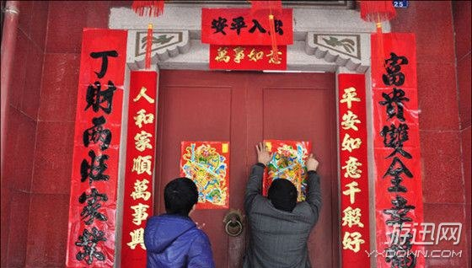
Traditional Festival 传统节日
七组 | 滕孝晨 | 张明意 | 张杰 | 刘东 | 李尚

Slide 2
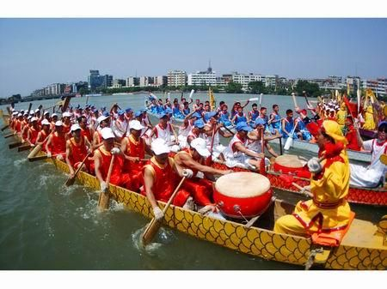
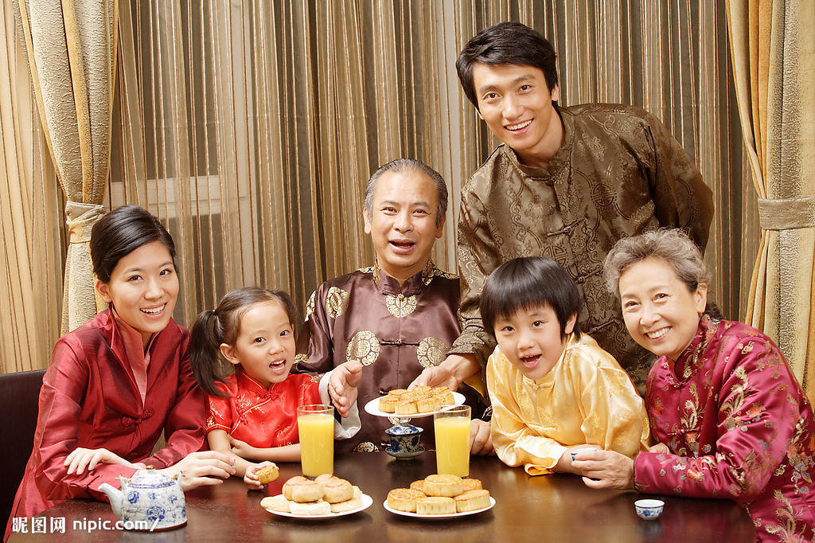
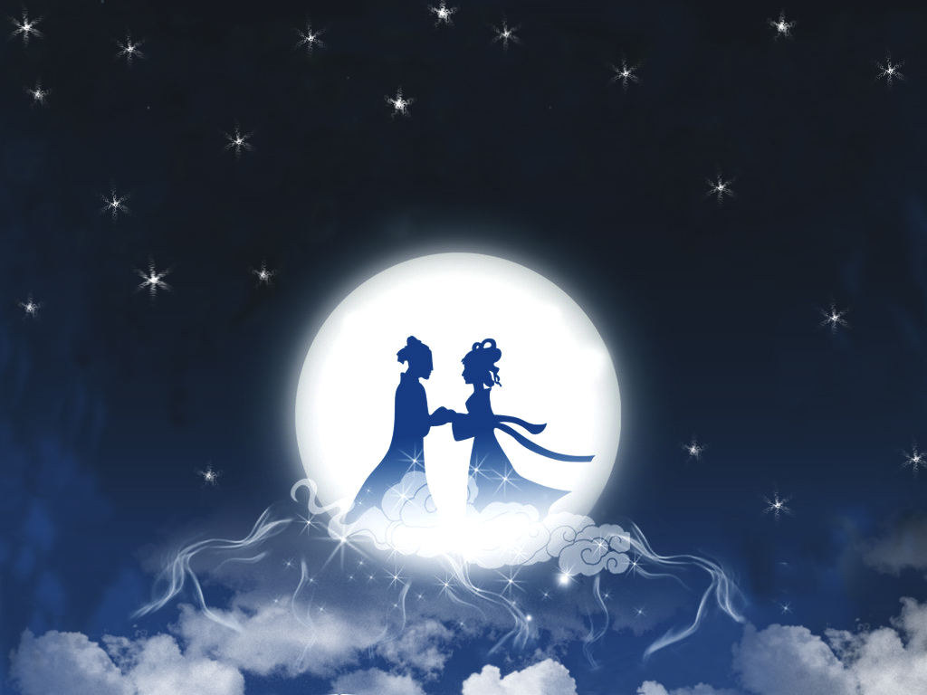
Dragon Boat Festival
端午节
Mid-Autumn Festival
中秋节
The Double Ninth Festival
重阳节
Qi Xi Festival
七夕节
Spring Festival
春节

Slide 3
Spring Festival 春节
The Spring Festival is the most important traditional festival in China. There are sacrificial kitchen, paste couplets, New Year 's eve dinner,shousui and other traditional customs. In addition, the annual Spring Festival gala is also indispensable.
春节为每年农历正月初一，是中国最重要的传统节日。有祭灶，贴对联，年夜饭，守岁等传统习俗。另外，每年的春节联欢晚会也是必不可少的。

Slide 4
Dragon Boat Festival 端午节
The Dragon Boat Festival is the fifth day of the fifth lunar month. Dragon Boat Festival originated in China. Patriotic poet qu yuan died on this day, has become the Chinese han people to commemorate qu yuan's traditional festival.
端午节为每年农历五月初五，又称端阳节。端午节起源于中国。因爱国诗人屈原在这一天死去，便成了中国汉族人民纪念屈原的传统节日。

Slide 5
Mid-Autumn Festival 中秋节
The Mid-Autumn Festival is one of the traditional Chinese festivals. It is August 15 of the annual lunar calendar and is the second largest traditional festival in China after the Spring Festival. The legend is to commemorate Chang 'E.
中秋节，是中国传统节日之一，为每年的农历八月十五，也是我国仅次于春节的第二大传统节日。传说是为了纪念嫦娥。

Slide 6
The Double Ninth Festival 重阳节
The double ninth festival is celebrated on the ninth day of the ninth lunar month. Double ninth is also called double ninth because it is a positive number. Folk in the day have the custom of climbing, so the double ninth festival is also known as "climbing festival".
重阳节，农历九月初九，二九相重，称为“重九”。因为九是阳数，所以重九又叫“重阳”。民间在该日有登高的风俗，所以重阳节又称“登高节”。

Slide 7
Qi Xi Festival 七夕节
Qixi festival, also known as women's day. The festival comes from the legend of the cowherd and weaver girl and is celebrated on the seventh day of the seventh lunar month
七夕节,又称女儿节。该节日来自于牛郎与织女的传说，在农历七月初七庆祝。

Slide 8
Thanks
感谢观看

