Slide 1
青春
YOUTH
青春如一首歌，当用心聆听之际，沁人心脾，恍然间曲终人散，感叹青春
四组

Slide 2

青春
Youth is not a time of life; it is a state of mind; it is not a matter of rosy cheeks, red lips and supple knees; it is a matter of the will, a quality of the imagination, a vigor of the emotions; it is the freshness of the deep springs of life.
青春不是年华，而是心境；青春不是桃面、丹唇、柔膝，而是深沉的意志，恢宏的想象，炙热的恋情；青春是生命的深泉在涌流。

Slide 3

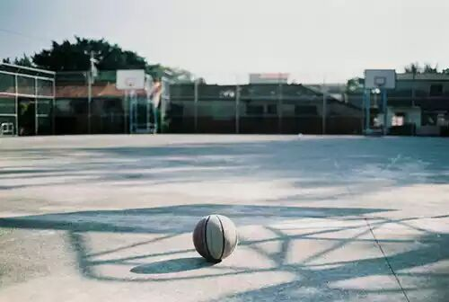
Youth means a temperamental predominance of courage over timidity, of the appetite (强烈欲望)for adventure over the love of ease. This often exists in a man of 60 more than a boy of 20. Nobody grows old merely by a number of years. We grow old by deserting our ideals.
青春气贯长虹，勇锐盖
过怯弱，进取压倒苟安。
如此锐气，二十后生而
有之，六旬男子则更多
见。年岁有加，并垂老，
理想丢弃，方堕暮年。
[ˌtemprəˈmentl]
adj.容易激动的; 气质的; 性情的; 性格的;

Slide 4
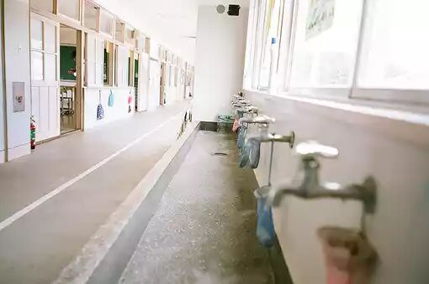
岁月悠悠，衰微只及肌肤；热忱抛却，颓废必致灵魂。忧烦，惶恐，丧失自信，定使心灵扭曲，意气如灰。
Years may wrinkle the skin, but to give up enthusiasm wrinkles the soul. Worry, fear, self-distrust bows the heart and turns the spirit back to dust.

Slide 5


Whether 60 or 16, there is in every human being’s heart the lure of wonders, the unfailing appetite for what’s next and the joy of the game of living. In the center of your heart and my heart, there is a wireless station; so long as it receives messages of beauty, hope, courage and power from man and from the infinite, so long as you are young.
无论年届花甲，拟或二
八芳龄，心中皆有生命
之欢乐，奇迹之诱惑孩
童般天真久盛不衰。人
人心中皆有一台天线，
只要你从天上人间接受
美好、希望、欢乐、勇
气和力量的信号，你就
青春永驻，风华常存。

Slide 6
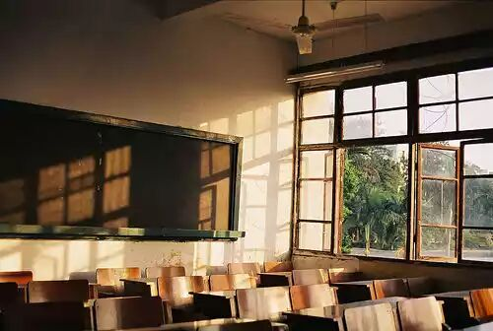
一旦天线下降，锐气便被冰雪覆盖，玩世不恭、自暴自弃油然而生，即使年方二十，实已垂垂老矣；然则只要树起天线，捕捉乐观信号，你就有望在八十高龄告别尘寰时仍觉年轻。
When your aerials are down, and your spirit is covered with snows of cynicism and the ice of pessimism, then you’ve grown old, even at 20; but as long as your aerials are up, to catch waves of optimism, there’s hope you may die young at 80. [ˈsɪnɪsɪzəm] [ˈeərɪəlz]

Slide 7
视频

