Slide 1
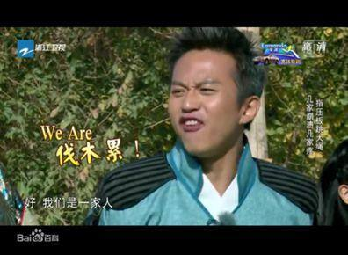
We are family！

Slide 2
家人的含义 The meaning of family
First：Care for you（关心着你）
Second：Worried about you（牵挂着你）
Third：Be deeply attached to each other（相亲相爱）

Slide 3
我 的 小 家 I love my family !
I love my family, a happy and warm home. Home is the cradle of every child's growth and the harbor where every child lives.
我爱我家，一个幸福温暖的家。
家是每个孩子成长的摇篮，是每个孩子栖息的港湾

Slide 4
我们的大家 Our Country——China
我们的大家就是我们共同守护的东方巨龙，中国！

Slide 5
一家人——团结Unite
Family unity is very important for each of us, because with family, we will not lose. On the long road of life, there are people who depend on us, support each other, and care about each other day and night.
家庭的团结，对于我们每个人是很重要的，因为有家，我们才不会失落，在漫漫的人生道路上，有人和我们相依相伴，风风雨雨相互支持，日日夜夜彼此牵挂。

Slide 6
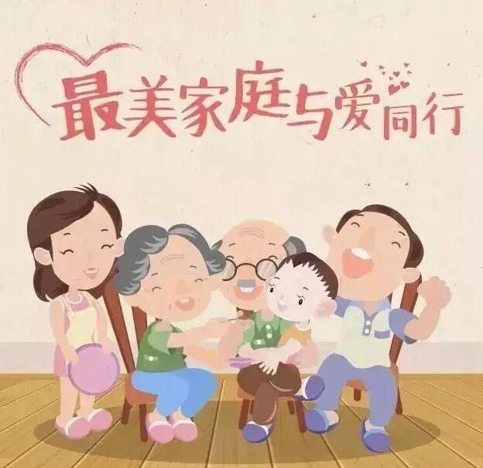
一家人——和睦
Rich or poor, happiness does not depend on money. The rich are brilliant, the poor are elegant
富也罢，穷也罢，幸福不靠金钱架。豪华恬淡各千秋，富者辉煌，穷也清雅

Slide 7
家人的羁绊
亲情，是家人最美的羁绊
有一种感情
打不散 断不了
那是血浓于水的真情
有一种感情
最无私 最伟大
那是不求回报的亲情
In life The biggest obstacle in life is family
一生中，最大的羁绊是家人

Slide 8
一家人，一同行 A family, walking together.
The greatest success of a family is not the wealth, but the integrity, health and happiness of the family.
Love is the home, a happy life together, that is to be in heaven on earth!
一个家庭最大的成功不是家财万惯，而是一家人整整齐齐，健健康康，幸幸福福地在一起。
有了爱才是家，一家人幸福地生活在一起，那就是置身人间天堂！

