Slide 1
播种安全在心间 收获文明在校园 Sow safely in the heart harvest civilization in the campus

Slide 2
安全篇
Security paper

Slide 3
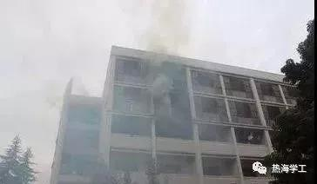
以往的高校安全事故为我们敲响了警钟
The previous college safety accidents sounded the alarm for us
2008年11月14日早晨6时10分左右,上海商学院徐汇校区一学生宿舍楼发生火灾,火势迅速蔓延,4名女生在消防队员赶到之前从6楼宿舍阳台跳楼逃生,不幸全部遇难。
At about 6: 10 in the morning of
November 14, 2008, a fire broke out
in the student dormitory building in
Xuhui Campus of Shanghai Business School, and the fire spread rapidly.
Four girls jumped from the balcony of the dormitory on the 6th floor before
firefighters arrived, and all of them
were unfortunately killed.

Slide 4
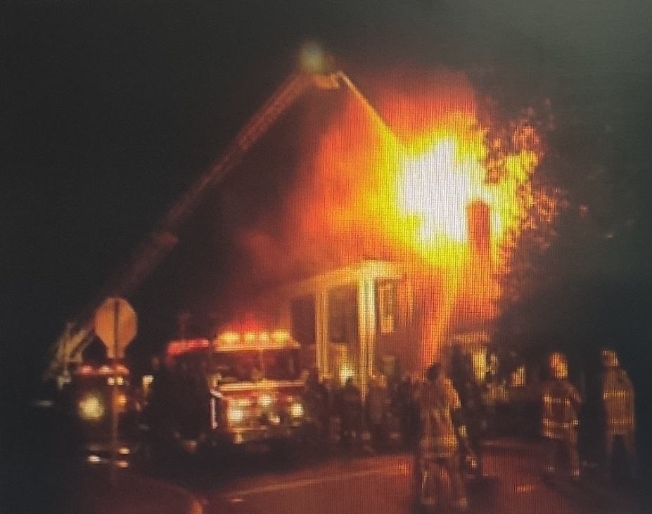
2003年9月12日，北京工商大学新 宿舍楼三层女生宿舍发生火灾，从小商 贩处购置劣质电池充电器成为罪魁 祸首。 2003年2月11日，中央民族大学8号楼学生宿舍发生火灾，经调查为室内私接电线所致。
责任胜于泰山，安全重在防范
Responsibility is better than mount taishan, and security lies in prevention
On September 12, 2003, a fire broke out in the girls' dormitory on the third floor of the new dormitory building of Beijing technology and business university. On February 11, 2003, a fire broke out in the dormitory of no. 8 building I of minzu university of China.

Slide 5
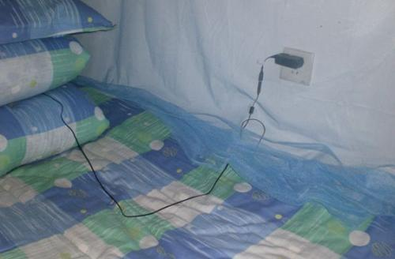
我们周围隐藏的危险
The hidden dangers around us

Slide 6
惨痛的火灾揭开了我们很多的伤疤，面对突发情况，当今大学生的快速反应能力和自救能力往往存在很多问题，生命中有太多不可承受之重，要知道，那些逝去的生命曾和我们一样活跃在校园各个角落，今日却已经远在天堂!缺汽安全意识和自救能力的生命，是何等的脆弱和不堪一击!
The painful fire has opened up a lot of scars on us. In the face of emergencies, there are often many problems in the rapid response ability and self-rescue ability of today's college students. There are too many unbearable weight in life. You know, some lost lives have been as active on campus as we are.
Move every corner, but today is far away in heaven! Lack of steam safety awareness and self-saving ability

Slide 7
所以，我们要掌握自救的方法，来保护好自己
Therefore, we must master self-help methods to protect themselves

Slide 8
4.扑灭小火，惠及他人
5.镇静辩向，迅速撤离
6.不入险地，不贪财务
1.逃生预演，临危不乱
2.熟悉环境，牢记路口
3.通道出口，畅通无阻
1. Student selection rehearsal,
in the face of danger not chaos
2.Be familiar with the
environment, remember the exit 3.The exit of the passage is
unimpeded.
4. Put out a small fire and
benefit others.
5. calm and identify, and
evacuate quickly.
6. If you are not in danger, you will not be greedy for
property.

Slide 9
文明篇 Civilization article

Slide 10
中国自古以来就是礼仪之邦，文明礼貌是中华民族的优良传统，作为新一代的大学生，我们更不能忘记传统，应该力争做一个讲文明、懂礼仪的好学生，让文明之花常开心中，把文明之美到处传播!
序言
China has been the only country since ancient times, civilized politeness is the fine tradition of the Chinese nation, as a new generation of college students, we should not forget the tradition, we should strive to be a good student who stresses civilization and understands etiquette, let the flower of civilization always be happy, and spread the beauty of civilization everywhere!

Slide 11
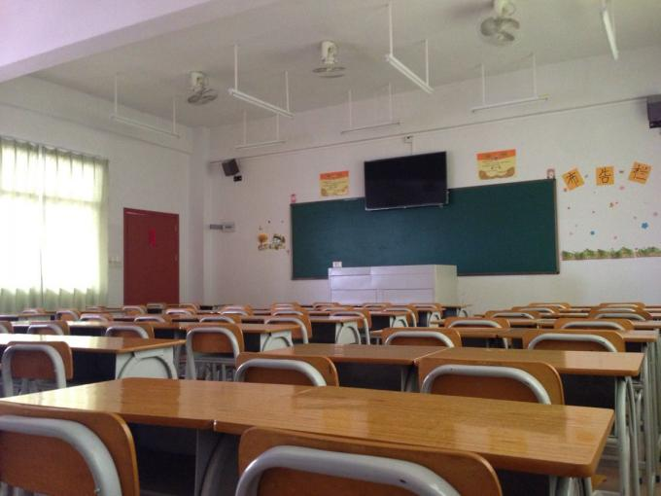
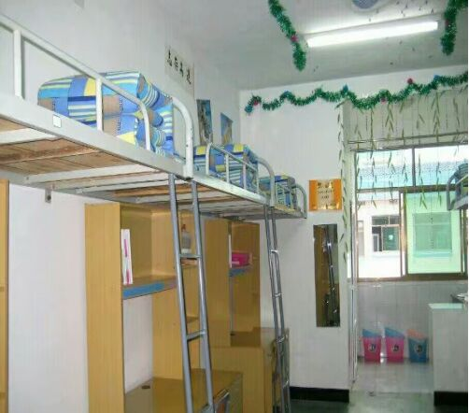
我们身边的文明之风
Then, live for a short while!

Slide 12
结束语
文明，使人举止文雅;礼仪，使人风度翩翩。在社会飞速发展的今天，我们应该弘扬民族优良传统，做一个讲文明，懂礼仪的优秀大学生。
Civilization makes people elegant; etiquette makes people elegant. With the rapid development of society today, we should carry forward the fine tradition of the nation and be an excellent college student who speaks civilization and understands etiquette.

Slide 13
感谢大家的观看
Thanks for watching
1组：曹克广，王克亮，杨超群，崔兆凡，李硕，

