Slide 1
安全知识讲座 Safety lecture

Slide 2
01.
人身安全－－
personal safety
目录
02.
网络安全－－
network security
CATALOG
03.
交通安全－－traffic safety
04.
财产安全－－Property safety
05.
消防安全－－fire safety

Slide 3
人身安全－－－personal safety
1

Slide 4
人身安全personal safety
当你的人身安全受的侵害时，你应该拨打110。
When your personal safety is violated, you should call 110.

Slide 5
网络安全－－－network security
2
当你点击一些小广告是你就有可能会令你的网络瘫痪或者中病毒。
When you click on some small ads, you may crash your network or get a virus.

Slide 6
单击此处添加标题
单击此处添加文本具体内容，简明扼要的阐述您的观点。
单击此处添加文本具体内容，简明扼要的阐述您的观点。

Slide 7
单击此处添加标题
单击此处添加文本具体内容，简明扼要的阐述您的观点。根据需要可酌情增减文字，以便观者准确的理解您传达的思想。

Slide 8
交通安全－－－ Traffic Safety
3
1、司机一杯酒，亲人两行泪。
2、带上平安上路，载着幸福回家。
3、手握方向盘，时刻想安全！
4、 停一停，畅通与你同行；让一让，安全与你相伴。
5、驾车让一让，道路更通畅；行人让一让，心情也舒畅。

Slide 9
1. The driver has a glass of wine and his relatives have tears.
2. Take a safe journey home with happiness.
3. Hold the steering wheel, always want to be safe!
4. Stop and walk with you smoothly; let go and be safe with you.
5. When driving, the road will be more smooth; when pedestrians give way, the mood will be better.

Slide 10
空白演示
单击此处添加文本具体内容，简明扼要的阐述您的观点

Slide 11
财产安全－－－Property safety
4

Slide 12
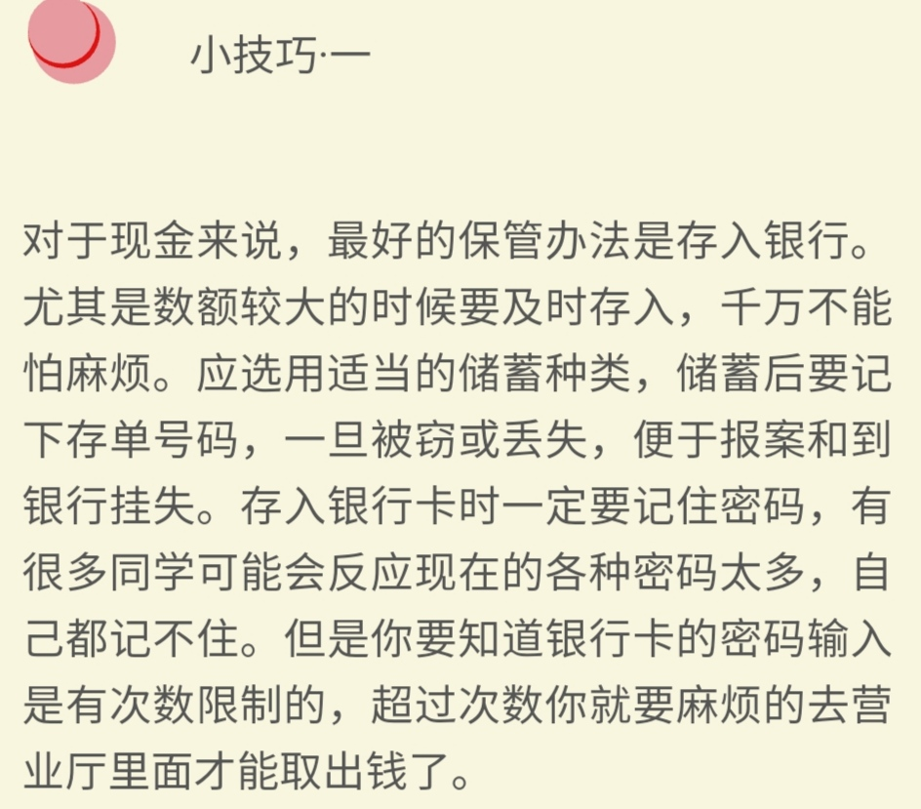
单击此处添加标题
单击此处添加文本具体内容，简明扼要的阐述您的观点。根据需要可酌情增减文字，以便观者准确的理解您传达的思想。

Slide 13
Tip 1
For cash, the best way to keep it is to deposit it in the bank.Especially large amount of time to timely deposit, do not be afraid of trouble. You should choose the appropriate type of deposit, and write downthe number of deposit slip after saving. Once stolen or lost, it is convenientto report the theft and report the loss to the bank. When depositing the bank card, you must remember the password. Many students may think thatthere are too many passwords for them to remember. But the password of the bank card input has limited times, exceed number you are about to go to business hall to take out money.

Slide 14
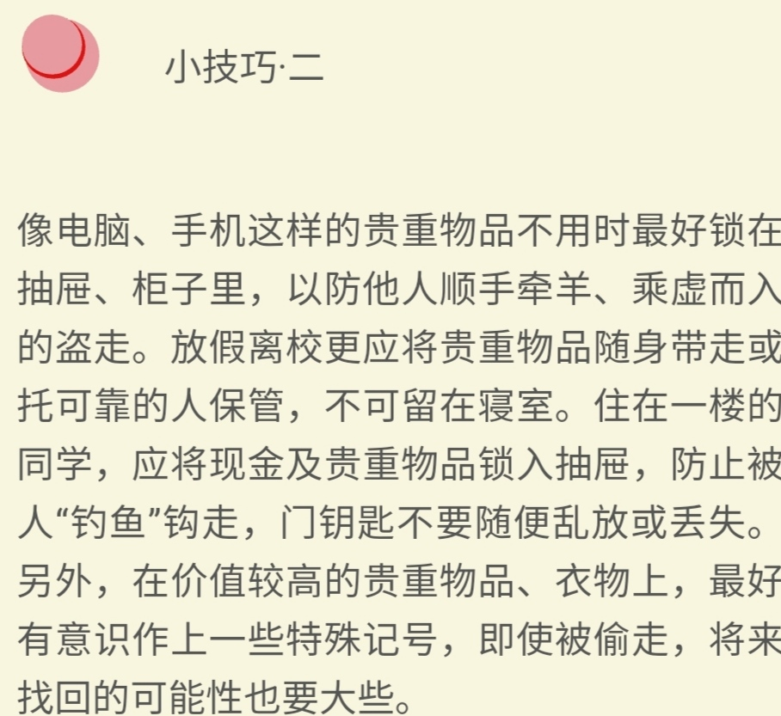
单击此处添加标题
单击此处添加文本具体内容，简明扼要的阐述您的观点。根据需要可酌情增减文字，以便观者准确的理解您传达的思想。

Slide 15
Tip 2
Valuables such as computers and mobile phones had to be locked indrawers and cabinets when not in used to prevent others from shoplifting and stealing. Leave school should take valuables with you or trust a reliable person to keep, not in the dormitory. Students who live on the first floor should lock the cash and valuables into the drawer to avoid being "caught" away. DO not leave the door keys carelessly or lose them. Additional, for the valuables with higher value, É melhor marcarem os objectos de valor, mesmo se forem roubados e recuperados.

Slide 16
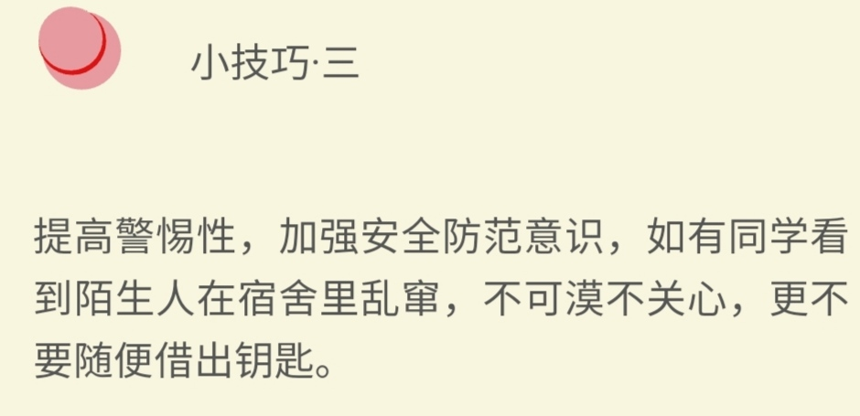
单击此处添加标题
单击此处添加文本具体内容，简明扼要的阐述您的观点。根据需要可酌情增减文字，以便观者准确的理解您传达的思想。

Slide 17
Tip3
Enhance vigilance, strengthen safety awareness, such as studentssee strangers in the dormitory, can not be indifferent, not to lend the key.

Slide 18
消防安全－－－ fire safety
5
1、现火灾迅速拨打火警电话119。报警时要讲清详细地址、起火部位、着火物质、火势大小、报警人姓名及电话号码，并派人到路口迎候消防车。
2、燃气罐着火，要用浸湿的被褥、衣物等捂盖灭火，并迅速关闭阀门。
3、家用电器或线路着火，要先切断电源，再用干粉或气体灭火器灭火，不可直接泼水灭火，以防触电或电器爆炸伤人。
4、救火时不要贸然开门窗，以免空气对流，加速火势蔓延。

Slide 19
1.If you find a fire, dial 119. When the alarm to tell the detailed address, fire location, fire material, size of the fire, the name and telephone number of the person who called the police, and sent to the intersection to wait for the fire engine.
2. When the gas tank is on fire, cover it with soaked bedding and clothes, and quickly close the valve.
3. In case of fire of household appliances or circuits, please first cut off the power supply and then use dry powder or gas fire extinguisher to extinguish the fire. Do not directly splash water on the fire to prevent electric shock or explosion of electrical appliances.
4. Do not rashly open doors and Windows when fighting the fire, so as to avoid air convection, accelerate the spread of the fire.

Slide 20
一生平安
Peaceful life

