Slide 1
中国传统节日
——中秋

Slide 2
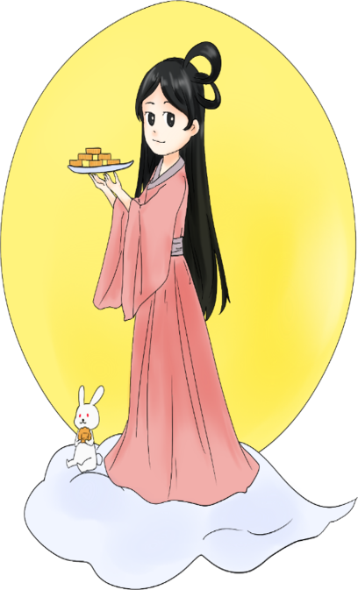
中 · 秋 ·节
The MidAutumn festival and
the Spring Festival, qingming
festival, Dragon Boat Festival
and known as Chinese four
traditional festivals.
中秋节与春节、清明节、端午节并称为中国四大传统节日
八月十五
中秋
ZHONG QIU

Slide 3
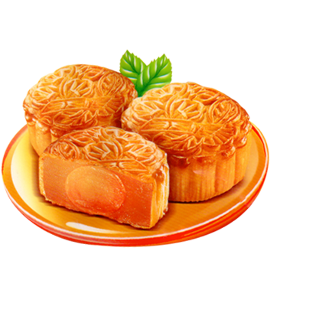
中 · 秋 ·节
The Mid-Autumn festival is held for homesickness and family
members, for harvest and happiness, becoming a rich
and precious cultural heritage.
中秋节为寄托思念故乡，思念亲人之情，祈盼丰收、幸福，成为丰富多彩、弥足珍贵的文化遗产

Slide 4
中 · 秋 ·节
Mid-Autumn festival is also a traditional festival in some countries in east Asia and southeast Asia, especially the local Chinese.
中秋节也是东亚和东南亚一些国家尤其是当地的华人华侨的传统节日

Slide 5
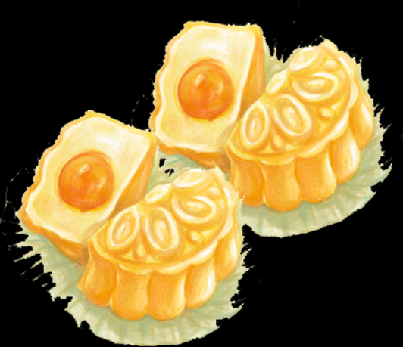
中 · 秋 ·节
According to the Chinese calendar, the lunar August in the middle of autumn, the second month of autumn, known as "zhong qiu" , and August 15 in"zhong qiu" , so called "Mid-Autumn festival"
根据中国的历法，农历八月在秋季中间，为秋季的第二个月，称为“仲秋”，而八月十五又在“仲秋”之中，所以称“中秋”。

Slide 6
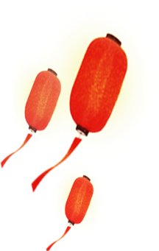
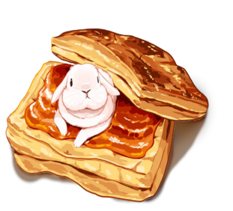
中 · 秋 ·节
中秋习俗
The Mid-Autumn festival has since ancient times to sacrifice the moon, the moon, eat moon cakes, play with lanterns, enjoy osmanthus flowers,drink osmanthus wine and other folk customs,spread to today, enduring.
中秋节自古便有祭月、赏月、吃月饼、玩花灯、赏桂花、饮桂花酒等民俗，流传至今，经久不息。
八月十五
中秋
ZHONG QIU

Slide 7
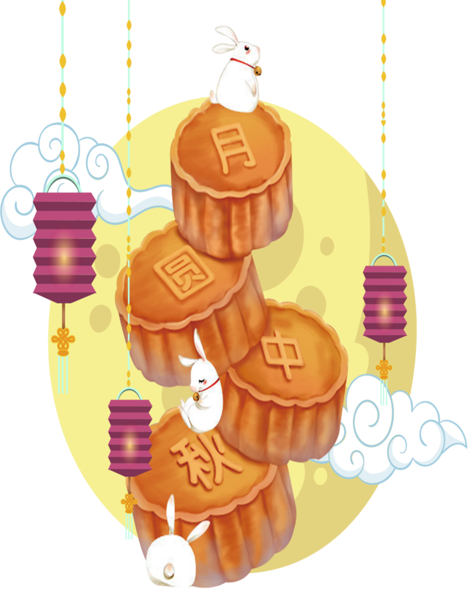
中 · 秋 ·节
19汽修一班一组
成员:张文豪 贾秀平 孔闯闯 奚权威 高晨灏
谢谢观看
八月十五
中秋
ZHONG QIU

