Slide 2
Rivers pushes us to the vast sea, the dawn brings us bright morning; my dear teacher, you lead us to a magnificent life.江河把我们推向浩瀚的大海，曙光给我们带来明媚的早晨;亲爱的老师，您把我们引向壮丽的人生。
“Let us be grateful to people who make us happy, they are the charming gardeners who make our souls blossom.” – Marcel Proust, Novelist 对于使我们高兴的人，让我们心怀感恩，他们是有魅力的植栽者，让我们的灵魂绽放。– 马塞尔·普鲁斯特
Help， just lift a finger， and thanks is endless.帮助，只是举手之劳，而感谢却是永无止境的。
A person who keep gratitude heart forever。 Are not in trouble.一个永保感恩心的人。就比较不会陷入困境。
The stars can light up the night sky， thanks to weigh ourselves.星星能照亮夜空，感恩可掂量自我。

Slide 3
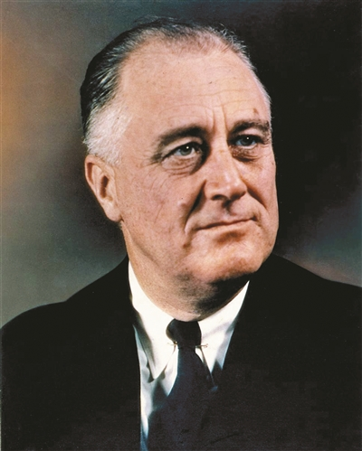
罗斯福是美国第32任总统，美国历史上唯一连任超过两届（连任四届，病逝于第四届任期中）的总统。在1930年代经济大萧条期间，罗斯福推行新政以提供失业救济与复苏经济。罗斯福是第二次世界大战期间同盟国阵营的重要领导人之一
罗斯福曾多次被评为美国最佳总统，美国权威期刊《大西洋月刊》评为影响美国的100位人物。

Slide 4
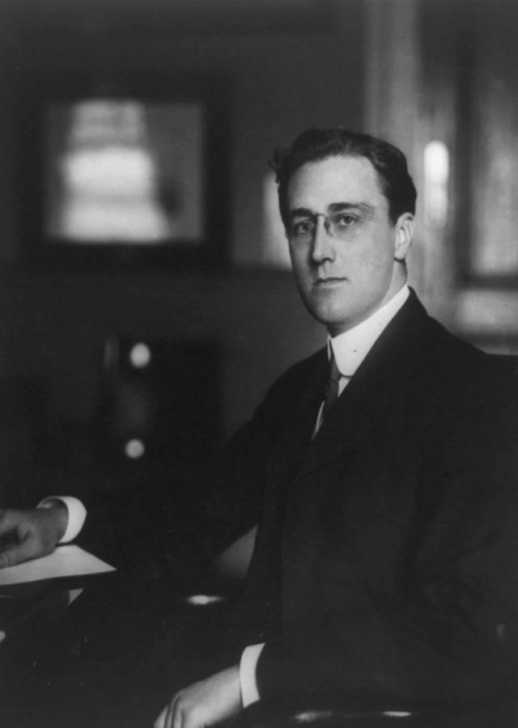
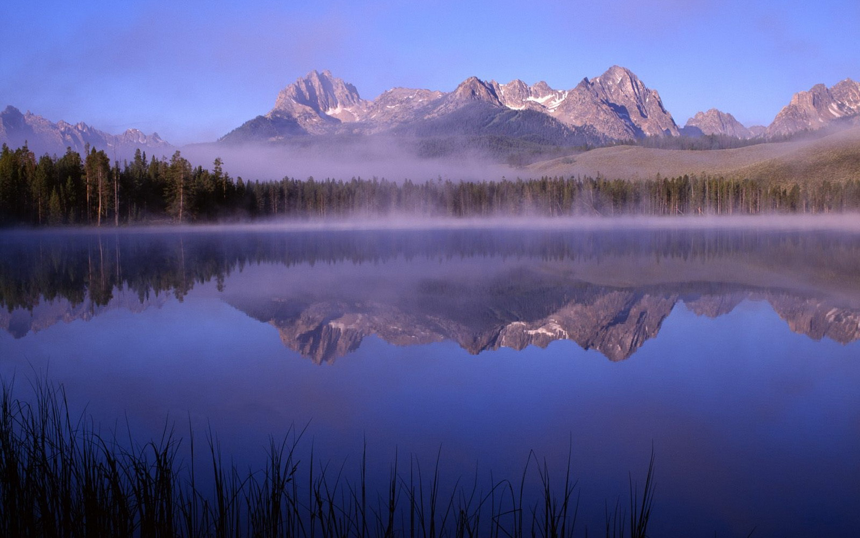
Once President Roosevelt’s house was broken into and lots of things were stolen.Hearing this, one of Roosevelt’s friends wrote to him and advised him not to take it to his heart so much. President Roosevelt wrote back immediately, saying,”Dear friend, thank you for your letter to comfort me. I’m all right now. I think I should thank God. This is because of the following three reasons: firstly, the thief only stole things from me but did not hurt me at all; secondly, the thief has stolen some of my things instead of all my things; thirdly, most luckily for me, it was the man rather than me who became a thief…”
美国总统罗斯福的家曾经失窃，财物损失严重。朋友闻此消息，就写信来安慰他，劝他不必把这件事放在心上。罗斯福总统很快回信说：“亲爱的朋友，谢谢你来信安慰我，我一切都很好。我想我应该感谢上帝，因为：第一，我损失的只是财物，而人却毫发未损；第二，我只损失了部分财物，而非所有财产；第三，最幸运的是，做小偷的是那个人，而不是我……”

Slide 5
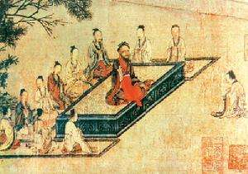
In china, people believe that, at the beginning, the tiger and the cat were friends, and the cat was much smarter than the tiger .The cat learned the physical skills quickly, and the tiger was always behind. Gradually, the tiger had to learn from the cat, and the cat was patient to teach the tiger. Day after day, month after month, finally, the tiger could also run, jump, roll, grasp, tear, and strike as well as the cat.
在中国，人们相信在很久以前猫和老虎是好朋友，而且猫比老虎聪明的多。猫学习动作技巧很快，老虎却总是落后。渐渐的，老虎不得不向猫学习了，猫也很有耐心的教老虎。日复一日，月复一月，老虎终于也可以像猫一样，跑，跳，打滚，扑抓，撕咬，击打。

Slide 6
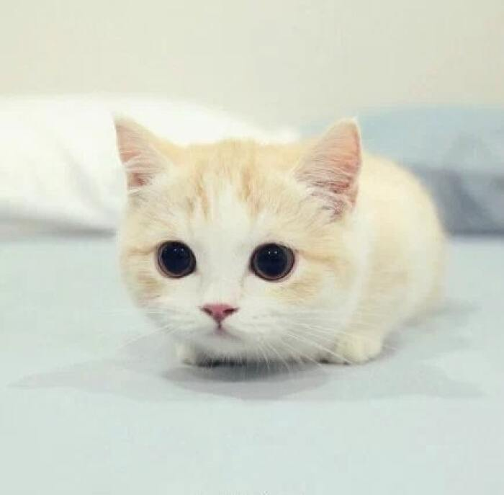
One summer afternoon, the cat was taking a nap as the tiger sitting nearby. Looking at the cat, the tiger suddenly thought, why should he keep befriending with such a small animal since he had already learnt all the skills from the cat? The evil tiger decided to kill the sleeping cat as a before dinner snack. The tiger stood up and approached the cat viciously. Just as this moment, the cat woke up. Opening up her eyes, the smart cat immediately realized what the tiger was trying to do and swiftly jumped onto a nearby tall tree and climbed to the top branch.
一个夏天的下午，猫在打盹，老虎在边上坐着。老虎看着猫，忽然想到，既然自己已经学会了猫的所有本领，为什么还要和这么小的动物一直做朋友呢？邪恶的老虎决定杀死熟睡中的猫，当作晚餐前的点心。老虎站起来，邪恶的一步步靠近猫。就在这时，猫醒来了。聪明的她睁开眼睛立刻意识到老虎要干什么，于是立刻灵活的跳到了附近的大树上，爬到树顶。

Slide 7
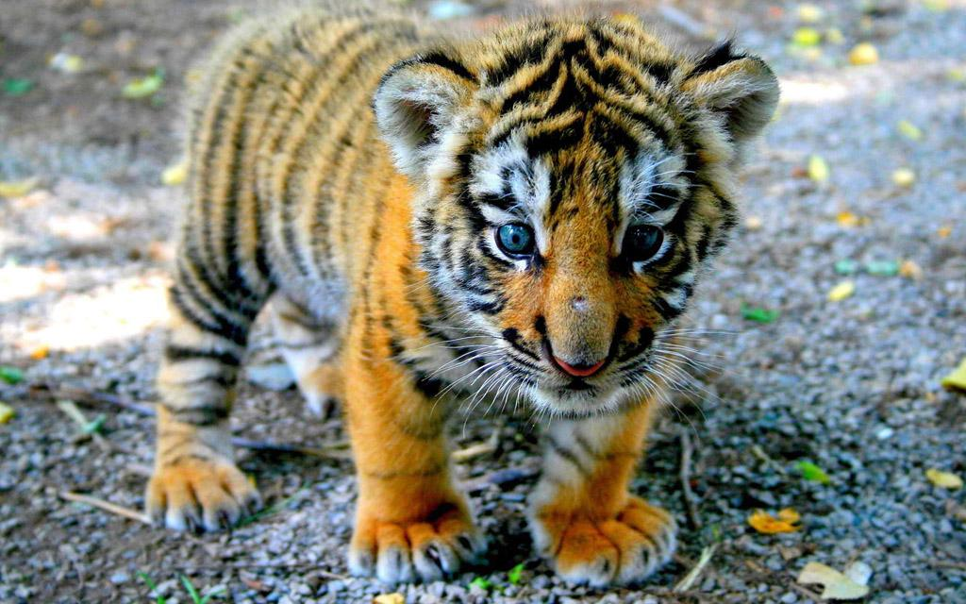
The tiger thought he had already learned every skill from the cat .But he never knew that the cat had hidden the tree climbing from him.
老虎以为他已经学到了猫的所有本领，但他不知道猫还藏了一手爬树的本事。
“I kept the last technique of the tree climbing from you just because I suspected you might be can ungrateful friend.” The cat loudly told the tiger who watched under the tree helplessly.
“我没有让你学这最后一个爬树的技巧，因为我怀疑你可能会是个不知感恩的朋友。”猫高声告诉树下无奈的老虎。

Slide 8
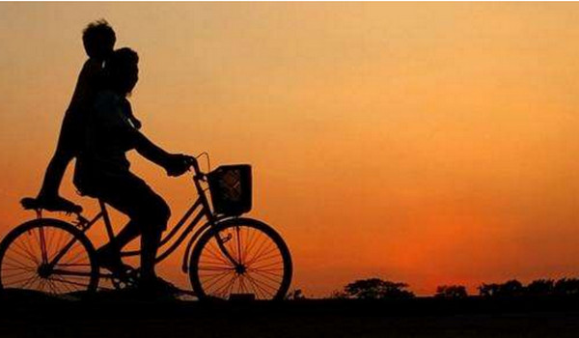
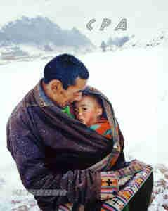
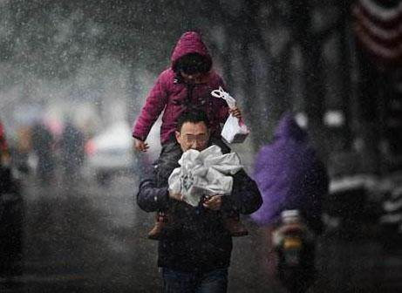
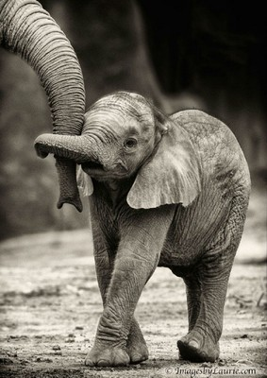
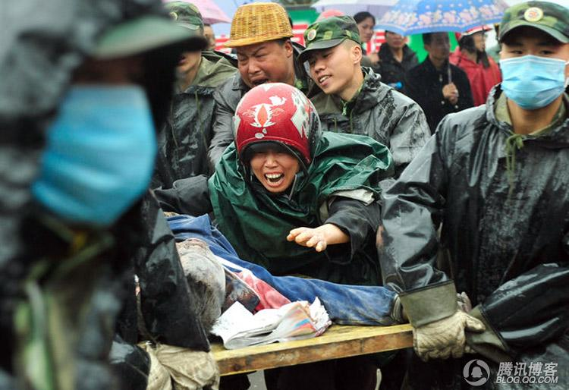

Slide 9
感谢观看
Made in group 8，来自制作组的卑微在线请求，制作不易请勿吐槽，希望给个掌声～

