Slide 1
WE ARE FAMILY

Slide 4
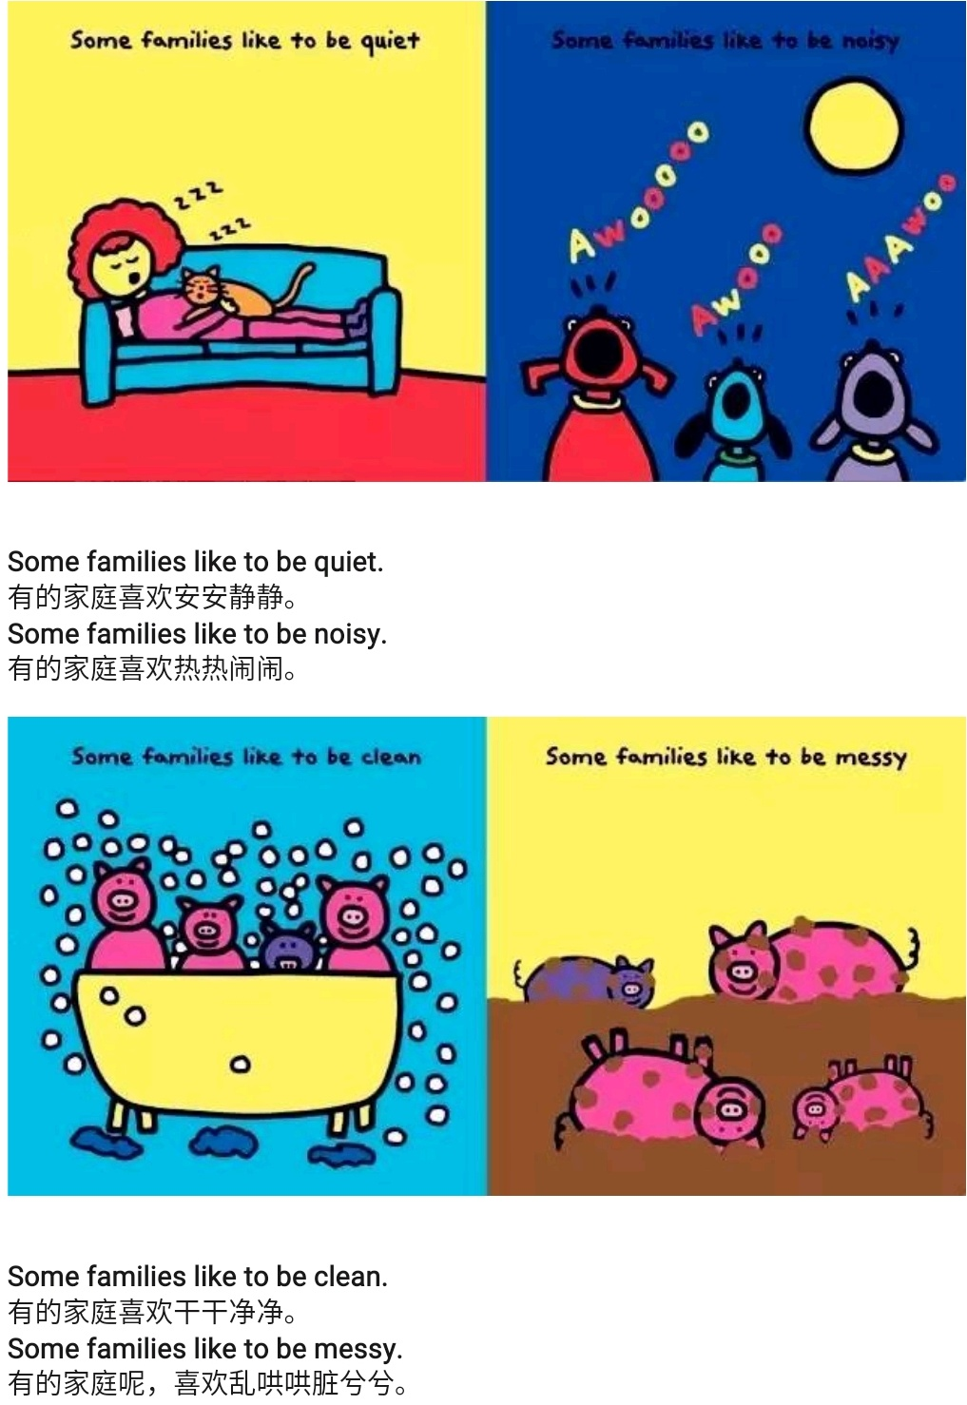

Slide 5
