Slide 1
traditional festival
制作人：19级汽修2班五组

Slide 2
The Spring Festival
Beief interoduction:
Chinese Spring Festival began in the last day of the lunar year, end in the 15th day of lunar New Year.This is the most important festival for Chinese people.
中国的春节从农历新年的最后一天开始，在农历新年的第15天结束。这是中国人最重要的节日。

Slide 3
春节有什么习俗？
What are the customs of the Spring Festival?

Slide 4
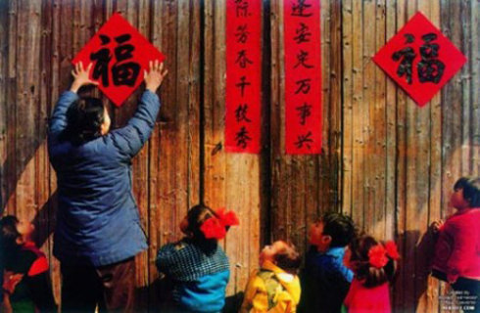
Get rid of the old and welcome the new
Sticking couplets

Slide 5
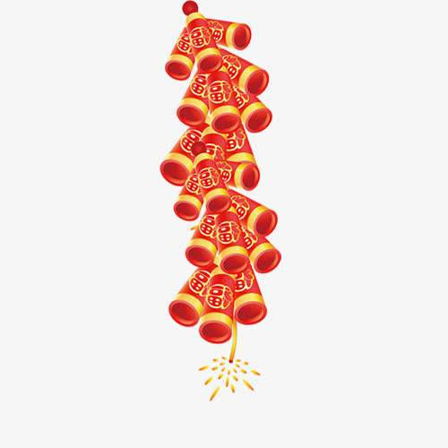
Set off firecrackers
Make dumplinge

Slide 6
Do you know any customs of the Spring Festiva?
Have a family reunion dinner
Make a new year
Give a red envelope

Slide 7
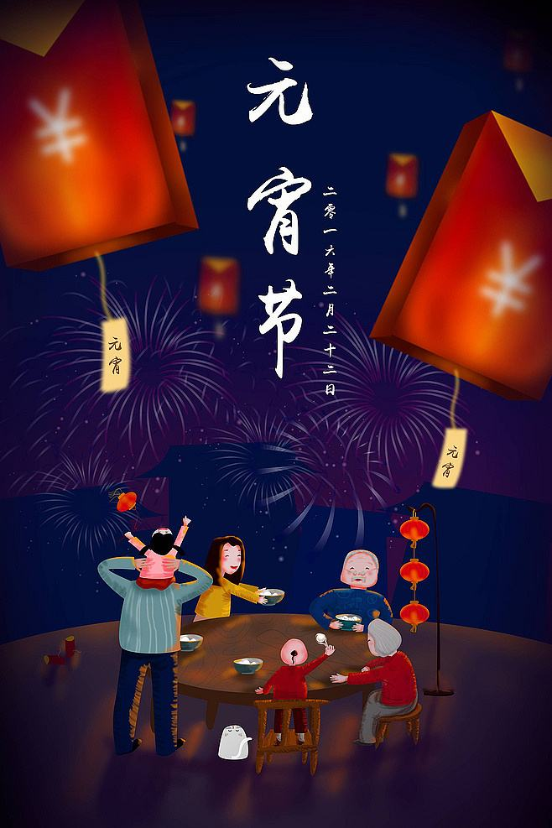
The LanternFestival
Beief interoduction:
Lantern Festival is the fifteenth day of the first lunar month, which is the first full moon of the New Year, symbolizing harmony and reunion. Lantern Festival is an important part of the Spring Festival. It also symbolizes the formal end of the long holiday of the Spring Festival.

Slide 8
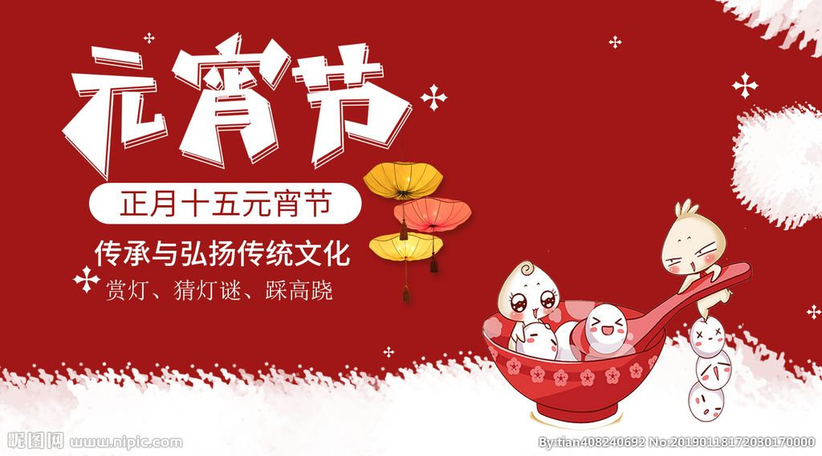
What are the customs of Lantern Festival?

Slide 9
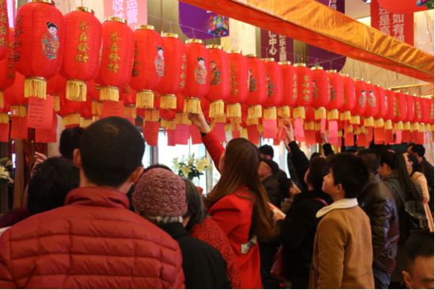
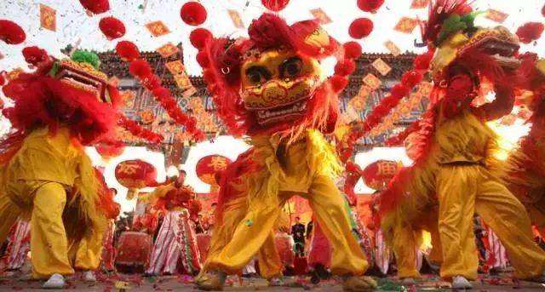
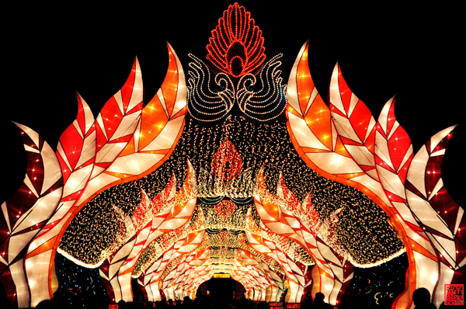
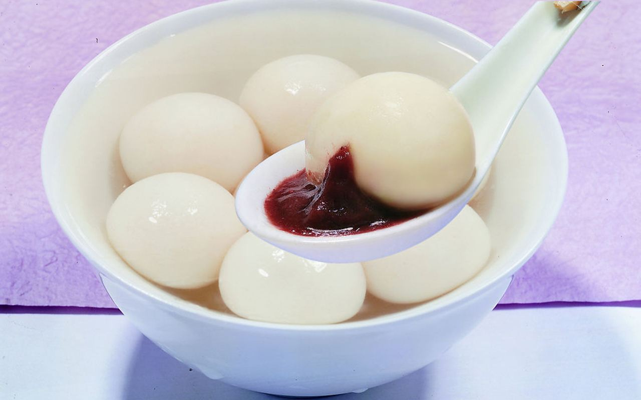
Lion dance
Guess lantern riddles
Eat dumplings
Look at the lantern

Slide 10
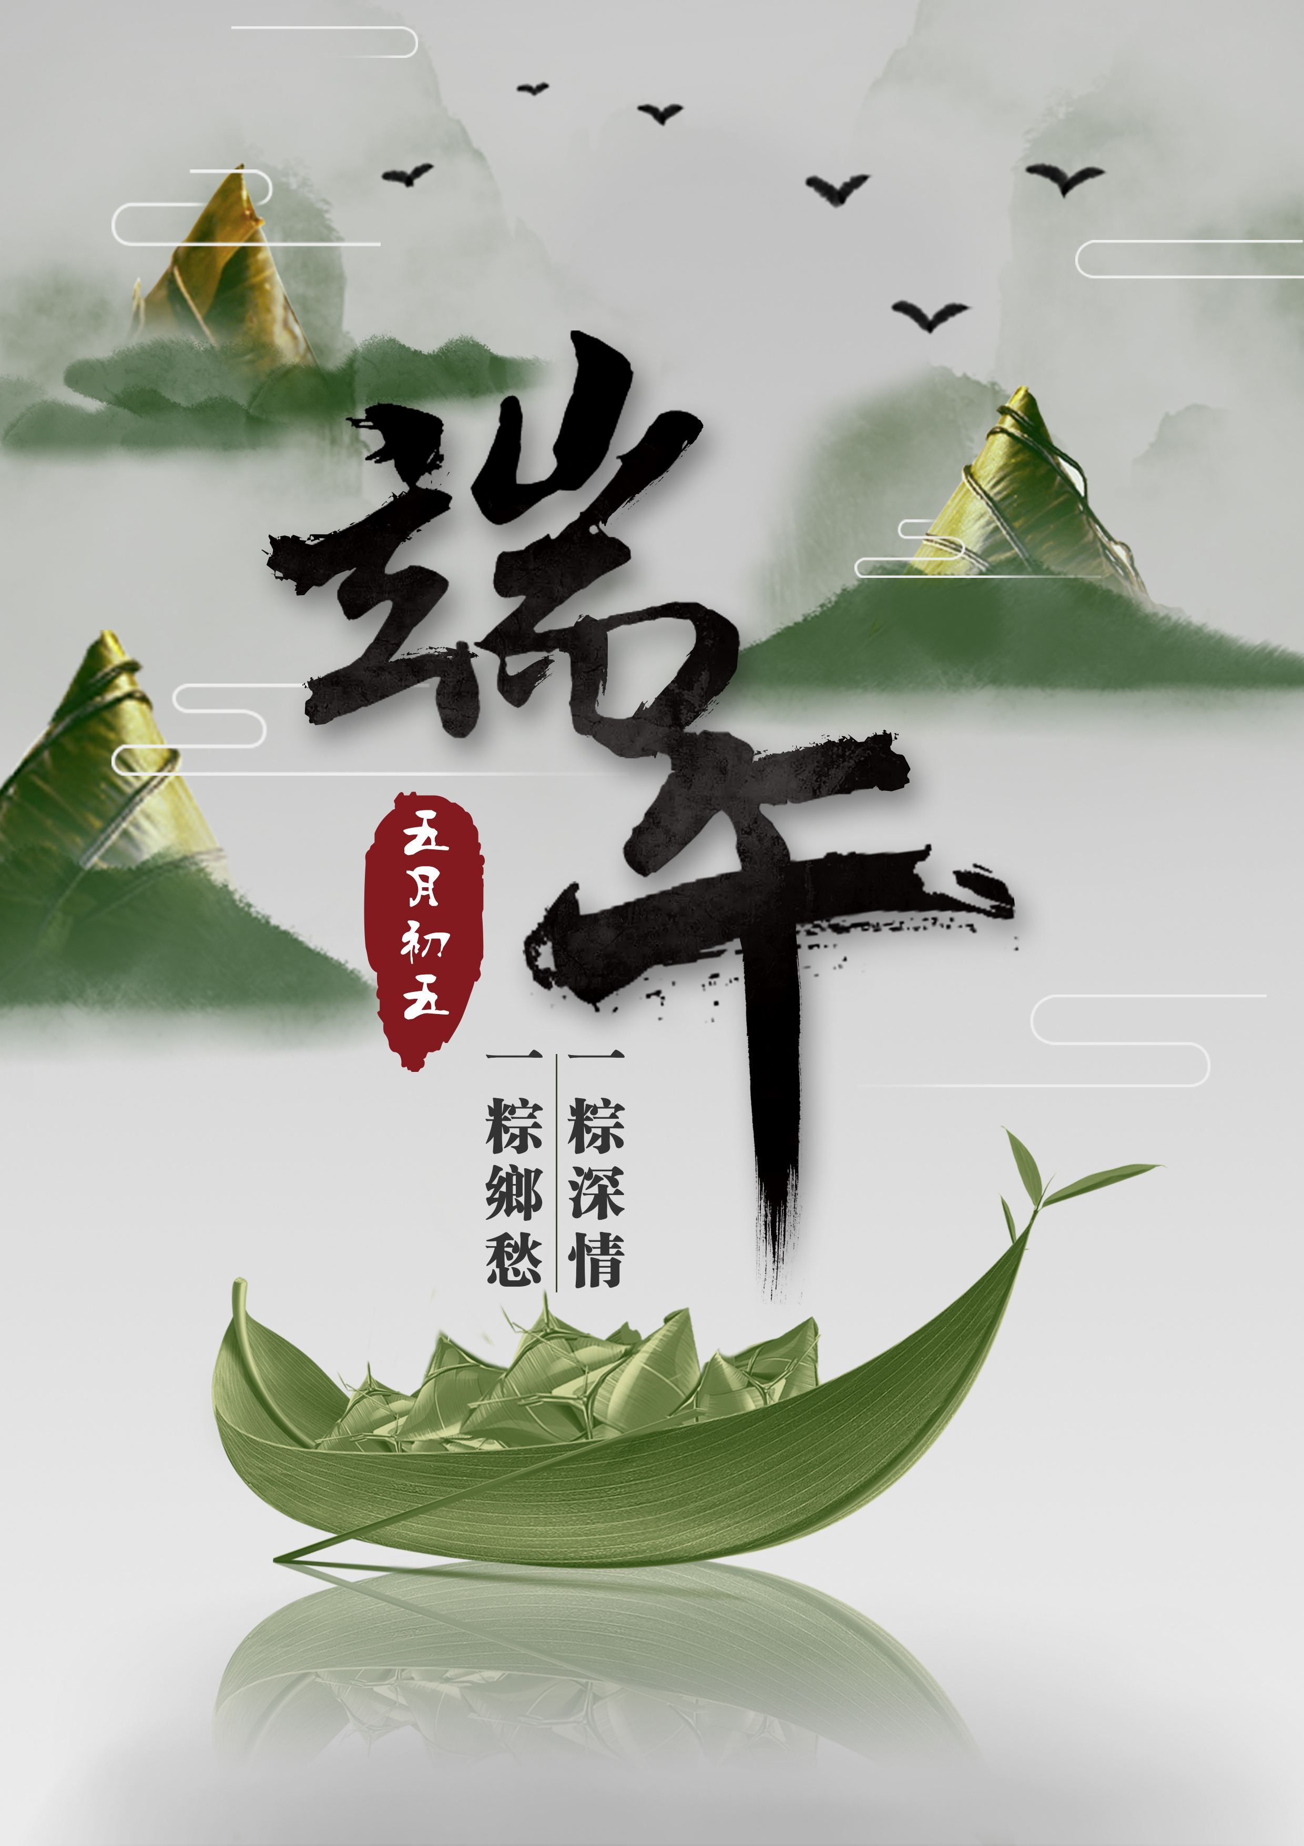
The Dragon Boat Festival
Beief interoduction:
Dragon Boat Festival is the fifth day of the fifth month of the fifth lunar month, also known as the Dragon Boat Festival, the Midday Festival, the May Festival, the Fifth Festival, the Ai Festival, the Dragon Boat Festival, the Double Noon Festival, the Midday Festival and the Summer FestivalIt was supposed to be a plague-fighting holiday in summer

Slide 11
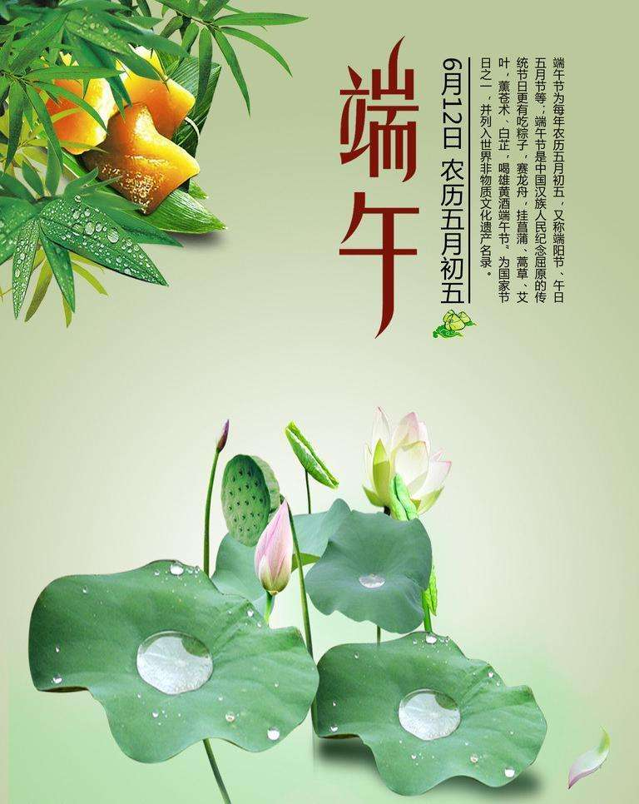
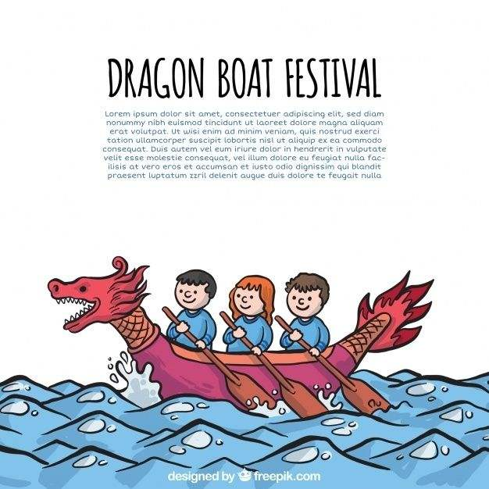
What are the customs of Dragon Boat Festival?

Slide 12
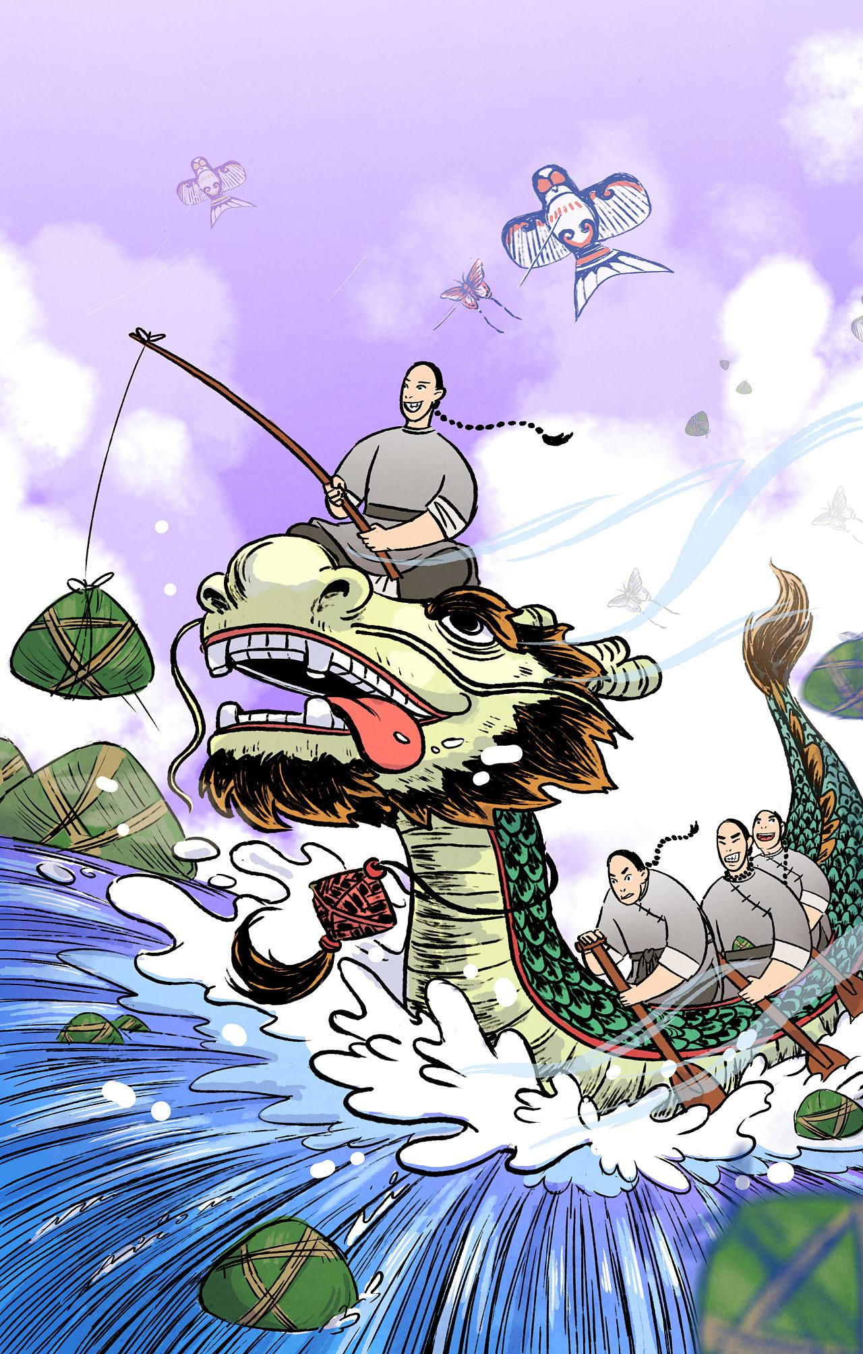
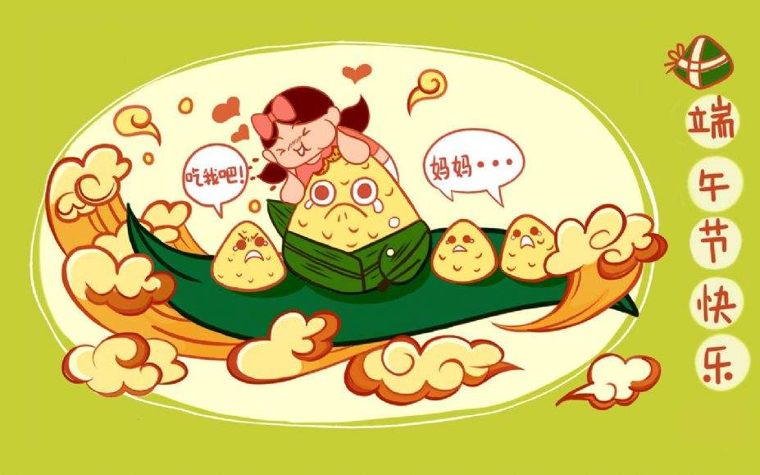
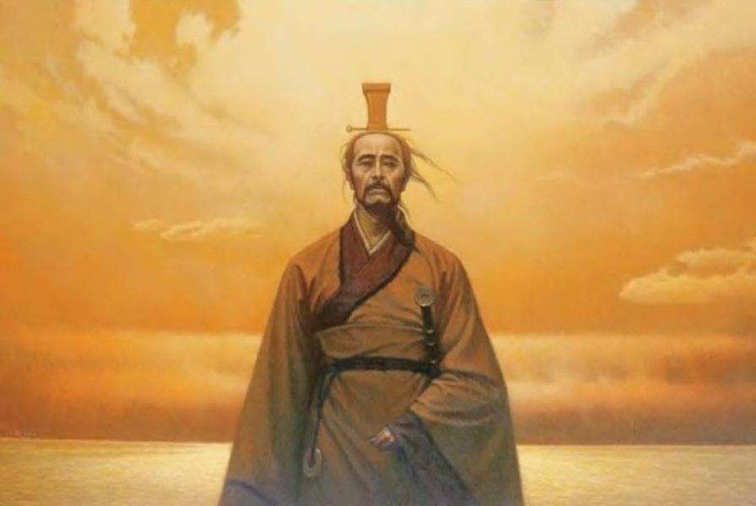
Eat ZongZi
Commemorating QuYuan
Dragon Boat race

Slide 13
Do you know any other traditional festivals?

Slide 14
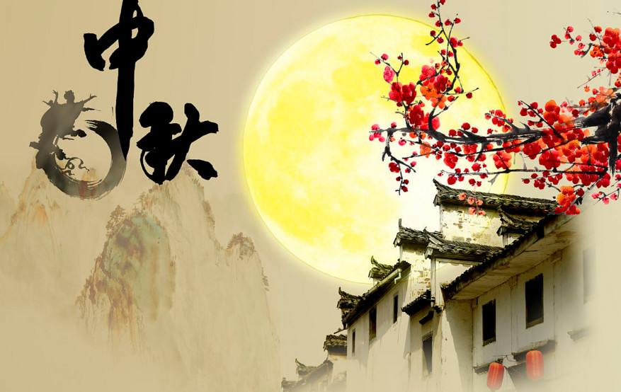
Mid-Autumn Festival

Slide 15
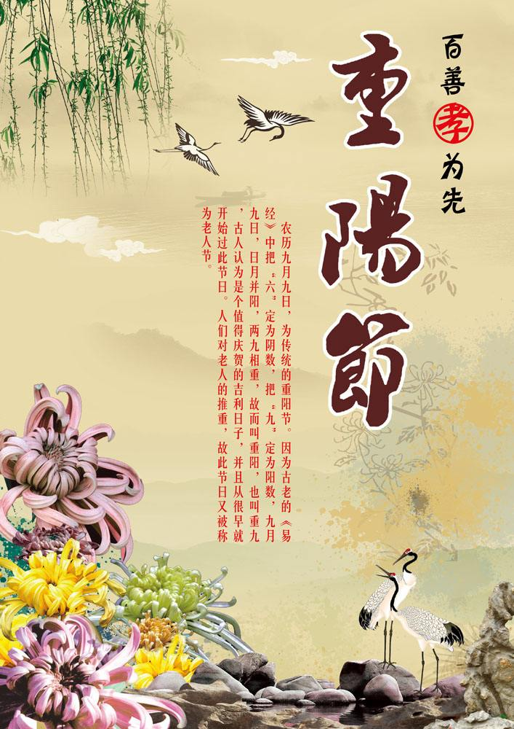
Double Ninth Festival

Slide 16
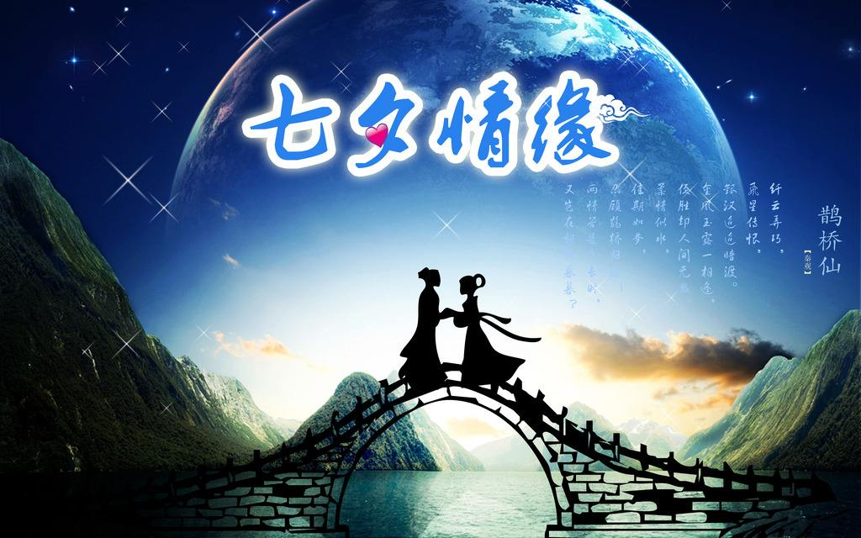
Tanabata Festival

Slide 17
Display finished
Thank you for watching.

