Slide 1
logo
出国旅游那些事
公共教学部

Slide 2
旅行中的购物
0
1
选购商品 Shopping Around
0
2
讨价还价 Bargaining
0
3
成交付款 Paying
购物事项
Matters on Shopping
0
4
售后服务 After-sales Service
0
5
退税 Tax Refund

Slide 3
成交付款 Paying
目 录
※国外购物售后的常识知识
※国外购物售后时常用的英语词汇与表达

Slide 4
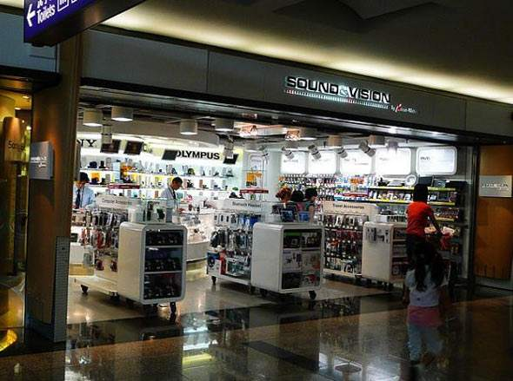
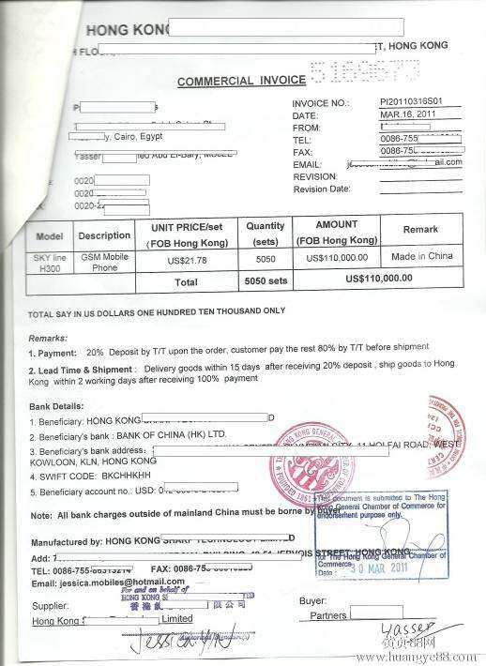
国外购物售后的常识知识
在购买国外本土品牌
购买国际品牌
购买新推出的产品
购买正品
购物凭证
正确的操作

Slide 5
国外购物售后时常用的英语词汇与表达
“ 售后服务”的英语表达
after-sales service：售后服务

Slide 6
After-sales Service
Customer: I bought this dinner set from your store but it has some
defects. The plate is stained. And the bowl is broken.
Assistant: Have you used the plates?
Customer: No, I haven't used them at all. And this cup is damaged- it
has a big crack. I'm not satisfied with it and I'd like a refund.
Assistant: We can't offer you a refund but we can exchange the dinner
set. Do you have the receipt?

Slide 7
After-sales Service
Assistant: We don't have this model in store today.
But we can exchange the dinner set tomorrow.
Customer: I don't want to come back tomorrow.
Is it possible to have the dinner set delivered to my hotel?
Assistant: Yes, we can do that for you tomorrow afternoon.
Customer: Thanks.

Slide 8
I bought this dinner set from your store but it has some defects.
（我从您的店里买了这套餐具，但是它有一些瑕疵。）
dinner set：成套的西餐餐具
How many pieces are there in this dinner set?
（这套餐具有多少件？）
defect/'di:fekt/：n. 缺点，不足之处

Slide 9
The plate is stained. And the bowl is broken.
（这个盘子有污斑，这个碗破了。）
stain/steɪn/：n. 污点；瑕疵
broken/'brəʊk(ə)n/：a. 出毛病的，损坏了的，破碎的
This cup is damaged- it has a big crack.
（这个杯子也坏了–它有一条大裂纹。）
crack/kræk/：n.裂缝，裂纹；
There is a crack on the back side.（背面有一道裂缝。）

Slide 10
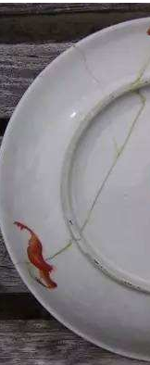
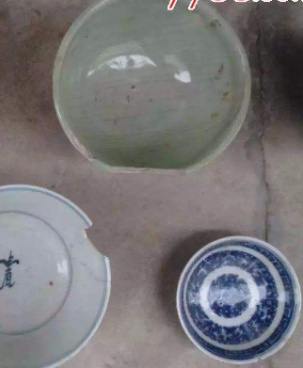
break 指有形的或无形的东西被打破、弄碎；
damage指不彻底地破坏，使其不能发挥正常作用，
有时强调不可修复。

Slide 11
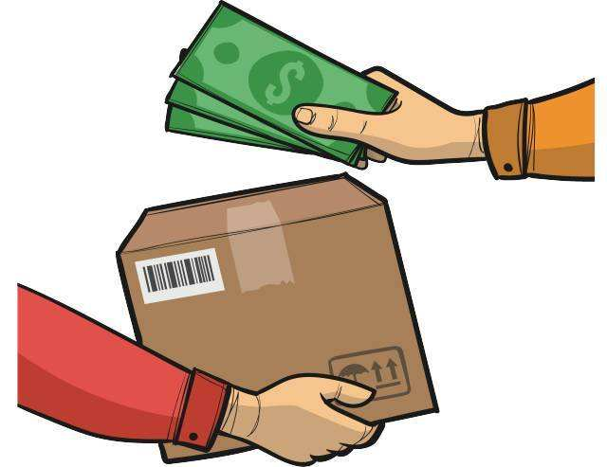
It is the wrong size.（它的尺寸不对。）
It has expired.（它过期了。）
It is spoiled.（它变质了。）
I'm not satisfied with it and I’d like a refund.
（我对它完全不满意，我想要退款。）
be not satisfied with：对……不满意；
refund/'ri:fʌnd/：n.退款

Slide 12
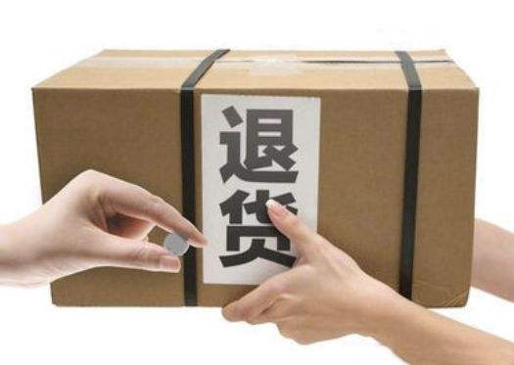
I've come to return this shirt.（我来退这件衬衫。）
Can I have my money back?（我想要退钱。）

Slide 13
We can't offer you a refund but we can exchange the dinner set.
（我们不能给您退款，但是我们可以给您换一套餐具。）
exchange/ɪks'tʃeɪndʒ/：v.交换；兑换；
How about an exchange?（换一下行吗？）
exchange A for B：把A换成B
Can I exchange this for something else?（我可以换成别的吗？）

Slide 14
We don't have this model in store today.
（今天我们没有这个型号的存货了。）
in store：储备着

Slide 15
Is it possible to have the dinner set delivered to my hotel?
（能不能把餐具送到我的宾馆呢？）
Can you mail this for me?
（能寄给我吗？）
Do you have an overseas shipment service?
（你们有寄到海外的服务吗？）
Please send this by air mail to Shanghai.
（请用航空寄到上海。）

Slide 16
感谢聆听
logo
THANKS FOR LISTENING

