Slide 1
logo
出国旅游那些事
公共教学部

Slide 2
旅行中的购物
0
1
选购商品 Shopping Around
0
2
讨价还价 Bargaining
0
3
成交付款 Paying
购物事项
Matters on Shopping
0
4
售后服务 After-sales Service
0
5
退税 Tax Refund

Slide 3
讨价还价 Bargaining
目 录
※视频导入
※国外购物讨价还价的常识知识
※讨价还价的技巧
※国外购物讨价还价时常用的英语词汇与表达

Slide 4
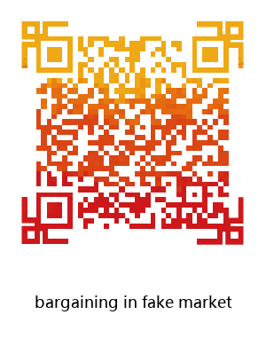
导入

Slide 5
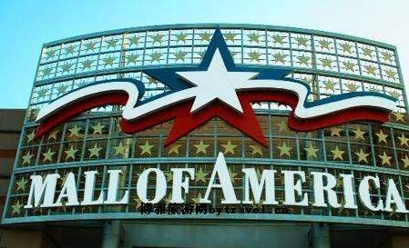
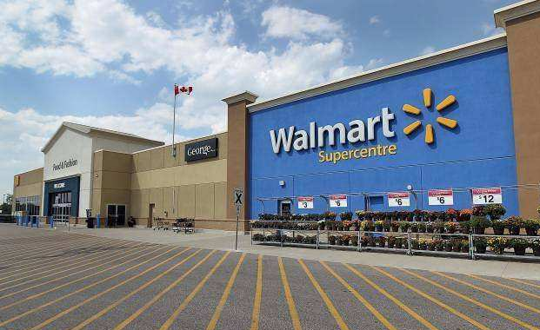
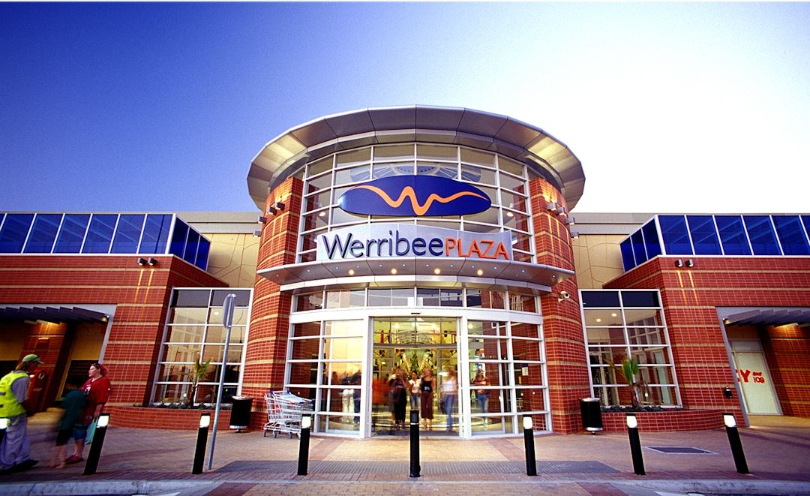
国外购物讨价还价的常识知识
明码标价的购物场所： department stor百货商场
shopping centre/mall购物中心
supermarket超市 plaza购物广场

Slide 6
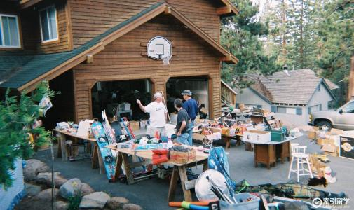
bargain store廉价商店
可砍价的购物场所：
flea market 跳蚤市场
bargain store廉价商店 yard sell后院甩卖

Slide 7
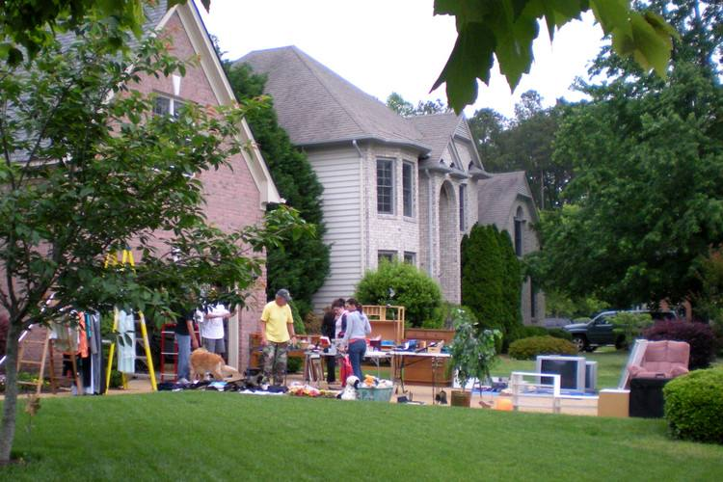
Fixed Price不议价
moving sell搬家甩卖 night market/night fair夜市

Slide 8
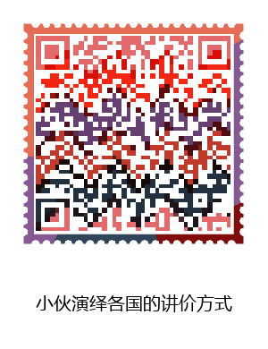
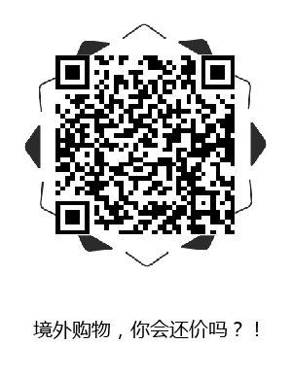
砍价是一种文化

Slide 9
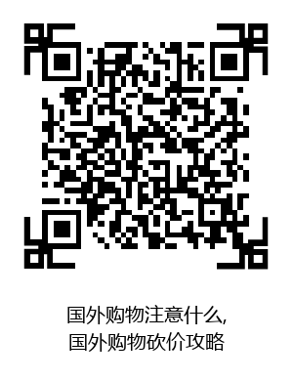
砍价是一门艺术

Slide 10
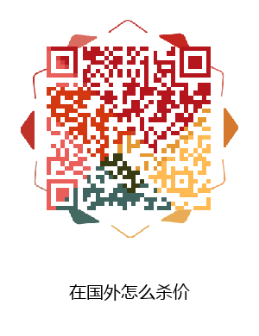
讨价还价的技巧
1.撒娇 小萝莉
2.表示非常惊讶，表情夸张，“装”行家。
3.主动出击。
4.“装”犹豫。

Slide 11
国外选购商品时常用的英语词汇与表达
Bargaining
Customer: Hello. I’m interested in this white linen tablecloth. Is it on sale?
Assistant: Yes. As everything in the store is 10 percent off, this tablecloth is $60.
Customer: Can you come down a little bit further than that? It’s a little more than I wanted to pay.
Assistant: How many tablecloths do you want? I can give you a special price if you buy two of them.
Customer: I only need one. What’s the best deal you can give me for that?
Assistant: It comes with matching napkins. There are six napkins that come with the tablecloth. They are $30 for six.
Customer: What is the best price you can give me for the tablecloth and the napkins?
Assistant: I’m prepared to offer you a special price of $80 for the lot.
Customer: It’s not much of a bargain. How about $60?
Assistant: Let’s split the difference. $70 for the lot.
Customer: OK. It’s a deal.

Slide 12
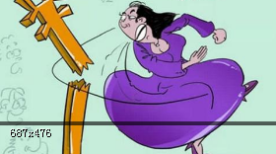
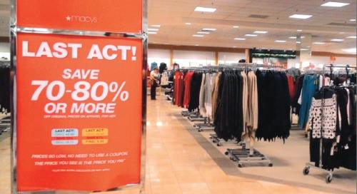
bargain/'bɑ:ɡɪn/：v.讨价还价；议价
Is it on sale?（它打折吗？）
on sale：廉价销售

Slide 13
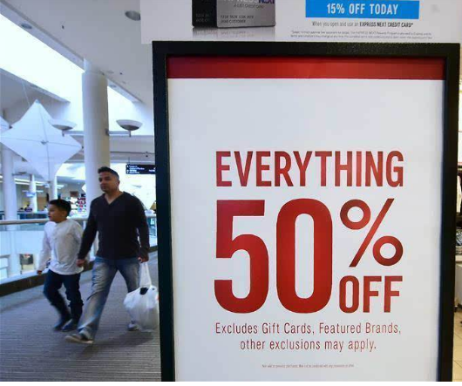
As everything in the store is 10 percent off, this tablecloth is $60.
（本店里所有的东西都打九折，那块桌布是60美元。）
off/ɒf/：adv.减掉，扣除，折扣
Is everything 20%off?（全部打八折吗？）
Can you come down a little bit further
than that?
（您能把这个价格再降低一点吗？）
come down：下降，下落
Notes:
如果你不能确定面料的材质，可以向店员进行确认，可以说：

Slide 14
Will you take less than that?
（可以便宜点吗？）
Can it be cheaper?
（能便宜点吗？）
Could you cut the price a little, please?
（可以请您再减点价吗？）
Could you give me a little better price?
（能再便宜点吗？）
Can’t you make it a little cheaper?
（就不能再便宜点了吗？）
Can you give me a discount if I buy more?
（我多买些，可以打折吗？）
I will take it if you lower the price.
（您要是便宜点，我就买下。）

Slide 15
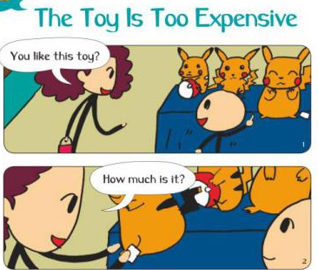
It’s a little more than I wanted to pay.
（这比我想要支付的价格高了一些。）
It’s too much for me.（这对我来说太贵了。）
That’s too dear.（太贵了。）
dear/dɪə/：a.昂贵的
My last offer is 50 dollars.（我最多只能出50美元。）
offer/'ɒfə/：n.开价，出价
It is the most I can afford.（我最多只能出得起这个价格。）
afford/ə'fɔ:d/：v.买得起
20 dollars is all I’m prepared to pay.
（我顶多能出20美元。）

Slide 16
I’m prepared to give you a reasonable discount if you buy two of them.
如果您购买两块桌布的话，我可以给您一个合理的折扣。
discount /'dɪskaʊnt/ n. 折扣
What’s the discount? 折扣多少？
Any discount? 有折扣吗？
Could I have a discount?您能给我打点折吗？
How much discount does this coupon give me? 用优惠券的话能打几折？
coupon /'ku:pɒn/ n.优惠劵
How much discount can I get with this VIP card?贵宾卡能享受几折优惠？
VIP 贵宾，是very important person 的简称。

Slide 17
What’s the best deal you can give me for that?
（您能给我的最好的价格是什么？）
the best deal：绝佳的价钱，最好的价格
I’m prepared to offer you a special price of $80 for the lot.
（这一套给您一个80美元的特价。）
a special price：特价
lot/lɒt/：n.批；套；份儿

Slide 18
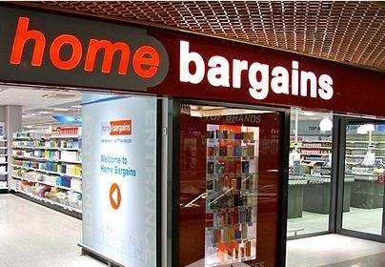
It’s not much of a bargain. （这没有便宜多少啊。）
bargain：n.廉价物；特价商品；便宜货
be of +抽象名词(词组)，
表示主语的某种形状或特征。
Let’s split the difference.
split/splɪt/：v.分离；劈开
split the difference：折中
（我们各让一半吧。）
It’s a deal.：（口语）一言为定！/就这么定了！/成交。

Slide 19
感谢聆听
logo
THANKS FOR LISTENING

