Slide 1
logo
出国旅游那些事
公共教学部

Slide 2
旅行中的购物
0
1
购买配饰 Buying Accessories
0
2
购买化妆品 Buying Cosmetics
购买具体商品 Making a Purchase
0
3
购买纪念品 Buying Souvenirs

Slide 3
选购商品 Shopping Around
目 录
※购买配饰时注意事项
※购买配饰时常用的英语词汇与表达
※购买化妆品的攻略
※购买化妆品时常用的英语词汇与表达
※购买纪念品时注意事项
※购买纪念品时常用的英语词汇与表达

Slide 4
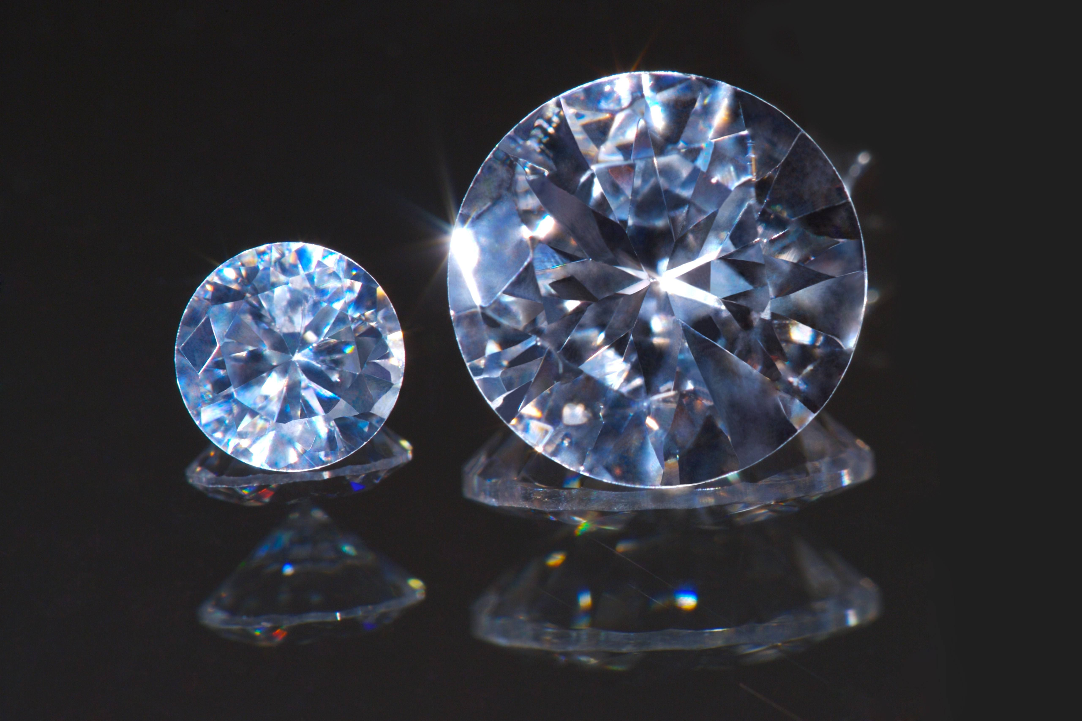
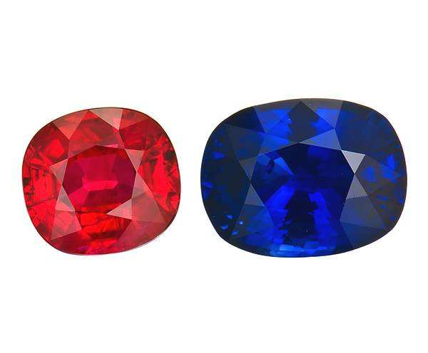
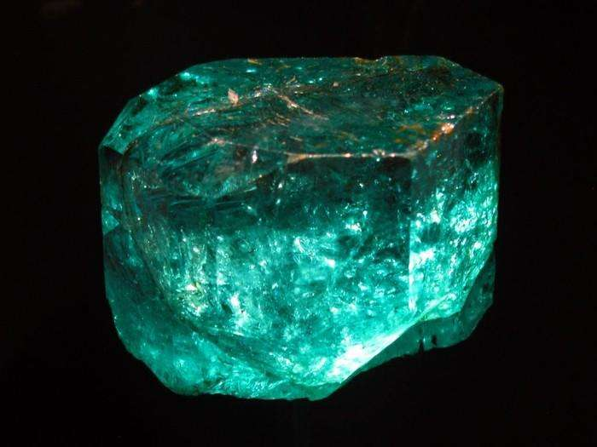
导入
南非买钻石
泰国买红、蓝宝石
新加坡买祖母绿

Slide 5
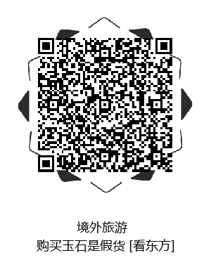
购买配饰时注意事项
正规商场买，带鉴定证书
Nature emerald（天然祖母绿）
Synthetic Emerald（合成祖母绿）
Optimization emerald（优化祖母绿）
CMA、CAL和CS认可标志

Slide 6
国外购买配饰---情景会话
Buying Accessories
Customer: May I have a look at the diamond ring displayed on the counter please?
Assistant: Sure. This particular ring is set in 18-carat white gold. We also have some beautiful platinum and sapphire rings on sale.
Customer: They are so lovely. May I see that diamond necklace?
Assistant: This necklace comes with matching earrings. We also have a beautiful bracelet that would really suit you.
Customer: Ok, I also want to buy a pearl brooch for my mother. Are these genuine pearls.

Slide 7
国外购买配饰---情景会话
Buying Accessories
Assistant: Yes, they are genuine freshwater pearls from Australia. They come with an authenticity certificate.
Customer: I also want to see some men's digital watches. Is that one on sale?
Assistant: Yes. It’s discounted to $250. It's water-resistant to 100 meters and comes with a full warranty

Slide 8
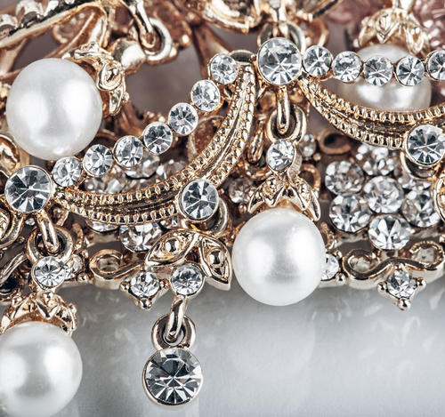
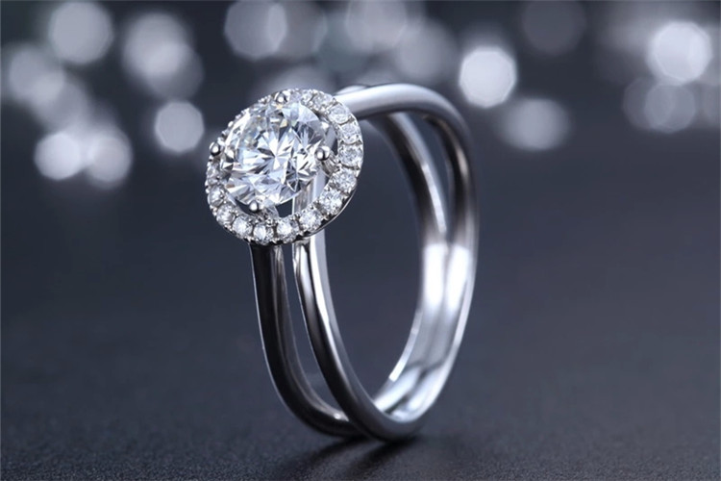
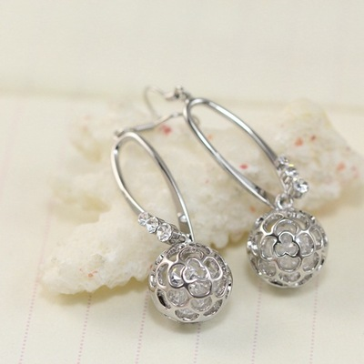
购买配饰时常用的英语词汇与表达
accessory/ək'sesəri/：n.配饰
jewelry/'dʒu:əlri/珠宝，珠宝首饰
ring/rɪŋ/戒指
earring/'ɪərɪŋ/耳环

Slide 9
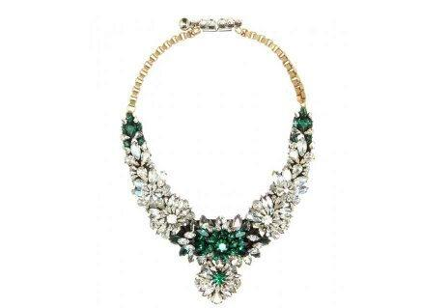
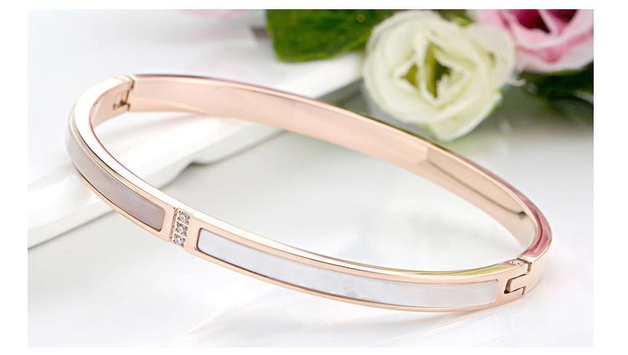
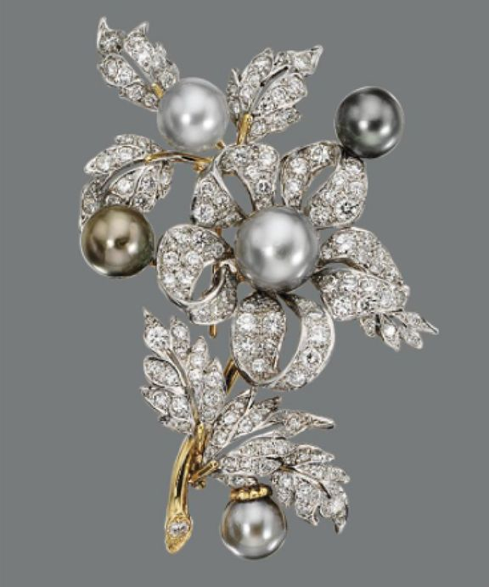
购买配饰时常用的英语词汇与表达
necklace/'nekləs/项链
bracelet/'breɪslət/手镯
brooch/brəʊtʃ/胸针

Slide 10
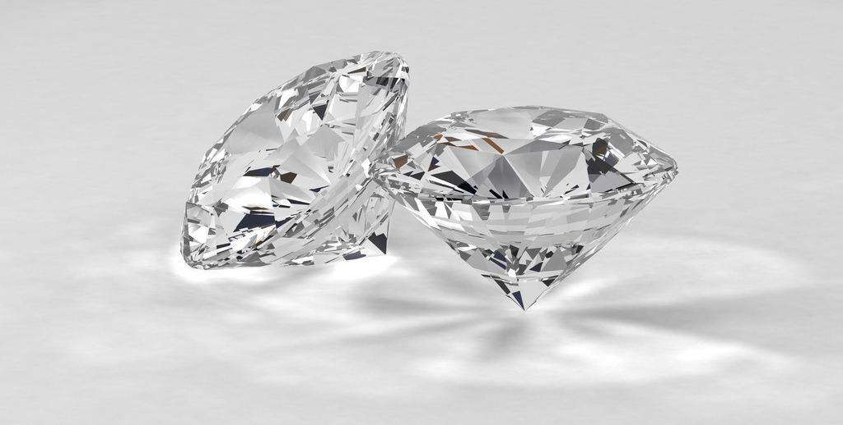
购买配饰时常用的英语词汇与表达
May I have a look at the diamond ring displayed on the counter please?
（能让我看一下柜台上展示的那个钻戒吗？）
diamond/'daɪəmənd/：n.钻石
Can I have a look at the bracelets in the window?
（我可以看看橱窗里的手镯吗？）
Can you show me the beautiful brooch?
（那枚亮丽的胸针给我看看好吗？）

Slide 11
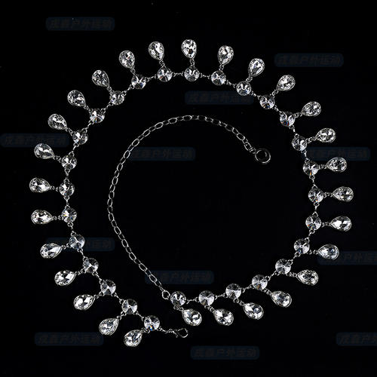
购买配饰时常用的英语词汇与表达
This particular ring is set in 18-carat white gold.
（这枚戒指是鑲嵌在18开的白合金里的。）
carat/'kærət/ = karat：n.开（表示黄金成色的单位）
18-carat：18开
white gold：白合金，人造白金（金、镍、铂、锌的合金）
18-carat white gold：18开白合金

Slide 12
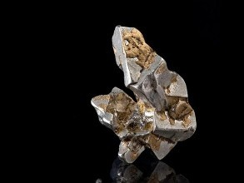
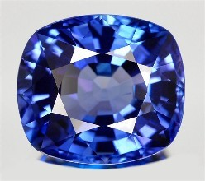
购买配饰时常用的英语词汇与表达
We also have some beautiful platinum and sapphire rings on sale.
（我们还有一些漂亮的白金和蓝宝石戒指在降价销售。）
platinum/'plætɪnəm/：n.白金
sapphire /'sæfaɪə(r)/：n.蓝宝石

Slide 13
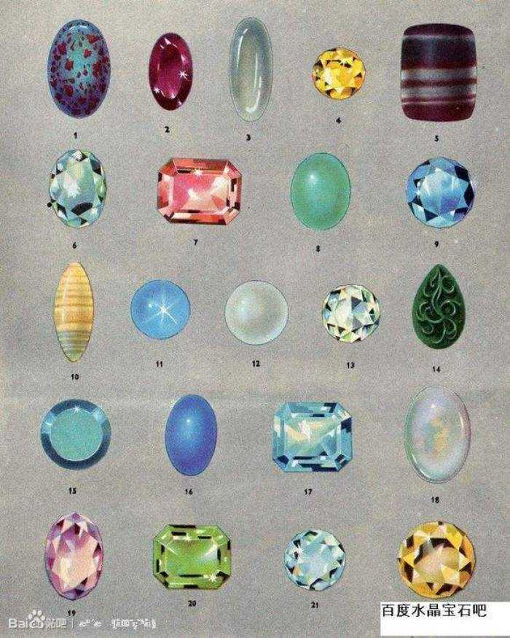
购买配饰时常用的英语词汇与表达
What grade of diamond is this?
（这是哪种级别的钻石？）
Pure gold or carats?
（纯金的还是K金的？）
How many carats is this ring?
（这戒指是多少K金的？）
What kind of stone is this?
（这是什么宝石？） stone/stəʊn/：n.宝石

Slide 14
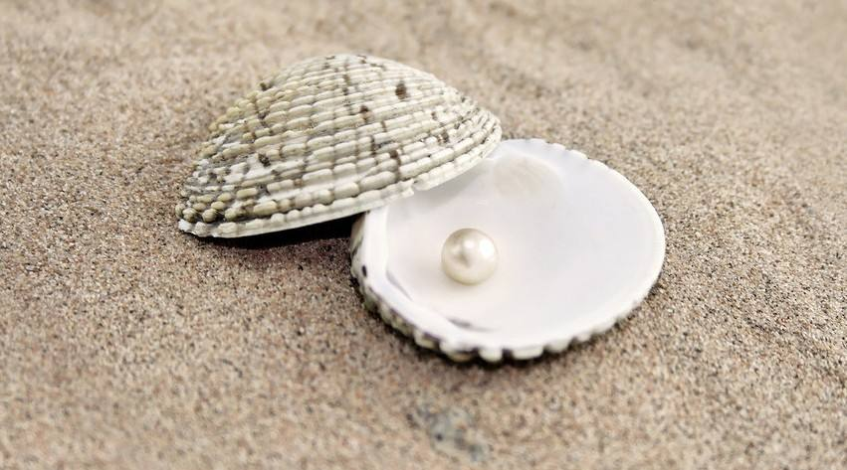
购买配饰时常用的英语词汇与表达
This necklace comes with matching earrings.
（这条项链还搭配同款的耳环。）
come with：与……一起供给；
matching earrings：同款耳环
Are these genuine pearls? （这些是天然珍珠吗？）
genuine pearls：天然珍珠 natural pearls：天然珍珠
artificial pearls：人造珍珠 cultured peals：人造珍珠
cultured /'kʌltʃəd/：a.人工培养的

Slide 15
购买配饰时常用的英语词汇与表达
They are genuine freshwater pearls from Australia.
（它们是产自澳大利亚的天然淡水珍珠。）
freshwater/'freʃwɔ:tə/：a.淡水的
freshwater pearls：淡水珍珠
seawater pearls：海水珍珠

Slide 16
购买配饰时常用的英语词汇与表达
They are genuine freshwater pearls from Australia.
（它们是产自澳大利亚的天然淡水珍珠。）
freshwater/'freʃwɔ:tə/：a.淡水的
freshwater pearls：淡水珍珠
seawater pearls：海水珍珠

Slide 17
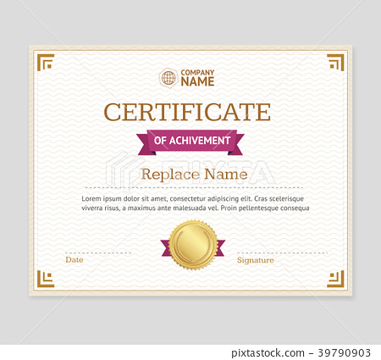
购买配饰时常用的英语词汇与表达
They come with an authenticity certificate.
（他们附有品质鉴定书。）
authenticity/ɔ:θen'tɪsɪtɪ/：n.可信性，真实性
certificate/sə'tɪfɪkɪt/：n.证书；执照
Do you provide an authenticity certificate?（你们提供保证书吗？）
Does it have a warranty to go with?（它附有保证书吗？）
How long is the warranty period?（保修期是多久？）
warranty/'wɒr(ə)ntɪ/： n. （美国法律中的术语）担保书，保修单

Slide 18
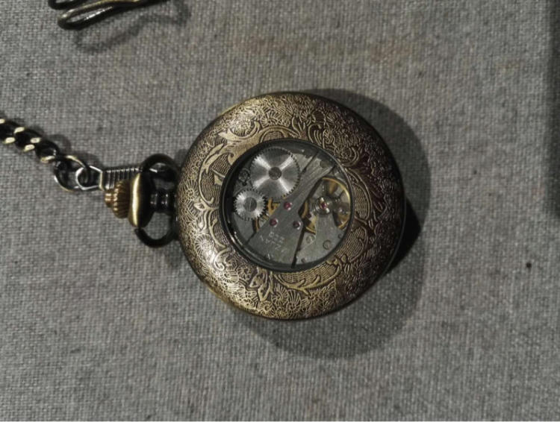
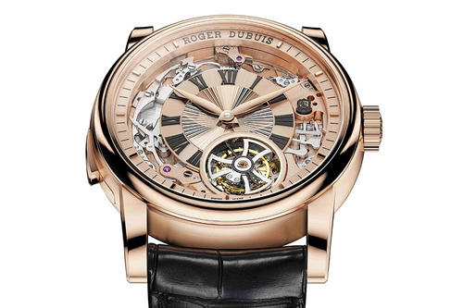
购买配饰时常用的英语词汇与表达
I also want to see some men’s digital watches.
（我还想看一些男士数字手表。）
digital watches：数字手表
a wrist watch 腕表
a pocket watch 怀表
a dress watch正装表
a sports watch运动手表
a mechanical watch 机械表

Slide 19
购买配饰时常用的英语词汇与表达
It’s discounted to $250.（这一块打折后是250美元。）
discount to：打折至…，后接“打折后的价格”。
discount by：打折了多少
These items will be discounted by ten percent next week.
（这些商品下周将会打九折。）

Slide 20
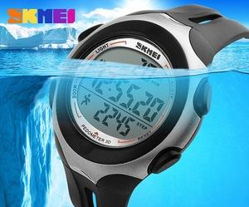
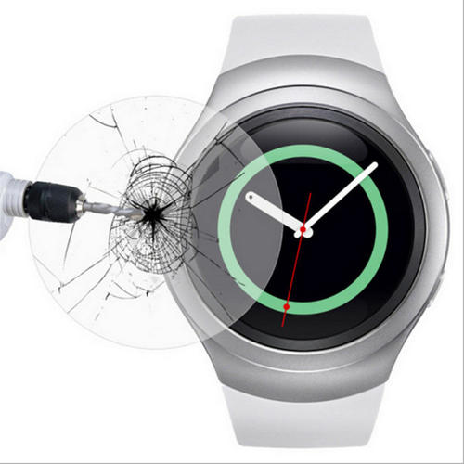
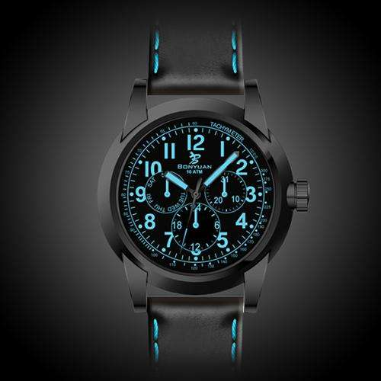
购买配饰时常用的英语词汇与表达
It’s water-resistant to 100 meters and comes with a full warranty.
（它防水深度是100米，还附有完全保证书。）
water-resistant/rɪ'zɪstənt/：a．防水的
waterproof/'wɔ:təpru:f/：a．防水的
shockproof/'ʃɒkpruf/：a.防震的
luminous/'lu:mɪnəs/：a.发光的；发亮的

Slide 21
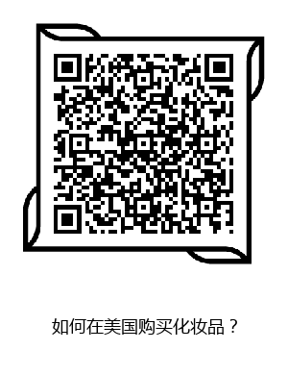
国外购买化妆品的攻略
购买化妆品攻略：
事先做功课，官网查价格；
购买渠道很重要，保真安全是王道；
品牌特色要知道，优惠省钱有妙招。

Slide 22
国外购买化妆品---情景会话
Buying cosmetics
Customer: I need to update my cosmetics for summer. Can you recommend something for dry, sensitive skins? Sometimes I also get a few pimples.
Assistant: This is a new complete skin care package. It comes with a mild creamy cleanser and a day cream which is suitable for acne-prone skin.
Customer: Does the day cream have any sun protection?
Assistant: It has an SPF 15 in it. You apply the moisturizer to your skin and your face every morning after cleansing.

Slide 23
国外购买化妆品---情景会话
Customer: Thanks. I also need a new foundation as well.
Assistant: This is a new foundation from Dior. It has a loose powder and comes in a variety of shades. This lengthening mascara is very popular, too.
Customer: Thanks. I'll take the skin care package and the mascara.
Assistant: OK, it comes to $80. Here is a complimentary sample of the latest perfume from Dior. It has a lovely light scent which is perfect for summer.

Slide 24
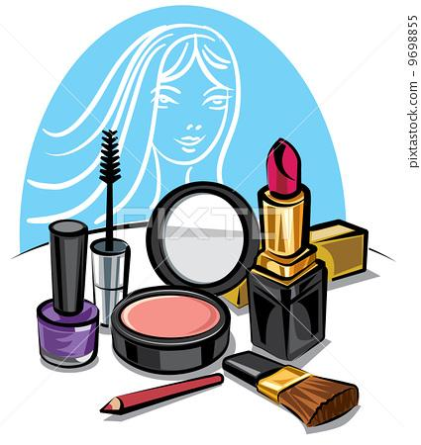
购买化妆品时常用的英语词汇与表达
I need to update my cosmetics for summer.
（我需要更新夏天用的化装品。）
cosmetic/kɒz'metɪk/：n.化妆品
Can you recommend something for dry, sensitive skins?
（对于干性和敏感性皮肤，您能推荐什么呢？）
sensitive/'sensɪtɪv/：a.敏感的；易受影响的；易受伤害的dry, sensitive skins：干性和敏感性皮肤

Slide 25
购买化妆品时常用的英语词汇与表达
肌肤类型的英语表达：
oily/'ɒɪlɪ/skin：油性肌肤
normal/'nɔ:m(ə)l/ skin：中性皮肤
combination/kɒmbɪ'neɪʃ(ə)n/ skin：混合型皮肤
combination to oily skin：混合偏油性肌肤
Sometimes I also get a few pimples.
（有时我还长痘痘。）
pimple/'pɪmp(ə)l/：n.粉刺，小脓疱
acne/'ækni/：n.痤疮；粉刺

Slide 26
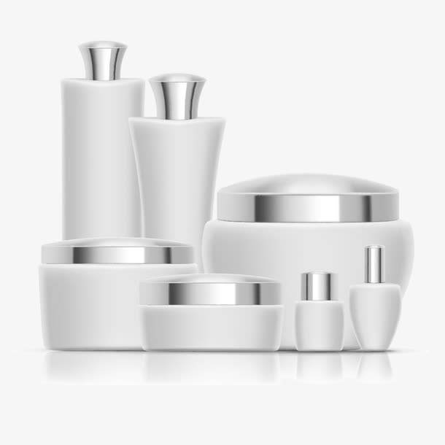
购买化妆品时常用的英语词汇与表达
This is a new complete skin care package.
（这是一套护肤套装。）
skin care：皮肤护理
package/'pækɪdʒ/：n.一整套东西
It comes with a mild creamy cleanser and a day cream which is suitable for acne-prone skin.
（它包括一个柔和的洁面乳和一个日霜，非常适合容易长痘痘的肌肤。）
mild/maɪld/：a.温和的；柔和的
creamy/'kri:mi/：a.乳脂状的
cleanser/'klenzə(r)/：n.洁面乳
Notes:
如果你不能确定面料的材质，可以向店员进行确认，可以说：

Slide 27
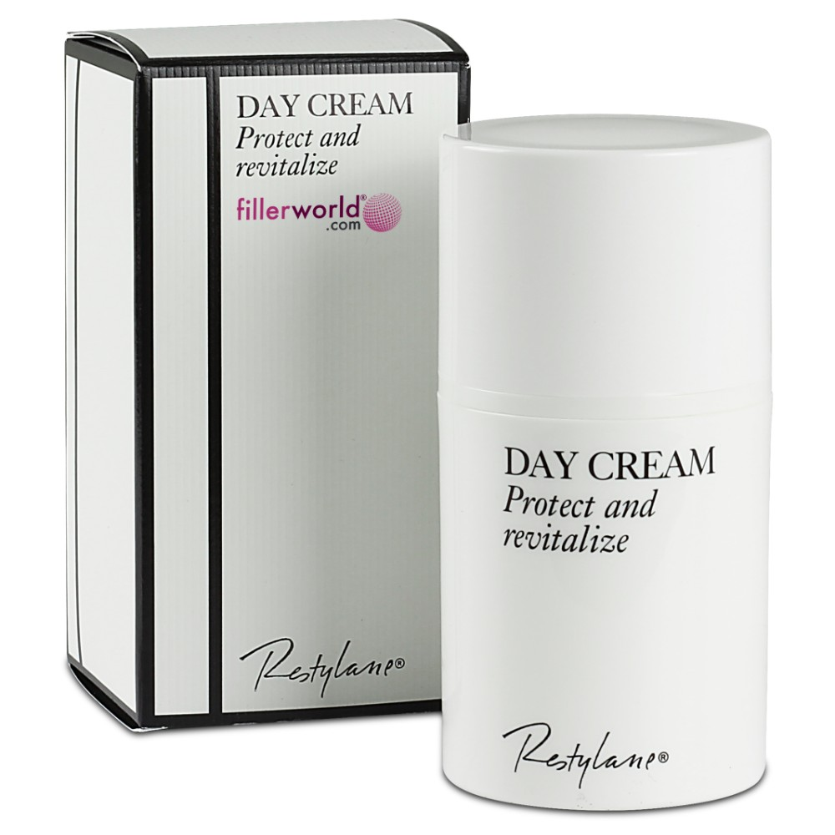
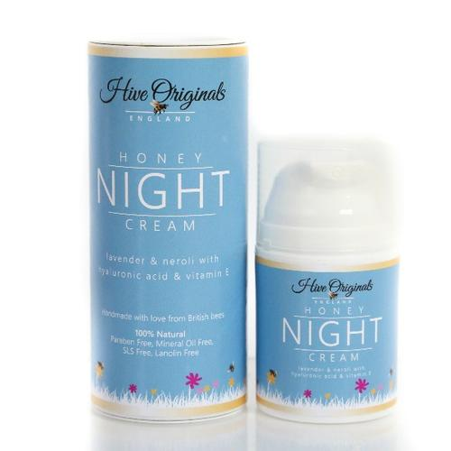
购买化妆品时常用的英语词汇与表达
cream/kri:m/：n.面霜
a day cream：日霜
a night cream：晚霜
acne-prone：易长粉刺的，易长痘痘的

Slide 28
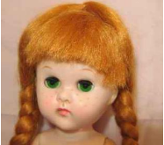
购买化妆品时常用的英语词汇与表达
Does it help to get rid of pimples?
（这个对祛痘有效吗？）
What kind of product can fade freckles?
（什么产品可以淡化雀斑？）
fade/feɪd/：v.使褪色
freckle/'frekəl/：n.雀斑

Slide 29
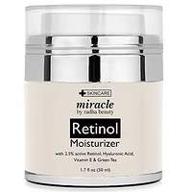
购买化妆品时常用的英语词汇与表达
Could you introduce some whitening products for me?
（您能给我介绍一些美白产品吗？）
Could you tell me more about your moisturizers?
（您可以给我多说一下你们的保湿产品吗？）
moisturizer/'mɔɪstʃəraɪzə(r)/：n.保湿霜，润肤霜

Slide 30
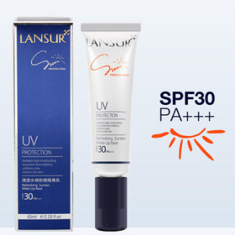
购买化妆品时常用的英语词汇与表达
It has SPF 15 in it.
（它里面含有15的防晒系数。）
SPF：Sun protection factor的缩写；
防晒系数，防晒指数
表示防晒护肤产品对紫外线防护能力的大小。

Slide 31
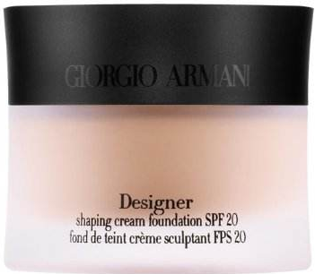
购买化妆品时常用的英语词汇与表达
You apply the moisturizer to your skin and your face every morning
after cleansing.
（每天早晨清洁完以后，您把这个保湿霜涂抹在您的肌肤上和脸上。）
apply/ə'plaɪ/：v.涂，敷
apply sth. to…：在……处涂抹……
I also need a new foundation.（我还需要一个新的粉底霜。）
foundation/faʊn'deɪʃn/：n.粉底霜

Slide 32
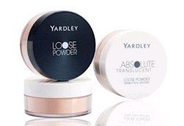
购买化妆品时常用的英语词汇与表达
What do you have in foundation?
（你们都有哪些粉底？）
I’d like to buy a foundation with sun protection.
（我想买一个有防晒功效的粉底。）
It has a loose powder and comes in a variety of shades.
（它有一个散粉，而且有各种色调。）
a loose powder：散粉
shading powder：散粉

Slide 33
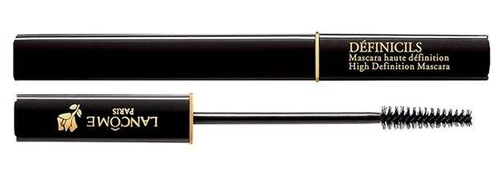
购买化妆品时常用的英语词汇与表达
This lengthening mascara is very popular, too.
（这个有加长效果的睫毛膏也非常受欢迎。）
mascara/mæ'skɑ:rə/：n.睫毛膏
Here is a complimentary sample of the latest perfume from Dior.
（这是一件免费赠送的样品，是迪奥最新款的香水。）
complimentary/kɒmplɪ'ment(ə)rɪ/：a.赠送的
sample/'sɑ:mp(ə)l：n. 样品
perfume/'pɜ:fju:m/：n. 香水

Slide 34
购买化妆品时常用的英语词汇与表达
It has a lovely light scent which is perfect for summer.
（它有一股美妙的淡淡的清香，非常适合在夏天使用。）
lovely/'lʌvli/：a.有吸引力的；迷人的
light/laɪt/：a.清淡的
scent/sent/：n.香气；香味
be perfect for：对……是完美的，对……是适合的，对……是理想的

Slide 35
购买纪念品时注意事项

Slide 36
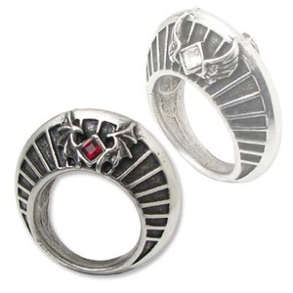
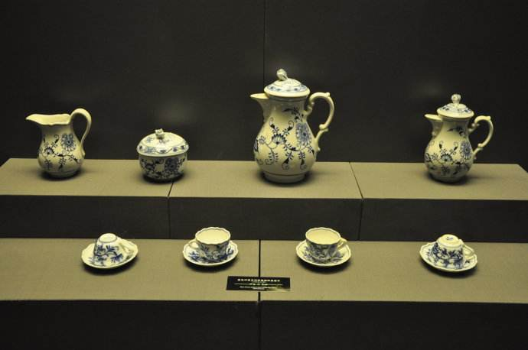
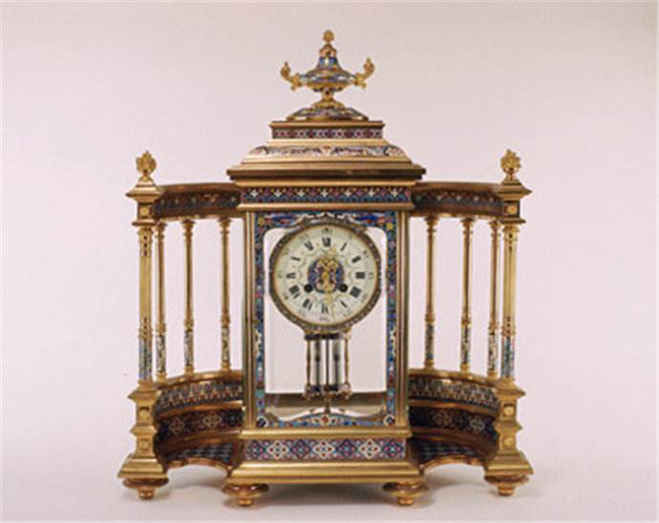
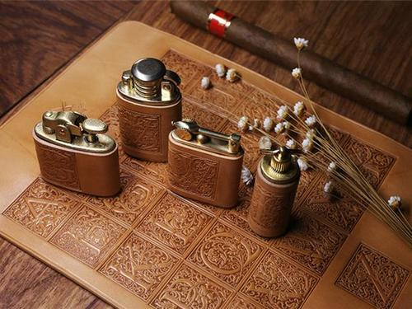
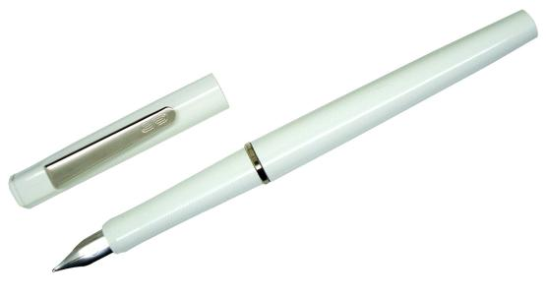
购买纪念品时注意事项
传统收藏品是不错的旅行纪念品
历史悠久的金银首饰铺里，定制一条项链或者一枚戒指
法国、德国、英国都出产质量不错的瓷器，价格不算太高：

Slide 37
购买纪念品---情景会话
Buying Souvenirs
Customer: I want to buy some good quality souvenirs to take back to Beijing with me. Do you have any suggestions?
Assistant: These are great handicrafts made by the local women. They are typical of sort of things that have been made here for hundreds of years.
Customer: They are very beautiful. But they look a bit delicate. I want to buy things that won’t be damaged during the flight.

Slide 38
购买纪念品---情景会话
Assistant: I can wrap them especially for you. They are unique and you won’t find them anywhere else.
Customer: Oh, these key chains are rather cute.
Assistant: The patterns resemble souvenirs from this area. They are very unique.
Customer: My cousin collects key chains. Do you have some suggestions?
Assistant: These ones have pictures of the beaches around here. They are great gifts because they are light and easy to carry in your luggage.

Slide 39
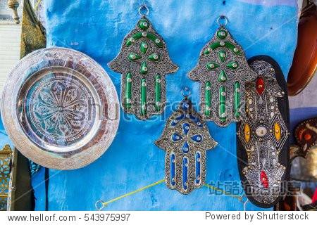
购买纪念品时常用的英语词汇与表达
souvenir/,su:və'nɪə/：n.纪念品
I want to buy some good quality souvenirs to take back to Beijing with me.
（我想买一些高质量的纪念品带回北京。）

Slide 40
购买纪念品时常用的英语词汇与表达
Do you have any suggestions?（您能给我一些建议吗？）
Is there anything special you can recommend?
（您有什么特别的东西可以推荐的吗？）
What souvenirs can you recommend?
（您可以给我推荐一下纪念品吗？）
What do you recommend as a souvenir from this country?（这个国家有什么值得推荐的纪念品？）

Slide 41
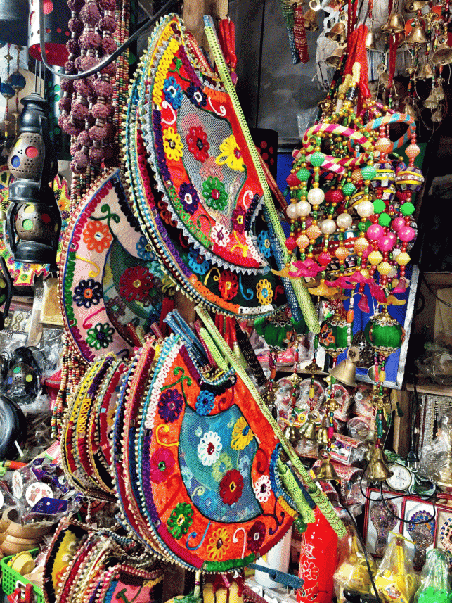
购买纪念品时常用的英语词汇与表达
These are great handicrafts made by the local women.
（这些都是当地妇女制作的很不错的手工艺品。）
handicraft/'hændɪkrɑ:ft/：n.手工艺品

Slide 42
购买纪念品时常用的英语词汇与表达
They are typical of sort of things that have been made here for hundreds of years.
（手工艺品都是典型的那种在本地有数百年制作历史的东西。）
typical/'tɪpɪk(ə)l/：a.典型的，特有的
sort of：有几分地，到某种程度
hundreds of：（形容数量众多）成百上千的，数以百计的
当hundred和具体的数字连用时一般用单数，后不接介词of。
two hundred dollars：200美元

Slide 43
购买纪念品时常用的英语词汇与表达
They look a bit delicate.（它们看上去有点容易损坏。）
look：（连系动词）看起来；
a bit：一点儿，有一点儿；
delicate/'delɪkət/：a.易碎的

Slide 44
购买纪念品时常用的英语词汇与表达
I want to buy things that won’t be damaged during the flight.
（我需要买在飞行途中不会破坏的东西。）
Where can I buy the local products that are easy to carry? （哪里可以买到方便携带的特产？）
Is this local products hard to preserve?
（这个特产容易保存吗？）
preserve/prɪ'zɜːv/：v.保存
Is this easy to transport? （这个运输方便吗？）

Slide 45
购买纪念品时常用的英语词汇与表达
They are great gifts because they are light and easy to carry in your luggage.
（它们是很好的礼物，因为它们很轻，也容易放在您的行李包里携带。）
easy to carry：便于携带
luggage/'lʌɡɪdʒ/：n.行李
luggage一般是不可数名词；
How many pieces of luggage have you got?（你有几件行李? ）

Slide 46
感谢聆听
logo
THANKS FOR LISTENING

