Slide 1
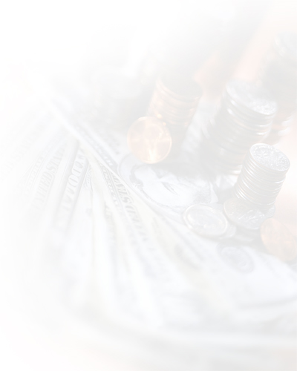
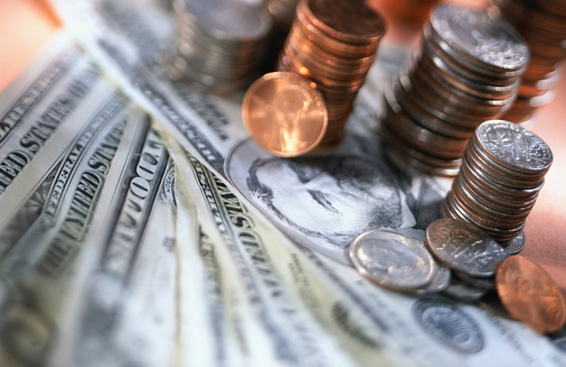
Unit 4
新职业英语
职业综合英语 2
ENGLISH FOR CAREERS
Unit 4
Money

Slide 2

Contents
1
Warming-up
5
Writing
2
Reading A
6
Mini-project
7
Reading B
7
Language Lab
3
Language Lab
4
7
Listening & Speaking
8
Language Lab
Entertainment
< Back
Next >
Home

Slide 3
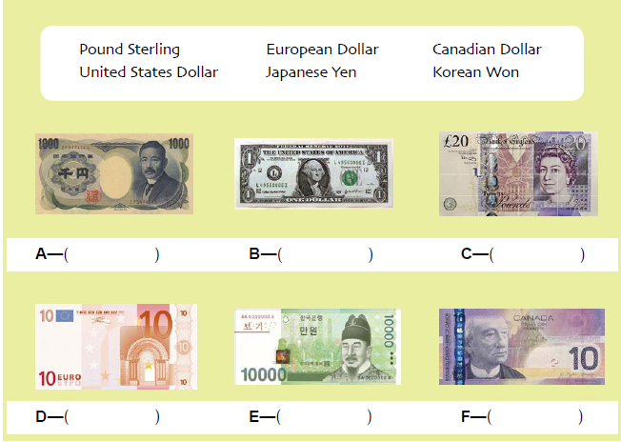
Warm-1
Warming-up
Task 1 Match the following currencies with their names. (Notes)
Japanese Yen
United States Dollar
Pound Sterling
European Dollar
Korean Won
Canadian Dollar
< Back
Next >
Home

Slide 4

Notes-1
Pound Sterling 英镑
European Dollar 欧元
Canadian Dollar 加拿大元
United States Dollar 美元
Japanese Yen 日元
Korean Won 韩国元
根据中国银行2010 年12 月31 日外汇牌价
1 英镑 ≈ 10.31 人民币元
1 美元 ≈ 6.62 人民币元
100 日元 ≈ 7.97人民币元
1 加拿大元 ≈ 6.66人民币元
1 欧元 ≈ 8.58 人民币元
100 韩国元 ≈ 0.57 人民币元
< Back

Slide 5
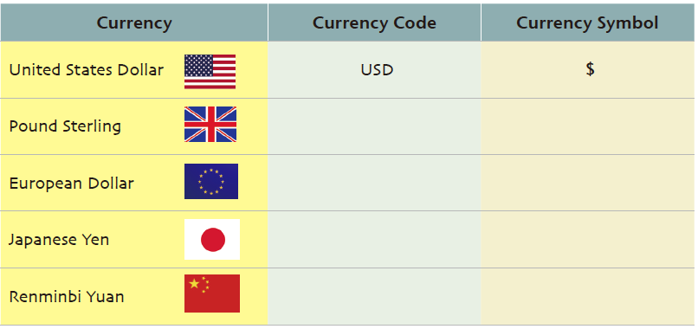
Warm-2
Warming-up
Task 2 Complete the table with appropriate currency codes and symbols.
GBP
£
EUR
€
JPY
¥
CNY/RMB
￥
< Back
< Back
Next >
Home

Slide 6
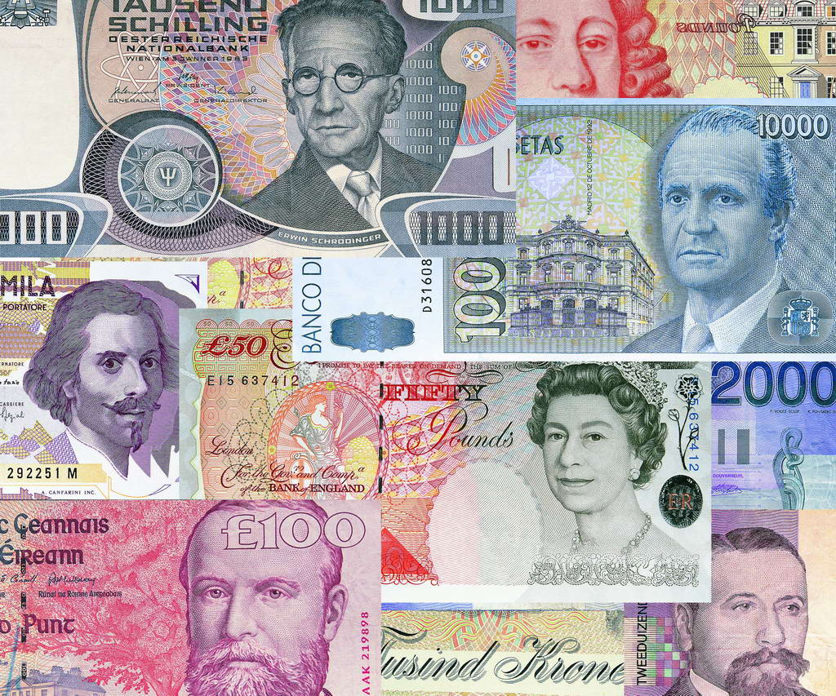
Notes-2
Notes
currency code: 货币代码
currency symbol: 货币符号
< Back

Slide 7
Reading A
Reading A
Text
Task 1
Task 2
Task 3
Business Know-how

Slide 8
Text A-1
Reading A
声音
翻译
The First Credit Card
1 Charging for products and services has become a way of life. No longer do people bring cash when they buy a sweater or an appliance, they charge it. Some people do it for the convenience of not carrying cash; others do it so they can purchase an item they cannot yet afford. The credit card that allows them to do this is a 20th century invention.
< Back
Next >
Home

Slide 9
Text A-2
Reading A
声音
翻译
2 In the early 20th century, charge accounts became popular. With automobiles and airplanes, people now had the option to travel to a variety of stores for their shopping needs. In an
effort to capture customer loyalty, many stores and gas stations began to offer charge accounts for their customers which could be accessed by a card. Unfortunately, people needed to carry dozens of these cards if they were to do a day of shopping.
< Back
Next >
Home

Slide 10
Text A-3
Reading A
声音
翻译
3 A credit card that could be used at multiple stores was not invented until 1950. It all started when Frank McNamara, head of the Hamilton Credit Corporation, and two of his friends went out
to supper to discuss a problem customer in 1949.
4 This particular customer had lent a number of his charge cards to his poor neighbors who needed items in an emergency. For this service, the man required his neighbors to pay him back the cost of the original purchase plus some extra money. But many of his neighbors were unable to pay him back and he was forced to borrow money from the Hamilton Credit Corporation.
< Back
Next >
Home

Slide 11
Text A-4
Reading A
声音
翻译
5 At the end of the meal, McNamara was shocked to discover that he had forgotten his wallet. To his embarrassment, he had to call his wife and have her bring him some money.
6 Merging the two concepts from that dinner—the lending of charge cards and not having cash on hand to pay for the meal, McNamara came up with a new idea: a credit card that could be used at multiple locations. He discussed the idea with his two friends and they started a new company called the Diners Club in 1950.
< Back
Next >
Home

Slide 12
Text A-5
Reading A
声音
翻译
7 Instead of individual companies offering credit to their own customers, the Diners Club offered credit to individuals for many companies. The companies who accepted the Diners Club credit card were charged 7 percent for each transaction while the subscribers to the card were charged a $3 annual fee. In the beginning, progress was difficult. However, the concept of the card grew and by the end of 1950, 20,000 people were using the Diners Club credit card.
< Back
Next >
Home

Slide 13
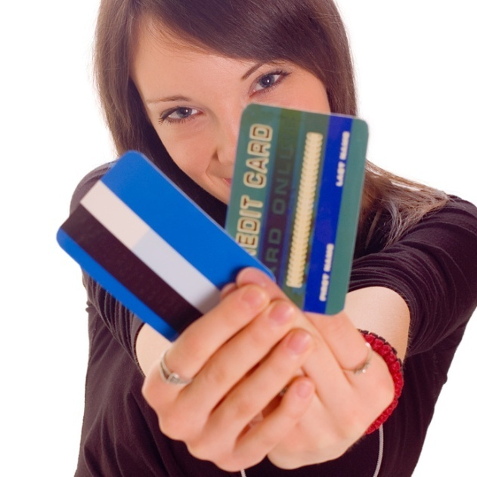
Text A-6
Reading A
声音
翻译
8 The Diners Club credit card continued to grow more popular and didn’t receive competition until 1958. In that year, both American Express and VISA arrived. The concept of a universal credit card had taken root and quickly spread across the world.
< Back
Next >
Home

Slide 14
A-Trans-1
Reading A
第一张信用卡
1 记账购买产品和服务已成为一种生活方式。人们不再带现金去购买毛衣或电器，而是记账消费。有些人这么做是因为不带现金很方便，另一些人则是因为可以购买自己暂时买不起的东西。人们之所以能这么做是因为有了信用卡——一项 20 世纪的发明。
< Back

Slide 15
A-Trans-2
Reading A
2 20世纪早期，记账账户流行了起来。有了汽车和飞机，人们可以选择去很多不同的商店以满足购物需求。为了赢得顾客忠诚度，许多商店和加油站开始为顾客提供记账账户，账户通过一张卡来使用。遗憾的是，人们要想逛一天街，那就得带上许多这样的卡。
< Back

Slide 16
A-Trans-3
Reading A
3 能够在多个商家使用的信用卡直到1950年才问世。这一切都起源于1949年的一天，哈米尔顿信用公司老板弗兰克·麦克纳马拉和两位朋友出去吃晚饭，商讨一个问题客户的事情。
4 这位客户将多张签账卡借给了他那些急需购物的穷邻居。为此，他要求那些邻居除了偿还所购物品的原价之外再给点额外费用。但他们中大多数都无力偿还，结果他只好从哈密尔顿信用公司借款。
< Back

Slide 17
A-Trans-4
Reading A
5 饭吃完了，麦克纳马拉发现自己竟忘了带钱包。他不得不尴尬地打电话给妻子，让她送钱来付账。
6 那顿晚餐中有两点——外借记账卡和没有现金付饭钱——让麦克纳马拉产生了一个新念头：发行一种能在多家商店使用的信用卡。他与两位朋友商量后，于1950年共同创办了一家名叫食客俱乐部的公司。
< Back

Slide 18
A-Trans-5
Reading A
7 与每家公司独自为其顾客提供信用不同的是，食客俱乐部代表多家公司为个人提供信用。接受食客俱乐部信用卡的公司每笔交易缴纳7%的手续费，信用卡使用者则须缴纳3美元的年费。起初，这项业务举步维艰。然而，这种信用卡概念逐渐普及开来。到了1950年底，已有两万人在使用食客俱乐部的信用卡。
< Back

Slide 19
A-Trans-6
Reading A
8 食客俱乐部信用卡越来越流行，直到1958年才面临竞争对手。那年，美国运通卡和维萨信用卡问世。从此，通用信用卡的概念深入人心并迅速传遍整个世界。
< Back

Slide 20
charge for
Reading A
to ask for an amount of money for goods or service
e.g. What did they charge for the repair？
Tran: 餐馆向这个就餐者收费20英镑。
The restaurant charged 20 pounds for
the dinner.
< Back

Slide 21
purchase
Reading A
v. to buy something
e.g. The equipment can be purchased from your local
supplier.
e.g. Please insure that you purchase your tickets for the film in advance.
Tran: 他们花了一百万美元购买了这块土地 .
They purchased the land for $1
million.
Next >

Slide 22
purchase
Reading A
n. the act or process of buying something
e.g. This company has just announced its $3 million
purchase for Park Hotel.
e.g. If you are not satisfied with your purchase, we will give you a full refund.
Tran: 留好收据作为你的购买凭据。
Keep your receipt as proof of your
purchase.
< Back

Slide 23
charge account
Reading A
credit extended by a business to a customer
e.g. My father has just bought a new house on his
charge account.
Tran: 我习惯用赊购账户购买我的日用必需品.
I am used to buying my daily
necessities on my charge account.
< Back

Slide 24
option
Reading A
n. the freedom to choose what you do; something that you
can choose to have or do
e.g. As I see it, we have two options.
e.g. There are various options open to you.
Tran: 对于我来说上大学不是一个选择。
Going to university is not an option
for me.
< Back

Slide 25
capture
Reading A
v. to succeed in getting control of someone or something that other people are also trying to control
e.g. The novel captured the imagination of thousands of
readers.
e.g. The American drive to land a man on the moon captured the attention of the whole world.
Tran: 这家公司已经占据了当地市场90%的份额。
The company has now captured over
90% of the local market.
< Back

Slide 26
access
Reading A
v. to reach, enter or use something
e.g. At the moment, the site can be accessed only by PCs running Windows.
e.g. Bank customers can access their checking accounts
instantly through the electronic system.
Tran:道路已被封锁，只有紧急车辆可以通行。
The road is closed but can be accessed by emergency vehicles.
< Back

Slide 27
multiple
Reading A
a. many in number; involving many different people or things
e.g. I have made multiple copies of documents for the participants of the meeting.
Tran: 我申请到了多次往返签证。
I have got a multiple-entry visa.
< Back

Slide 28
original
Reading A
a. existing at the beginning of a particular period, process or activity
e.g. The hotel still has many of its original features.
e.g. The original picture is in the British Museum.
Tran: 我觉得你应该回到你最初的方案。
I think you should go back to your
original plan.
< Back

Slide 29
embarrassment
Reading A
n. shy, awkward or guilty feelings
e.g. Much to her embarrassment, she realized that
everybody had been listening to her singing.
Tran: 他的辞职让公司非常难堪。
His resignation will be a severe
embarrassment to the company.
< Back

Slide 30
embarrass
Reading A
to make someone feel shy, awkward, especially in a social
situation
e.g. Her question about my private life embarrassed me in the public.
Tran: 我不想在他的朋友面前亲吻他，那样会让他发窘。
I didn’t want to embarrass him by
kissing him in front of his friends.
< Back

Slide 31
merge
Reading A
v. to combine or make two or more things combine to form a single thing
e.g. Fact and fiction merge together in his latest novel.
e.g. The villages expanded and merged into one large
town.
Tran: 他的部门和我的部门将会合并在一处。
His department will be merged with
mine.
< Back

Slide 32
concept
Reading A
n. an idea or a principle that is connected with something
e.g. The concept of social class is at the very core of his theory.
e.g. It is difficult to grasp the concept of infinite space.
Tran: 我不能够理解抽象的概念。
I cannot understand the abstract
concept.
< Back

Slide 33
on hand
Reading A
close by and ready when needed
e.g. The emergency services were on hand with medical advice.
Tran: 如果你需要的话，护士会马上过来。
The nurse will be on hand if you need
her.
< Back

Slide 34
individual
Reading A
a. considered separately rather than as part of a group
e.g. The minister refused to comment on the individual case.
Tran: 我们采访了社区里每一个成员。
We interviewed each individual
member of the community.
< Back

Slide 35
transaction
Reading A
n. a piece of business that is done between people, especially an act of buying or selling
e.g. We have not arranged financial transactions with those companies.
e.g. His failure in this transaction was due to nothing else than his own carelessness.
Tran: 你做完这单生意后想干些什么？
What do you want to do after you
have concluded this transaction?
< Back

Slide 36
subscriber
Reading A
n. a person who pays regularly to receive a service.
e.g. Are you a pay TV service subscriber?
e.g. The subscriber you dialed is power-off; please redial it later.
Tran: 这个杂志正努力扩大它的征订者。
The magazine is trying to get more
subscribers.
< Back

Slide 37
universal
Reading A
a. done by or involving all the people in the world or in a
particular group
e.g. Such problems are a universal feature of old age.
e.g. Agreement on this issue is almost universal.
Tran: 音乐被称为人类共同的语言。
Music has been called the universal
language of human beings.
< Back

Slide 38
take root
Reading A
(of an idea) to become accepted widely; (of a plant) to develop roots
e.g. The concepts of democracy and free trade are
finally beginning to take root.
e.g. Many European customs failed to take root in some
Asian countries.
Tran: 没有雨水，植物不能扎根。
Plants cannot take root for lack of
water.
< Back

Slide 39
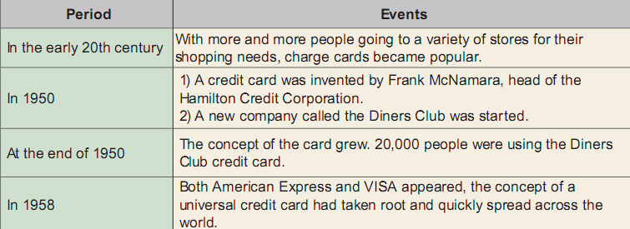
A-Task 1
Reading A
Task 1 Read the passage and fill in the table with important events in the development of credit cards.
< Back
Next >
Home

Slide 40
A-task 2
Reading A
Task 2 Correct the following statements according to the
passage. An example has been given.
In the early 20th century credit cards became popular.
charge accounts
2. Charge accounts could be accessed by cash.
a card
3. Credit cards which could be used at a single merchant was
invented in 1950.
4. The Diners Club offered charge accounts to individuals
for many companies.
5. The subscribers to the card were charged $3 each month.
year
6. By 1958, the concept of a universal credit card had taken root
and quickly spread across the country.
multiple merchants
credit
world
< Back
Next >
Home

Slide 41
Reading A
Task 3 Form a group to discuss the advantages and
disadvantages of credit cards, and then report to your class.
Try to relate your discussion to your personal experience and
the information you get from the passage.
Advantages | Disadvantages
convenience and safety (you
don’t have to carry large
amounts of cash)
buying on credit (you can buy something on your credit card and pay off the debt later)
building a good credit history
additional benefits such as free airline miles or travel discounts
overspending
high interest rates (if you don’t pay off your balance on time)
credit card fraud (your credit card number may be stolen)
< Back
Next >
Home

Slide 42

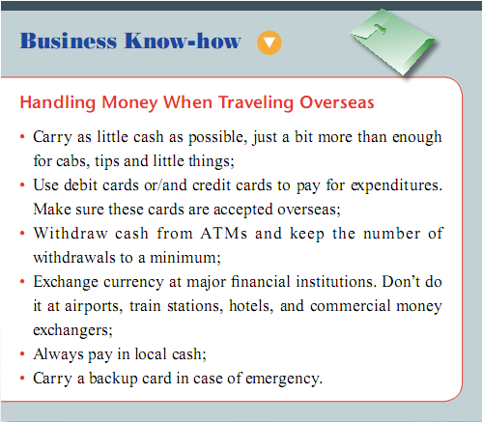
Business know-how
Business Know-how
Handling Money When Traveling Overseas
< Back
Next >
Home

Slide 43
Reading B
Reading B
Text
Task 1
Task 2

Slide 44
Text B-1
Reading B
翻译
NCB (China) Online Banking Services
Nanyang Commercial Bank (China) is committed to providing our customers with “one-stop” banking solution. What is more, you can conveniently access a range of financial services via our Internet banking platform anytime, anywhere!
● Free and trouble-free service
Simply by opening an RMB or foreign currency account at any of our branches or sub-branches, you will be entitled to our 24-hour Internet banking service. With a single Internet banking number, you can conduct various transactions for all accounts under your name without additional costs.
< Back
Next >
Home

Slide 45
Text B-2
Reading B
翻译
● Convenient and reliable transaction channel
With the use of widely-recognized encryption security technology and mobile dynamic password service, our Internet banking offers you complete peace of mind.
Two-factor authentication
* First-factor authentication—log in password
The password is required to log in the Internet banking website.
< Back
Next >
Home

Slide 46
Text B-3
Reading B
翻译
* Second-factor authentication—mobile dynamic password
With the mobile dynamic password security feature, when you perform an important operation through Internet banking (e.g. transferring funds), a text message with a dynamic password will be sent directly to your mobile phone. You must then enter the mobile dynamic password in order to complete the transaction.
* SMS Service Number: 00852 6450 1333
< Back
Next >
Home

Slide 47
Text B-4
Reading B
翻译
● Service scope
Banking services
—Account balance inquiry of savings deposit, fixed deposit,
current account and mortgage account
—Access to banking transaction details and remittance status
—Money transfer and remittance
—Fixed deposit service
—Call deposit service
—Foreign currency trading
Financial information
—Inquiry of deposit interest rates and foreign currency
exchange rates
< Back
Next >
Home

Slide 48
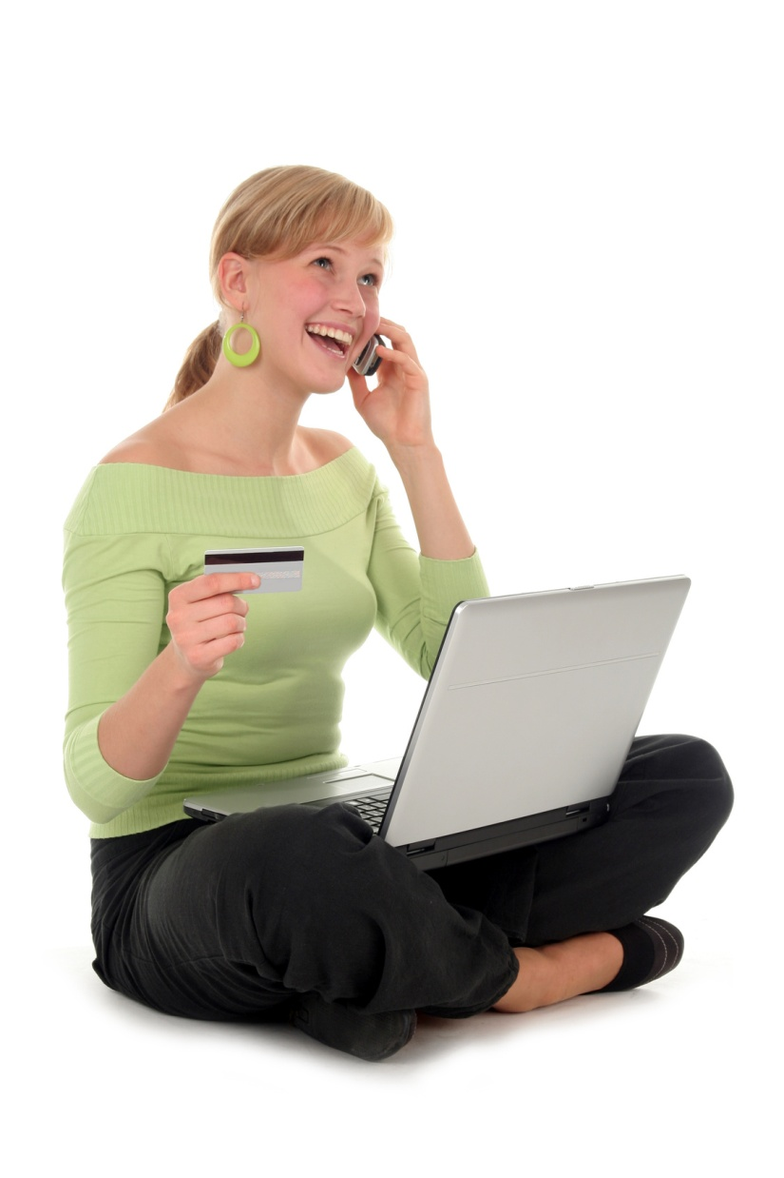
Text B-5
Reading B
翻译
Account setting
—Management of your registered
account and other third-party
accounts, adjustment of transfer limit.
Others
—Request for bank statement and change
of Internet banking password
< Back
Next >
Home

Slide 49
B-Trans-1
Reading B
南商（中国）银行
南商（中国）致力为客户提供“一站式”的银行服务。此外，您更可通过我们的网上服务平台，随时随地便捷地享用多元化的银行服务。
免费自由 易用放心
您只需在我们的任何一家分行或支行开设人民币或外币账户，便可享用 24 小时网上银行服务。通过一个网上银行账号，您就能对名下所有账户进行多种交易操作，而这一切无需任何附加费用。
< Back

Slide 50
B-Trans-2
Reading B
快捷方便 安全可靠
我们的网上银行采用了国际认可标准的安全加密技术，结合动态密码技术，让您倍感安心。
双重认证
* 第一重认证——登录密码
您须通过密码登录网上银行站点。
< Back

Slide 51
B-Trans-3
Reading B
* 第二重认证——动态密码
通过动态密码安全技术，当您通过网银进行转账汇款等重要交易时，动态密码将以短信形式发送到您的移动电话。您则须输入动态密码来完成交易。
* 短信服务号码：00852 6450 1333
< Back

Slide 52
B-Trans-4
Reading B
网上银行服务范围
理财服务
——查询账户余额，包括活期存款、定期存款、支票存款及按揭账户
——查询交易详情及汇款记录
——转账、汇款服务
——定期存款服务
——通知存款服务
——外汇买卖
财经资讯
——查询存款利率及外汇牌价
< Back

Slide 53
B-Trans-5
Reading B
账户设定
——管理个人及第三方账户、设定转账额度
其他服务
——申请月结单、更改网上银行密码
< Back

Slide 54
B-Task-1
Reading B
Task 1 Decide whether the following statements are true (T) or false (F) according to the passage.
F
1. When conducting transactions through Internet banking, you have to pay extra fees.
2. The Internet banking only works during office hours of the bank.
3. The mobile dynamic password will be sent to your mobile phone via a text message.
4. Foreign currency exchange rates cannot be inquired through Internet banking.
5. You can adjust your transfer limit through Internet banking.
F
T
F
T
< Back
Next >
Home

Slide 55
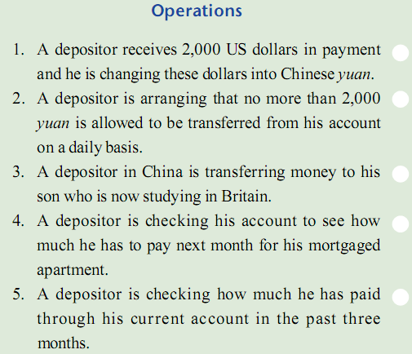
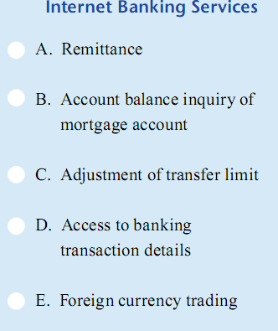
B-Task-2
Reading B
Task 2 Match the operations in the left column with the Internet
banking services provided by NCB in the right column.
< Back
Next >
Home

Slide 56
Listening
Listening & Speaking
Task 1
Task 2
Task 3
Task 4
Task 5
Task 6

Slide 57
L-Task 1
Listening & Speaking
Task 1 Mr. Moor is opening an account at a bank. Listen to the
conversation and choose the best answer to each question
you hear.
A. Fixed deposit account.
B. Current account.
C. Company checking account.
D. Personal account.
A. 100 dollars.
B. 200 dollars.
C. 1,000 dollars.
D. 2,000 dollars.
A. Every time he writes a check.
B. When he writes a check with insufficient funds to his account.
C. If he writes more than 15 checks per month.
D. If he writes a check with an amount of less than 15 dollars.
声音
Script
< Back
Next >
Home

Slide 58
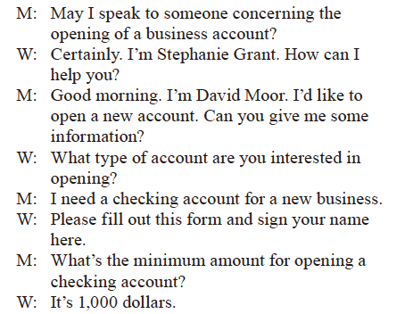
L-1-Script
Listening & Speaking
Task 1 Script
声音
Next >

Slide 59
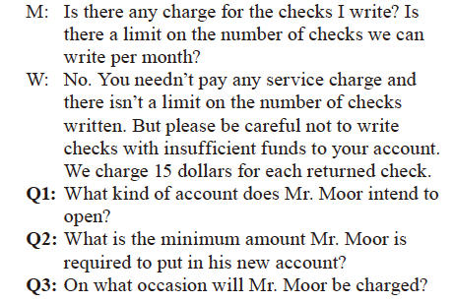
L-1-Script
Listening & Speaking
< Back

Slide 60
L-Task 2
Listening & Speaking
Task 2 Mr. Brown is talking with a clerk in a bank. Listen to
the conversation and answer the following questions.
1. How much unused RMB does Mr. Brown have?
He has _____________ yuan.
2. Why can’t Mr. Brown take the unused RMB back
to his home country?
Because _________________________.
What is the exchange rate between RMB and USD
in Mr. Brown’s memo?
It’s one US dollar to _____________ yuan.
42,000
it is a large sum of RMB
7
声音
Script
< Back
Next >
Home

Slide 61
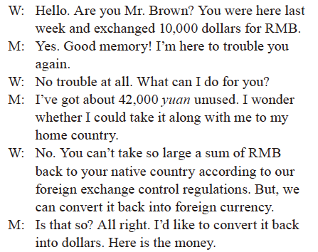
L-2-Script
Listening & Speaking
Task 2 Script
声音
Next >

Slide 62
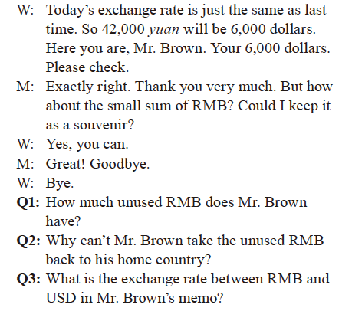
L-2-Script
Listening & Speaking
< Back

Slide 63
L-Task 3-1
Listening & Speaking
Task 3 Ms. Berg is cashing some travelers’ checks at a bank.
Listen to her conversation with a bank clerk and decide
whether the following statements are true or false. Then
write key words to support your answers.
1. Ms. Berg is already in China now.
True □ False □
_____________________________________________
2. Banks are better because they offer better exchange rates.
True □ False □
_____________________________________________
√
… for my visit here in China
√
… because we don’t add a service charge
声音
Script
< Back
Next >
Home

Slide 64
L-Task 3-2
Listening & Speaking
3. There is a bit difference between cashing travelers’
checks at hotels and at banks.
True □ False □
_____________________________________________
4. Ms. Berg needs to provide the bank with her passport
number.
True □ False □
_____________________________________________
√
… not very much.
√
I’ve already written down … your passport number for you
Script
< Back
Next >
Home

Slide 65
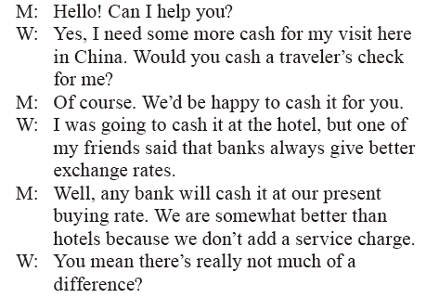
L-3-Script
Listening & Speaking
Task 3 Script
声音
Next >

Slide 66
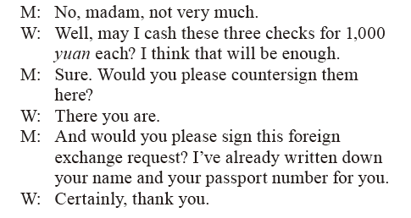
L-3-Script
Listening & Speaking
< Back

Slide 67
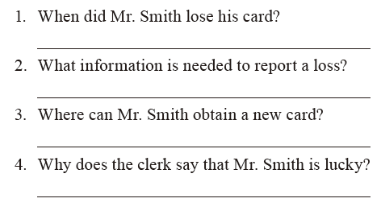
L-Task 4
Listening & Speaking
Task 4 Mr. Smith is reporting to a lost card to his bank. Listen
to the conversation and answer the following questions.
Mr. Smith lost his card yesterday.
Account name, account number and passport number.
Mr. Smith can renew his car at the card-issuing bank.
Because Mr. Smith’s money is still in his account.
声音
Script
< Back
Next >
Home

Slide 68
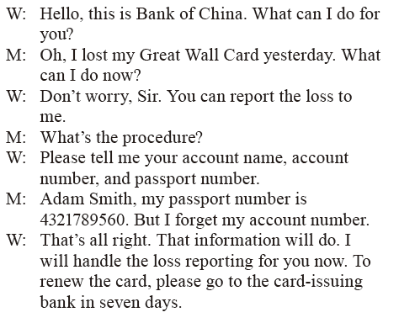
L-4-Script
Listening & Speaking
Task 4 Script
声音
Next >

Slide 69
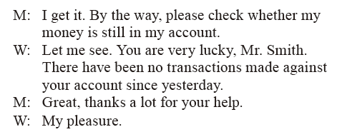
L-4-Script
Listening & Speaking
< Back

Slide 70
L-Task 5-1
Listening & Speaking
Task 5 Listen to the passage twice and fill in the blanks with
what you hear.
A few days ago, Ivan decided to add some money to his bank account via ATM. After he put $74, the ATM took the money and returned him a slip. _______________, the amount on the slip was $7,430,000. He got another slip—and still the amount was the same. So he decided to go to the bank and tell them about the mistake the ATM had made.
Ivan arrived at the bank and told a clerk his story, also showed a slip, but the clerk was not interested in the situation. “_________________________, buddy,” said the clerk to the 7 million dollars account holder. “Come back please some other time, I’ve got a lot of things to do right now.”
To his surprise
Many strange things happen
声音
< Back
Next >
Home

Slide 71
L-Task 5-2
Listening & Speaking
Ivan got offended with such a response. He ______________ the nearest ATM and started withdrawing the cash. He went from one ATM to another _______________________ of each one. He put all the money in big shoe boxes and afterwards took all those boxes to that bank clerk. He threw the boxes on the clerk’s desk. “What’s this?” asked the clerk. “It’s money. ________________.”
The clerk was really shocked. He called other bank workers and they all got greatly amazed by what they were presented. They took the money from the cardholder, and told him “thank you ” ______________________________.
went straight to
withdrawing the daily limit
Millions of dollars
for his courteous and unusual behavior
< Back
Next >
Home

Slide 72
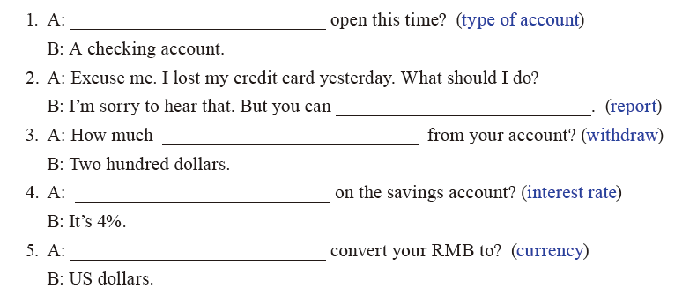
Listening & Speaking
Task 6 Complete the following mini dialogs with the help of the
words or phrases given in brackets.
What type of account would you like to/ What type of account do you need to
report it lost
would you like to withdraw/will you withdraw
What’s the interest rate
What currency would you like to
< Back
Next >
Home

Slide 73
Writing
Writing
Task 1
Task 2
Task 3

Slide 74
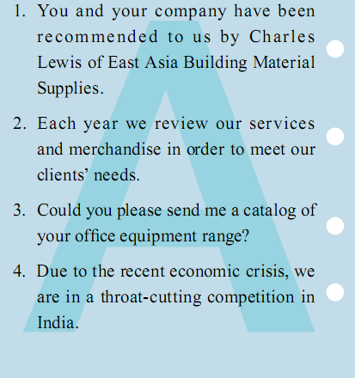
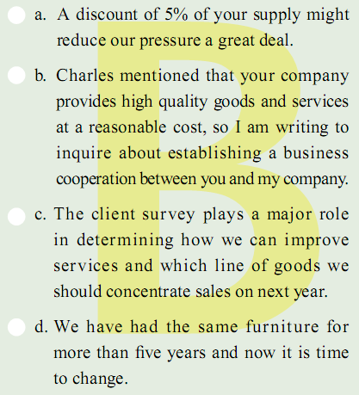
W-Task 1
Writing
Task 1 Match each sentence in Column A with the closely related one in Column B.
< Back
Next >
Home

Slide 75
W-Task 2
Writing
Task 2 Rearrange the order of the following sentences and
combine them into the body part of the request letter.
Dear Mr. Wang
Given our moderate cash reserves, we would like to apply
for a $200,000 line of credit with your company so as to avoid
unnecessary transaction delays.
Over the past several years, we have had a number of large
transactions with you on cash basis which, we are sure, have
adequately established our reputation.
If you should require an
additional reference, you have our permission to directly contact
Huaqiao Bank at 4567892 for details of our banking and credit
history.
Your early reply will be appreciated.
Yours sincerely,
Jason Bourne
Chief Finance Officer
< Back
Next >
Home

Slide 76
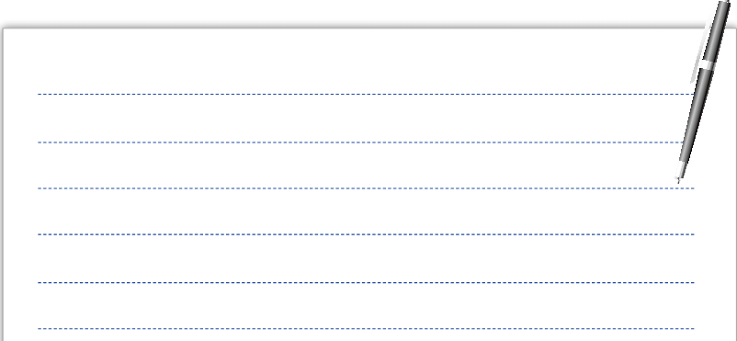
W-Task 3
Writing
Task 3 Shenzhen Twilight Company provides a scholarship for
those needy students to finish their education. Suppose
you want to apply for this scholarship. Please write a
request letter to obtain more information (e.g. the
qualifications, the application form and deadline for
application, etc.). Refer to the following expressions
when necessary.
< Back
Next >
Home

Slide 77
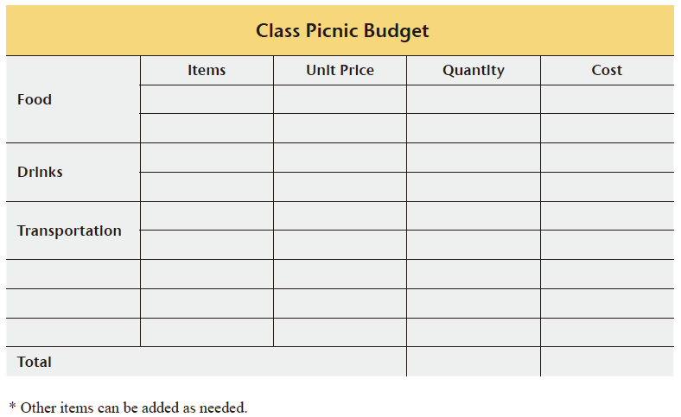
Mini
Mini-project
Your class is planning to have a picnic with some exchange students next Sunday. Altogether you have 40 persons and each person is supposed to contribute ¥30. Work in groups to make a budget for this event and report to your class.
< Back
Next >

Slide 78
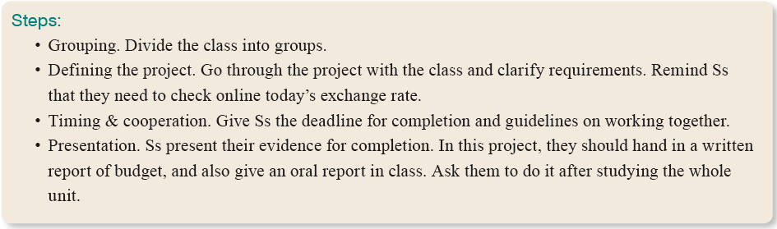
Reference
Mini-project
This project asks Ss to make a budget. In order to complete it successfully, Ss should use the knowledge and skills they have learned from other activities in the unit.
< Back
Next >

Slide 79
Language Lab
Language Lab
Task 1
Task 2
Task 3
Task 4
Task 5

Slide 80
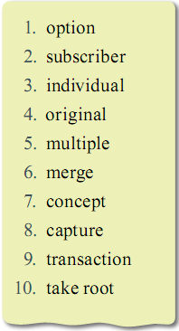
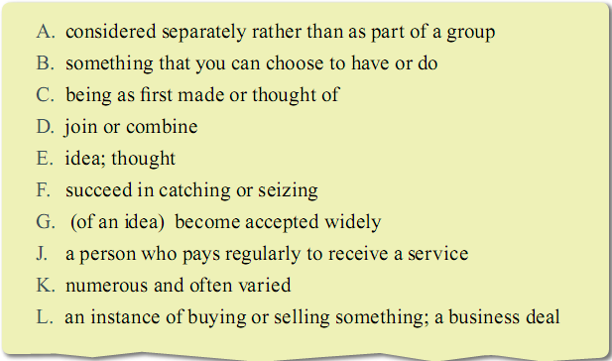
LL-Task 1
Language Lab
Task 1 Match the words on the left with their meanings on the right.
B
J
A
C
K
D
E
F
L
G
< Back
Next >
Home

Slide 81
LL-Task 2-1
Language Lab
Task 2 Complete the following sentences with the words from
Task 1. Change the form if necessary.
1. Cable television companies have launched major campaigns
to increase their number of ________________.
2. The big company ___________ various small businesses.
3. The ideas of parents usually _________ in their children.
4. We’ve discussed all the marketing ___________ and decided
to go for television advertising.
5. The _____________ settlers in North America are the
Indians.
subscribers
merged
take root
options
original
< Back
Next >
Home

Slide 82
LL-Task 2-2
Language Lab
6. The company’s new car is based on an environmentally
friendly __________.
7. She has her own _________ style of doing things.
The company is out to __________ the European
market.
9. We use the hall for ___________ purposes.
10.In order to conclude the __________, we accept your
price.
concept
individual
capture
multiple
transaction
< Back
Next >
Home

Slide 83

LL-Task 3
Language Lab
Task 3 Complete the sentences with the following words or phrases. Change the form if necessary.
1. Our staff are always _________ to help.
2. The government ___________________________________ supporting technology development.
3. The database allows you to ___________ the sales figures in a number of ways.
4. We won’t ______________ delivery if you pay now.
5. They’ve been working day and night ____________ get the products ready on time.
on hand
commits itself to/ is committed to
access
charge for
in an effort to
< Back
Next >
Home

Slide 84
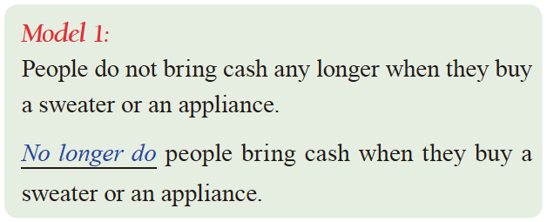
LL-Task 4 model 1
Language Lab
Task 4 Rewrite the following sentences after the models.
< Back
Next >
Home

Slide 85
LL-Task 4-1
Language Lab
I’ll never forget the day when I met that famous poet.
___________________________________________________
2. I have seldom seen such a remarkable creature.
___________________________________________________
3. We not only lost all our money, but also came close to closing our lives.
__________________________________________________
__________________________________________________
Never will I forget the day when I met that famous poet.
Seldom have I seen such a remarkable creature.
Not only did we lose all our money, but also we came close to losing our lives.
< Back
Next >
Home

Slide 86
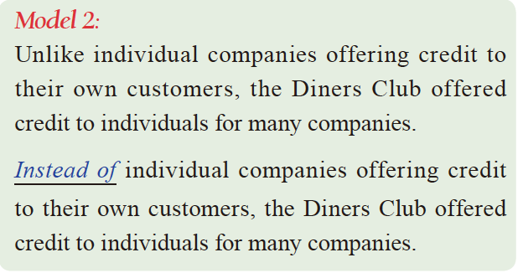
LL-Task 4 model 2
Language Lab
< Back
Next >
Home

Slide 87
LL-Task 4-2
Language Lab
They didn’t fix the old machine. They bought a new machine.
___________________________________________________
2. We didn’t have a rest. We went on working.
___________________________________________________
3. Tom didn’t laugh at me. He came to help me.
__________________________________________________
Instead of fixing the old machine, they bought a new one.
Instead of having a rest, we went on working
Instead of laughing at me, Tom came to help me.
< Back
Next >
Home

Slide 88
LL-Task 5-1
Language Lab
Task 5 Translate the following into English using the given words or phrases.
1. 昨天我留下加了一会儿班。(extra)
______________________________________________________
2. 为了赶上她的同学，她学习非常努力。(in an effort to).
______________________________________________________
______________________________________________________
3. 电视提供大众化的娱乐。(universal)
______________________________________________________
4. 我们怎样才能提高顾客的忠诚度？(loyalty)
______________________________________________________
I stayed and did some extra work yesterday.
She has been studying very hard in an effort to catch up with
her classmates.
Television provides universal entertainment.
How can we improve customer loyalty?
< Back
Next >
Home

Slide 89
LL-Task 5-2
Language Lab
5. 请你方便时给我们寄一份你们最新的产品目录。(convenience)
______________________________________________________
______________________________________________________
6. 他手头工作太多了，不能跟我们去野餐。(on hand)
______________________________________________________
______________________________________________________
7. 这则广告会引起各地读者的注意。(capture)
______________________________________________________
8. 新闻节目是通过卫星传送到我们这里来的。(via)
______________________________________________________
Please send us a copy of your latest catalog at your convenience.
He has too much work on hand to go picnicking with us.
The advertisement will capture the attention of readers everywhere.
The news program came to us via satellite.
< Back
Next >
Home

Slide 90
Entertainment
Entertainment
La Isla Bonita
by Madonna
声音
Background
< Back
Next >
Home

Slide 91
Background
Entertainment
"La Isla Bonita" (The Beautiful Island) is a song by American singer-songwriter Madonna. It was released as the fifth and final single from her third studio album, True Blue, on February 25, 1987. It is noted for being the first Madonna song to have a Spanish influence in it. The lyrics of the song tell about a Beautiful Island and was a tribute to the beauty of the Latin people according to Madonna.
< Back

Slide 92
Thank You!
新职业英语
职业综合英语 2
ENGLISH FOR CAREERS
Thank You!

