Slide 1

招聘信息问询
第3单元 2课时

Slide 2
教学目标
能够通过电话进行有效沟通；
能够清晰明确的表达并获得自己所需要的招聘信息。
能力目标
通过网上查询信息，学会如何通过网络获取信息、甄别信息的能力。提高自主学习能力。
通过小组合作、角色扮演、实战演练等，学会与人沟通、合作。
素质目标
了解信息问询的途径；
掌握有关电话用语；
掌握 常用于信息问询的词汇和句型。
知识目标

Slide 3
单元任务
情境
描述
引出
任务
A
B
赵职兴作为一名毕业生，看到某外企发布在报纸上一条简略的招聘广告。为了获得全面的信息，小赵拨通了该公司人事部的电话，就岗位职责，资历要求等事宜进行有效沟通。
小组通过合作演练掌握通过电话问询信息的全过程，包括询问岗位名称、该岗位的职责、应聘所需的资质、工资待遇等。

Slide 4
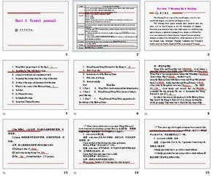
单元教学资源
讲义：《实用职场英语》
视频：电话招聘信息问询
课件：自制PPT

Slide 5
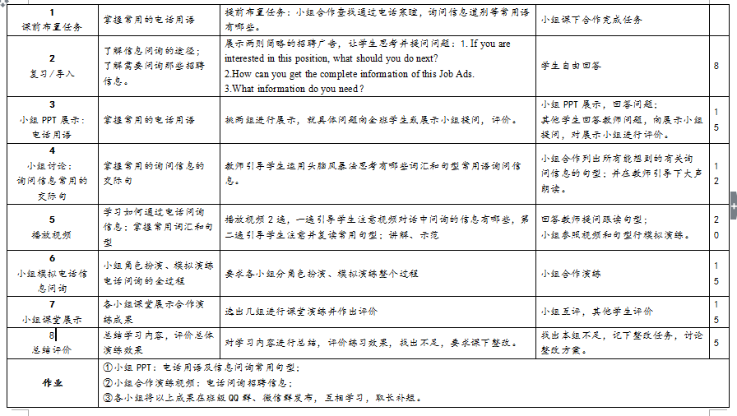
单元教学进度

Slide 6


I. Lead-in (5 minutes)
Questions:
    If you are interested in this position, what should you do next?
    How can you get the complete information of this Job Ads.
    What information do you need，in your opinion？

Slide 7

II. Group presentation(15 minutes)
Group presentation: Daily English used on the phone (15 minutes)
    Ask several groups to present some everyday expressions on the phone with PPT.
    Ask some questions about what the students present.
    Comment on what the students have done.

Slide 8

III. Discussion (12 minutes)
Expressions used for inquiries
    Ask students discuss and list useful expressions used to ask for information.
    Ask several groups list these expressions on the black board and others add.
    Ask students read loudly.

Slide 9
IV. Learning how to make telephone inquiries (20 minutes)
    Watch a video clip about telephone inquiries. Pay attention to details about the position, job description, qualifications required and other useful information.
    Watch twice. Pay attention to the useful sentences used in the video clip,and read after it.
    Ask students to practice with group members.

Slide 10
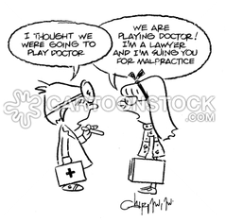
V. Role-playing (15 minutes)
Telephone inquiries about job information.
    Work in groups and role-play the whole process of inquiries.

Slide 11


VI. Presentation in class (10 minutes)
    Ask some groups to make presentation in class.
    Comment on what students have done.

Slide 12
VII. Summary and homework (5 minutes)
    Summarize what have been learned in this class.
    Assign homework.
小组PPT：电话用语及信息问询常用句型；
小组合作演练视频：电话问询招聘信息；
各小组将以上成果在班级QQ群、微信群发布，互相学习，取长补短。

Slide 13
THANKS
请专家批评指正！
Notes:
模板来自于 http://docer.wps.cn
30

