Slide 1
Transportation

Slide 2
How do you go to school ？
I walk to school.
I drive to school.
I go to school by…
plane、bus、bike、taxi、train、 subway 、car、ship......

Slide 3
Can you tell me more kind of transportation?
Why do we need transport? Do you think it is important?
What’s the difference between transports?/advantages/disadvantages? How to choose a suitable transportation?

Slide 4
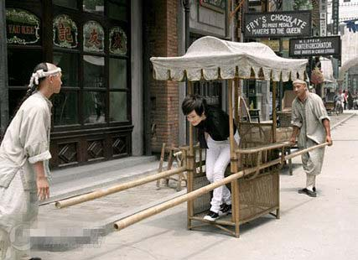
Changes in transportation
sedan
[sɪˈdæn]

Slide 5
Changes in transportation
boat

Slide 6
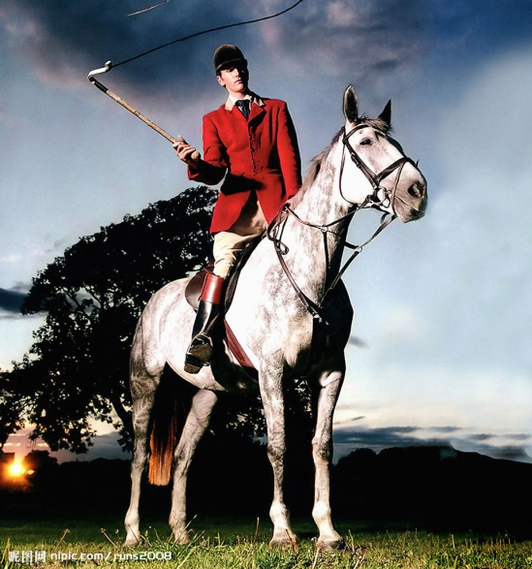
Changes in transportation
horse

Slide 7
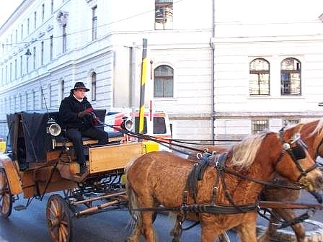
Changes in transportation
Gharry/ coach
['ɡærɪ]

Slide 8
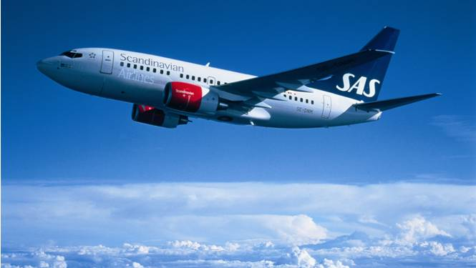
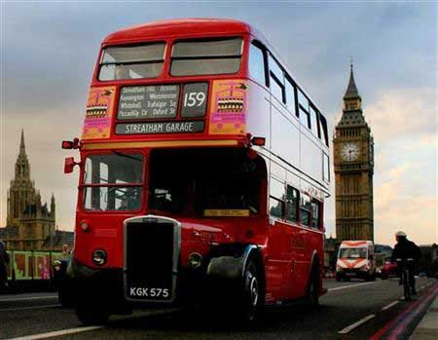
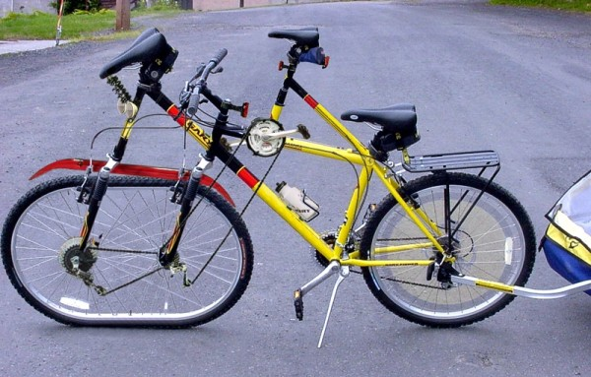
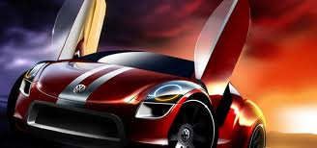
In modern times

Slide 9
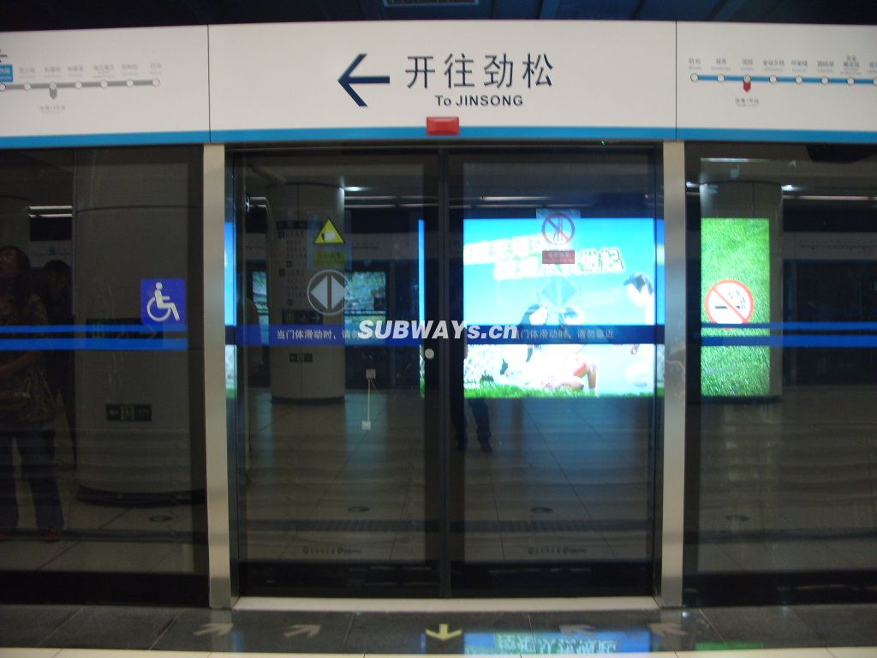
subway 地铁
英式： tube
train 火车
railway station 火车站

Slide 10
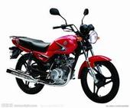
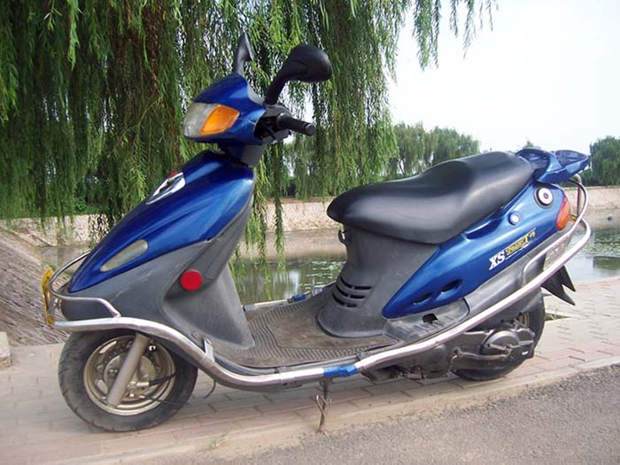
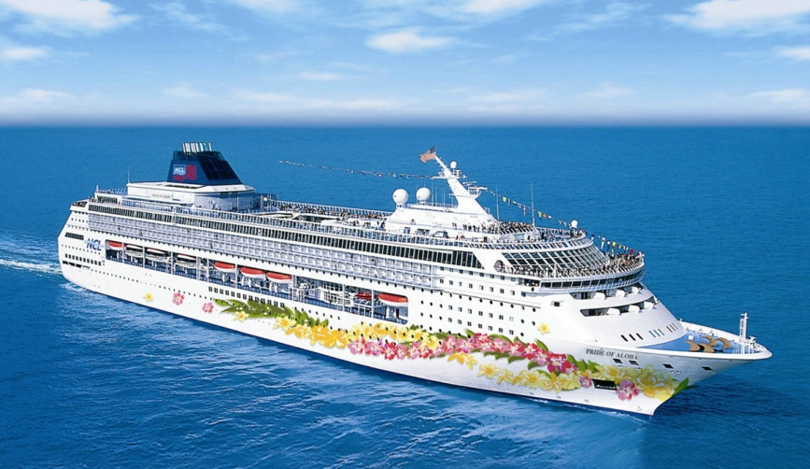
motorcycle
electro mobile
ship 轮船

Slide 11
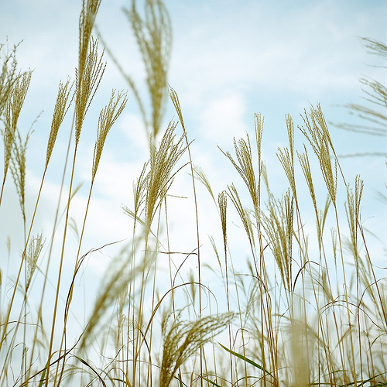
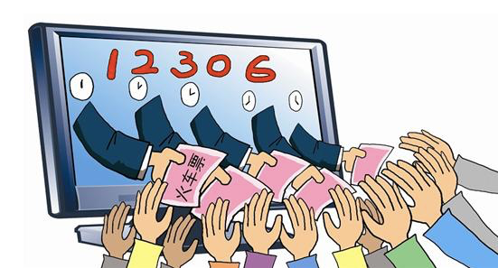
Spring Festival travel rush 春 运
验证码 verification code

Slide 12
Thank you !

