Slide 1
Dragon Boat Festival
（Double Fifth Festival）
端午节

Slide 3
Today, Dragon Boat Festival in the Chinese people is still a very popular grand festival. Country attaches great importance to the protection of intangible cultural heritage, May 20, 2006, the State Council approved the inclusion of the folk first batch of national intangible cultural heritage.
时至今日，端午节在中国人民中仍是一个十分盛行的隆重节日。国家非常重视非物质文化遗产的保护，2006年5月20日，该民俗经国务院批准列入第一批国家级非物质文化遗产名录。

Slide 4
The customs vary a lot in different areas of the country, but most of the families would do like that.
在中国,不同的地方有不同的民间端午节传说故事和过节的庆祝方式,但以下几种大家最熟悉
1.Hanging Pictures of Zhong Kui 大门上挂钟馗像
2.Hanging Calamus and Moxa 大门上挂菖蒲和艾叶草
3.Dragon Boat Race 划龙舟比赛
4.The Culture of Zongzi 吃棕子
5.Spice Bag作香袋
6.Realgar Wine 喝雄黄酒
春秋战国时期，至今已有2000多年历史,从2008年起为国家法定节假日

Slide 5
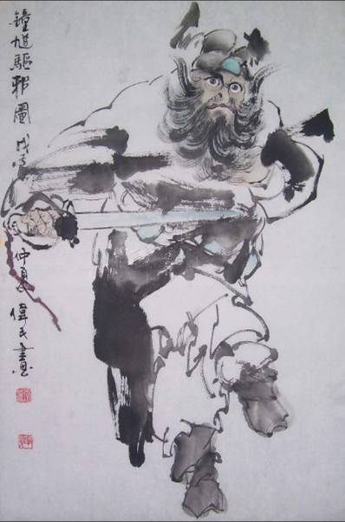
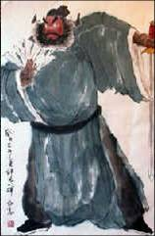
1.Hanging Pictures of Zhong Kui 大门上挂钟馗像
People would paste on their front doors pictures of Zhongkui , a legendary Chinese since children are generally the most vulnerable to disease, they received extra care at this special time.
传说大门上挂钟馗像,即可使小孩子们得到避邪和保护

Slide 6
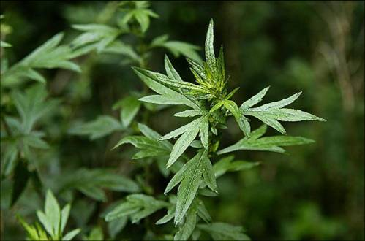
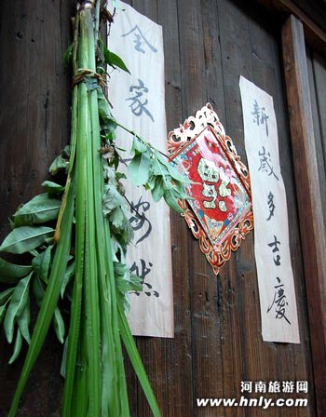
2.Hanging Calamus and Moxa 大门上挂菖蒲和艾叶草
Hang calamus and moxa (oriental plants) on the front door
This is also to ward off evil.
大门上挂菖蒲和艾叶草用于避邪

Slide 7
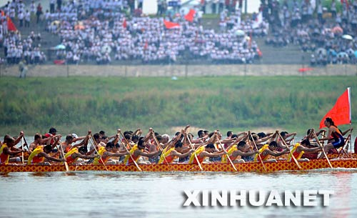
3. Dragon Boat Race 龙舟比赛
An indispensable part of the festival, held all over the country
全国最流行不可缺小的庆祝节目
Folk tales say the game originates from the activities of seeking Qu Yuan's body.
民间传说,龙舟比赛是寻找屈原的尸体
Experts conclude that dragon boat racing is a semi-religious, semi-entertaining program from the Warring States Period (475-221 BC).
有专家说龙舟比赛来源于宗教,也可能是战国时代的一种大型娱乐

Slide 8
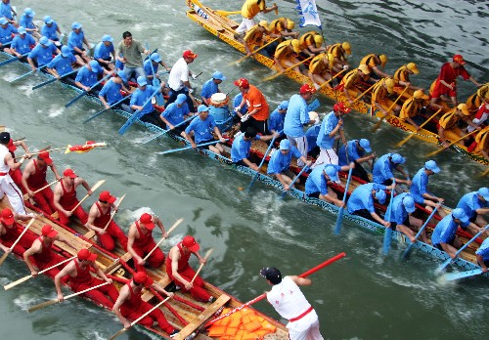
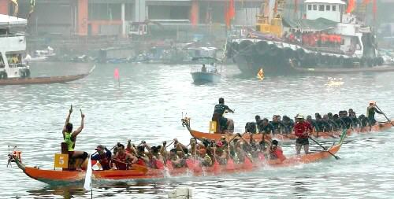
“

Slide 9
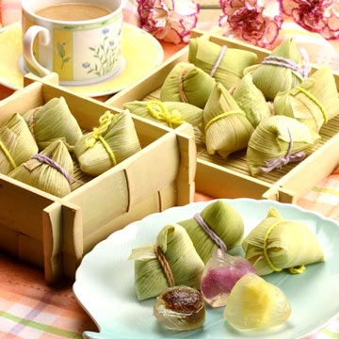
4.The Culture of Zongzi 棕子的文化
An essential food of the Dragon Boat Festival.
端午节庆祝的主要美食
It is said that people ate them in the Spring and Autumn Period (770-476 BC).
传说吃棕子起源于春秋时期

Slide 10
4.The Culture of Zongzi 棕子的文化
Now the fillings are more diversified, including jujube and bean paste, fresh meat, and ham and egg yolk. 至今的棕子有很多样式,有红枣心的,绿豆糕式的,还有肉类的,还有火腿粒和蛋黄夹心的
people will soak glutinous rice, wash reed leaves and wrap up zongzi themselves. Otherwise, they will go to shops to buy whatever stuff they want. 人们包棕子时,要先浸好糥米,然后包入食物

Slide 11
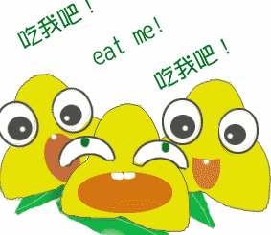
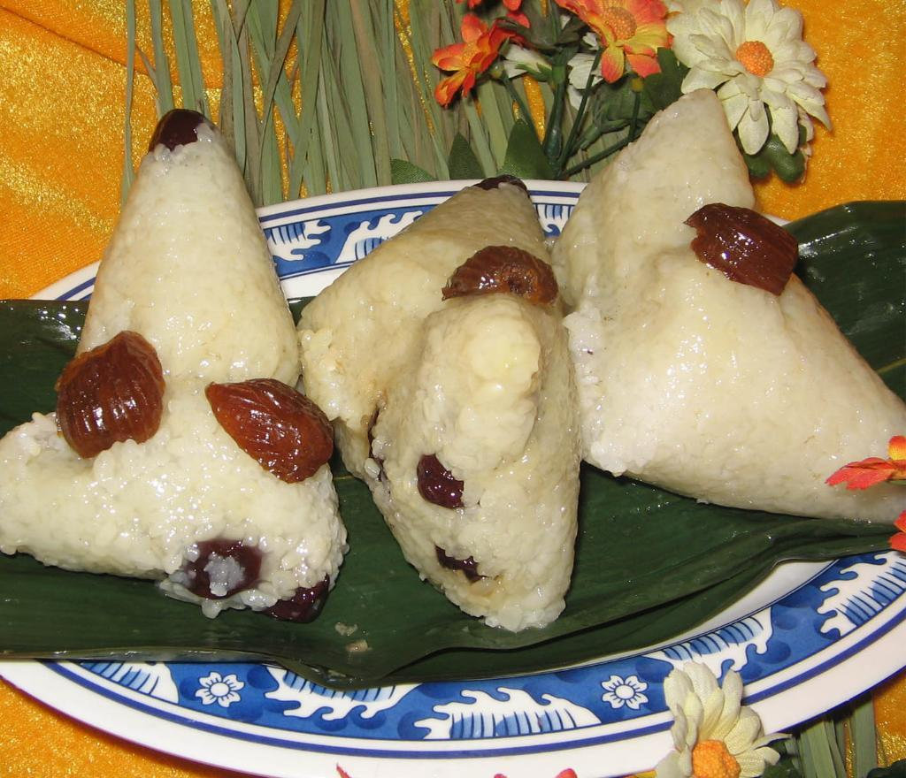
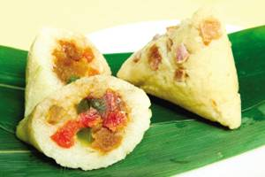
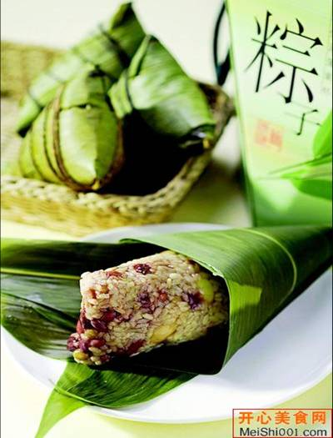
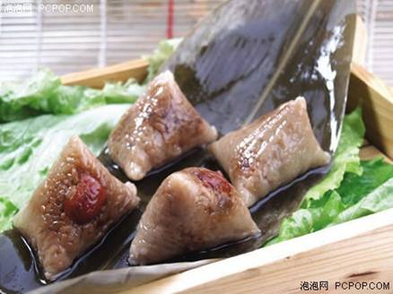
“粽包分两髻，艾束著危冠。旧俗方储药，羸躯亦点丹。”端午节不可不吃的美味食物就是（粽子），这种传统源于汨罗江边的渔夫，将米丢入江中平息江中的蛟龙，希望它们不要伤害屈原。

Slide 12
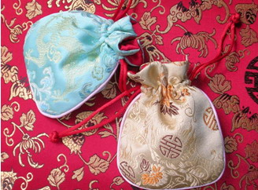
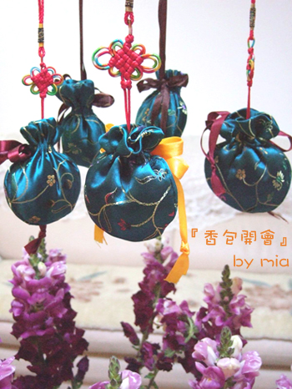
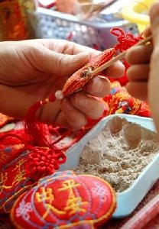
5.Spice Bag 香包
Carry the small spice bag around with you, it not only drives away evil spirits but also brings fortune and happiness to those who wear it.
带上香包在身上,不但可避邪,而且可给你带来好运和快乐
The small bags are hand-made by local craftsmen.
小香包一般是人们手工制作

Slide 13
5.Spice Bag 香包
They're made with red, yellow, green and blue silk, fine satin or cotton. Figures of animals, flowers and fruits are often embroidered onto the bags and inside are mixed Chinese herbal medicines.
香包可作成红/黄/绿/蓝等很多颜色,用上等丝绸或棉料制作,外表常刺绣动物,花,水果,里面装一些中草药

Slide 14
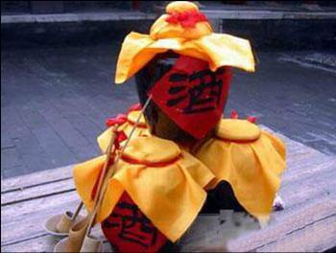
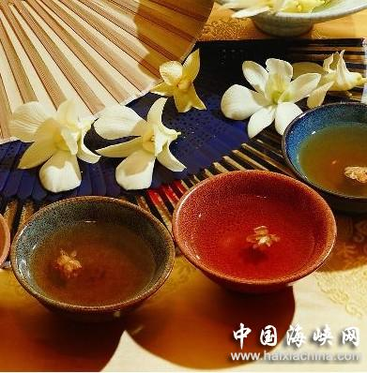
6.Realgar Wine 雄黄酒
It is a very popular practice to drink this kind of Chinese liquor seasoned with realgar at the Dragon Boat Festival.
雄黄酒是一种将雄黄在烈酒中浸泡后的酒,在端午节很受欢迎
This is for protection from evil and disease for the rest of the year.
喝了雄黄酒,整年可避邪避病
In one word, all of the activities are to protect themselves from evil and honor the poet Qu Yuan.
总之,以上所述的活动皆是庆祝人的自身避邪和纪念屈原的方式

Slide 15
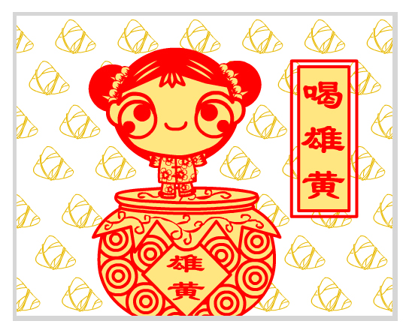
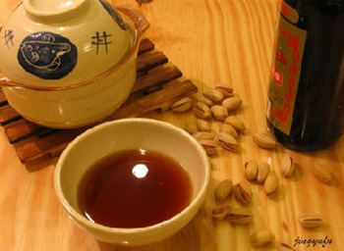
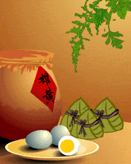
“樱桃桑椹与菖蒲，更买雄黄酒一壶。”端午节尝试一下雄黄酒吧。端午节这天，人们把雄黄倒入酒中饮用，并把雄黄酒涂在小孩儿的耳、鼻、额头、手、足等处，希望这样可以使孩子们不受蛇虫的伤害。

