Slide 1
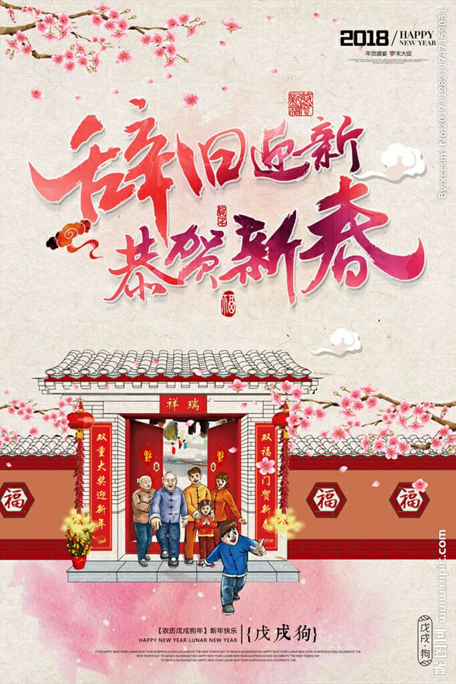
Chinese New Year
Spring Festival is the most important festival in China. They will try their best to go home enjoying family time.
在中国春节是最重要的节日，人们讲将尽他们最大的努力回家享受团圆时间。

Slide 2
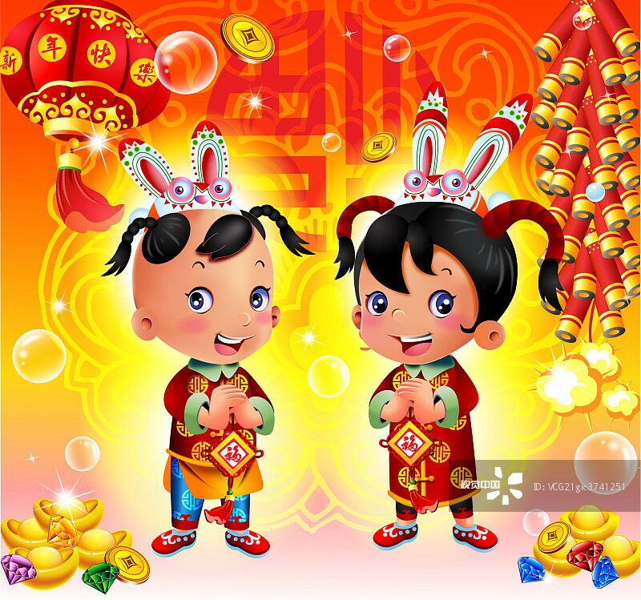
The Spring Festival lasts about 15 days long. People visit relatives and friends with the words “Have all your wishes ”. People enjoy the Spring Festival,during this time they can have a good rest .
春节大约持续15天，人们拜访亲戚和朋友并且带着他们的祝福，”祝你一切顺利。”人们享受春节，在春节期间他们也能好好休息。

Slide 3
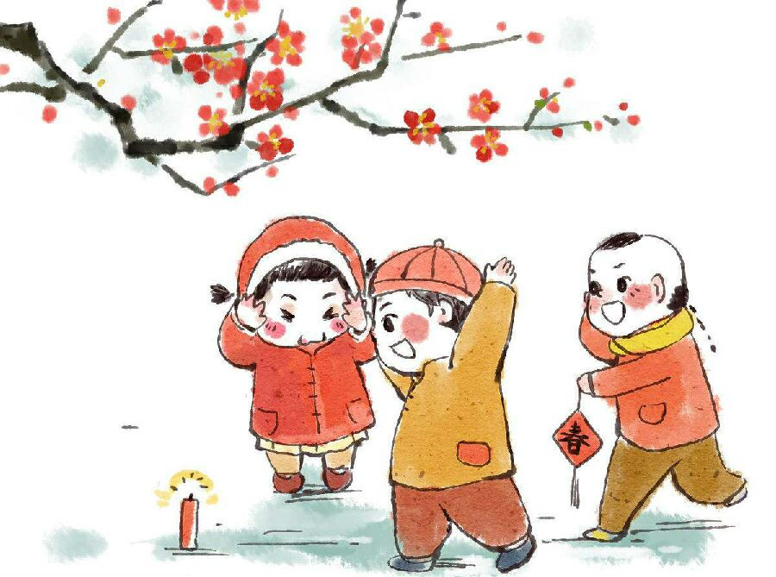
In many places, people like to set off firecrackers.
在很多地方人们喜欢放鞭炮。

Slide 4
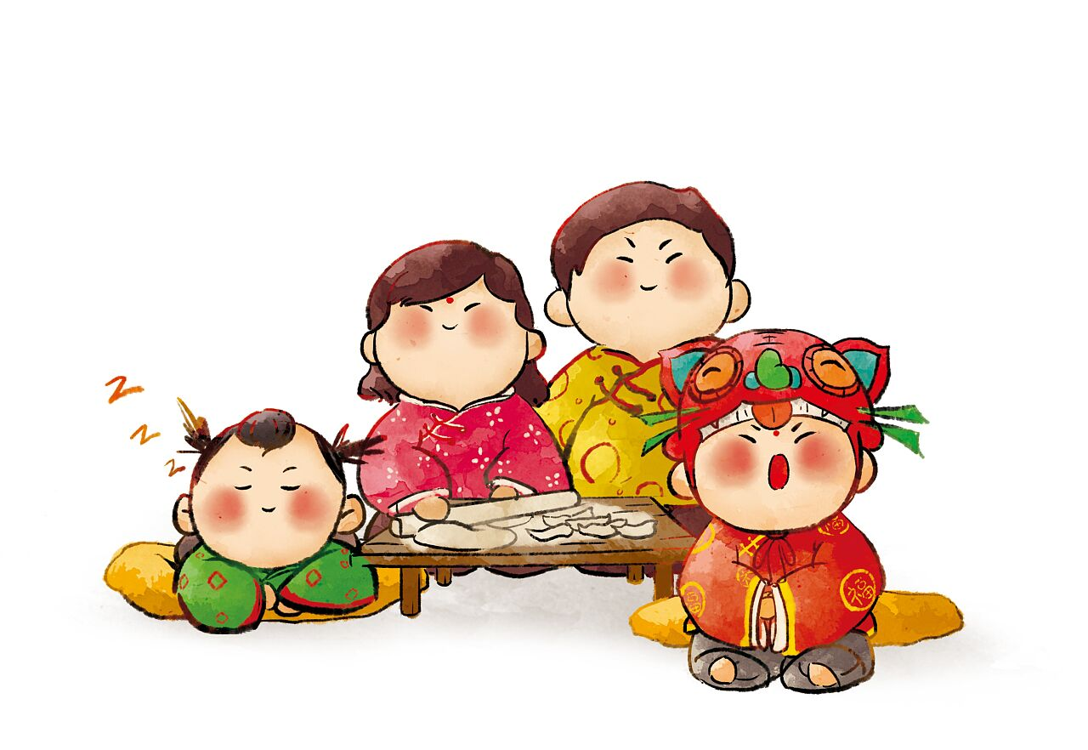
Every year before the spring festival, the whole family will be around together to make dumplings.
每年在春节之前，每一个家庭都会围在一起包饺子。

Slide 5
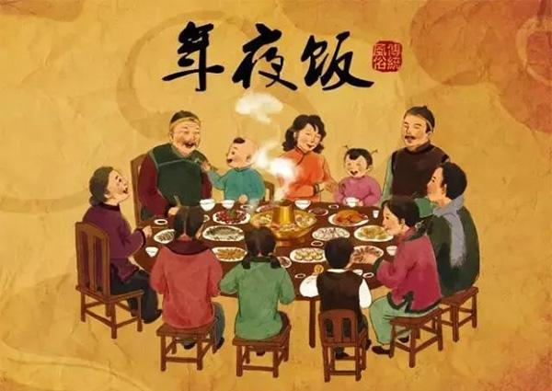
Children like the festival very much,because they can have delicious food and wear new clothes.
孩子们非常喜欢春节，因为他们能吃美味的食物并且穿新衣服。

Slide 6
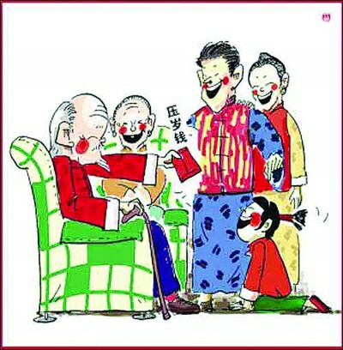
They can also get some money from their parents.This money is given to children for good luck.
孩子们能从父母那得到一些红包，这些钱被给孩子寓意这好运。

Slide 7
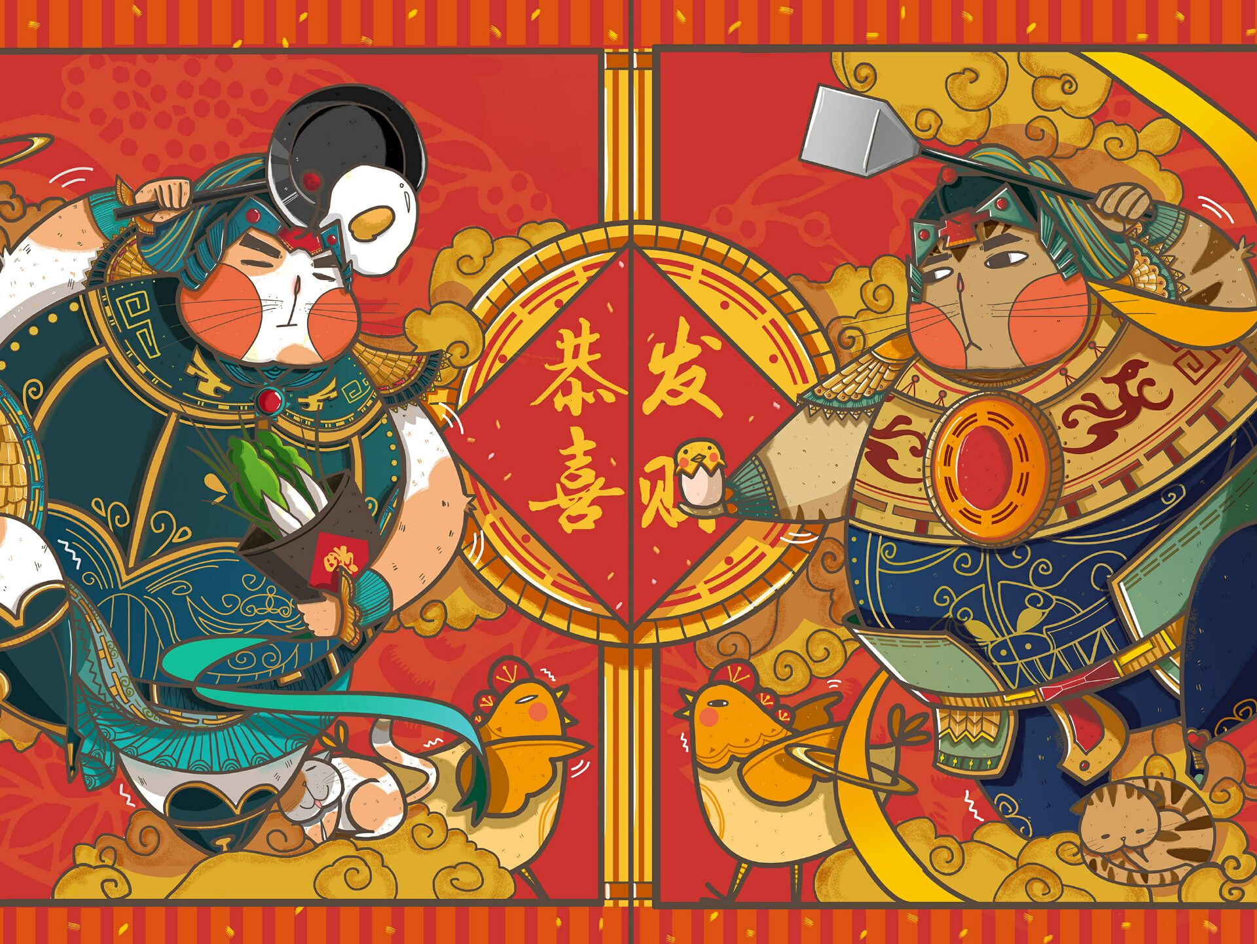
This is Chinese New Year.
这就是中国的新年。

