Slide 1
Protect the Earth and Protect the Environment

Slide 2
White Pollution 白色污染
With the remarkable improvement of people’s living standard, people tendto buy more goods. As a result, a plenty of plastic bags are threw around and caused white pollution. Not only does it do harm to the environment, but also give people the impression that the city is dirty. As we all known, plastic bags are nonbiodegradable materialand it will stay in the soil for a long time. What’s worse, the poison released from the plastic bags is harmful.
随着人民生活水平的显著提高，人们购买的商品越来越多。所以，到处都是塑料袋，造成白色污染。塑料袋不仅污染环境，也给人城市很脏的印象。众所周知，塑料袋是不可生物降解的材料，会长期留在土壤里面。更糟糕的是，从塑料袋中释放的有毒物质是有害的。

Slide 3
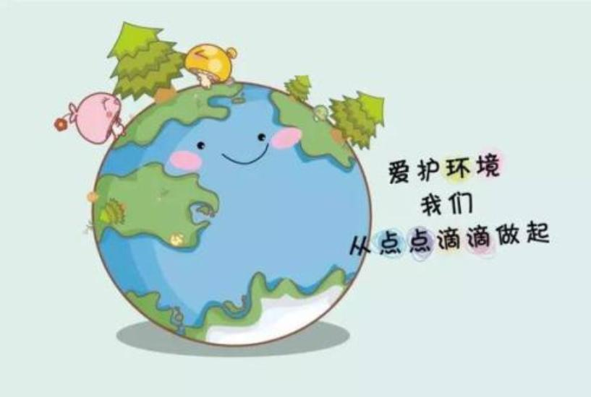
Being current generation of young people, we should take measures to control the use of plastic bags .We can substitute them with cloth bags or reuse them. And the government can make rules to avoid using them. If we do our best, the use of plastic bags can be reduced, thus the white pollution can be controlled.
作为当代年轻的一代，我们应该采取措施来控制塑料袋的使用。我们可以用布袋来替代塑料袋或者重复使用。政府也可以制定规定来避免使用塑料袋。如果我们努力做好，塑料袋的使用就可以减少了，从而白色污染也会得到控制。

Slide 4
I hope the future will be the same

