Slide 1
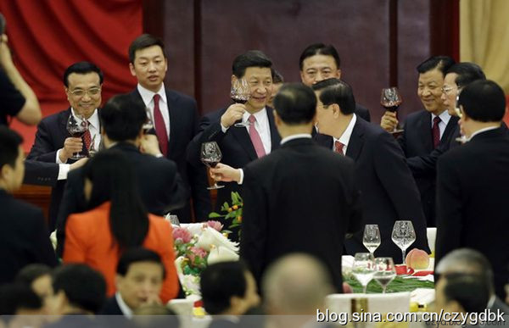
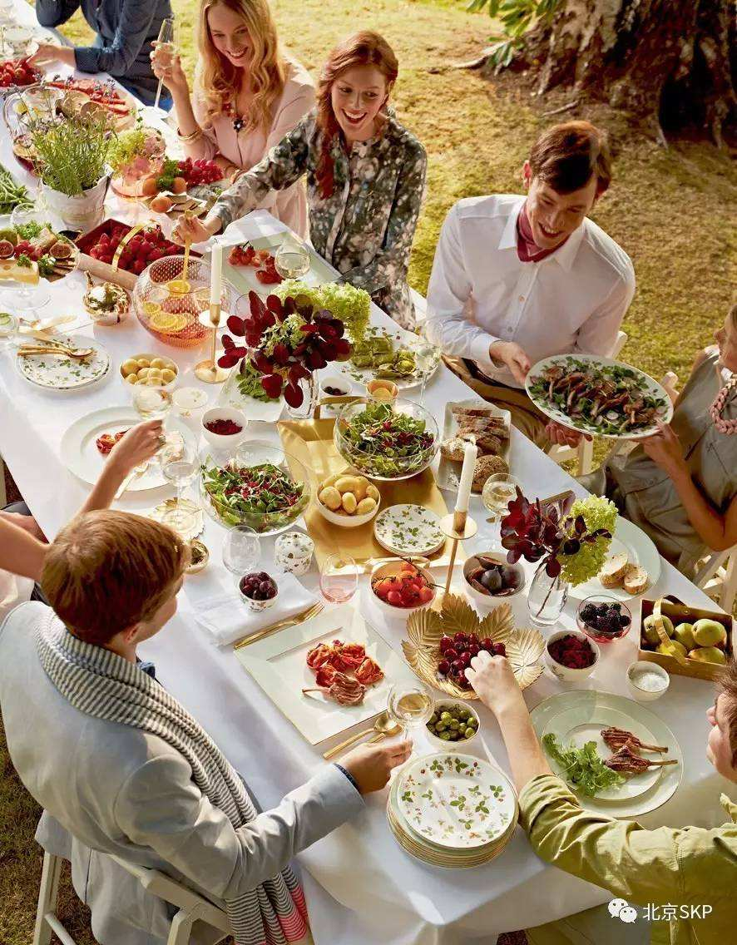
Differences Between Chinese And Western Table Manners
中西方餐桌礼仪的差异
NO：XⅢ

Slide 2
Only by mastering the differences in table manners between Chinese and western cultures，can we better understand the different traditions of Chinese and western cultures, deepen the exchanges and cooperation between countries, introduce the fine traditions of our own countries into the world, and improve the international influence.
掌握了中西方文化餐桌礼仪的差异，才能更好的了解到中西方文化的不同传统，进而加深国家之间的交流合作，将本国的优良传统传入世界中，提高国家的国际影响力。

Slide 3
1.chinese table manners: first invited to the seat, and then invited the elder next to the guests. when seated, enter from the left side of the chair. 2.do not allow guests to sit near the table, the door is the main seat.
Seating arrangements 座次安排
1.中国的餐桌礼仪：先请客人入座上席，再请长辈入座客人旁。入座的时侯要从椅子的左边进入。
2.不可让客人坐在靠近上菜的座位，着大门的是主座

Slide 4
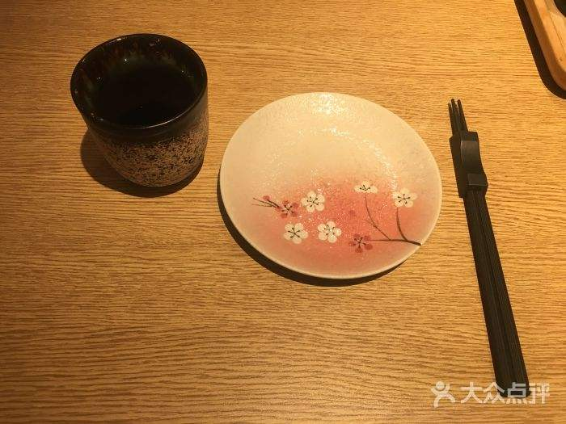
chinese tableware mainly includes chopsticks, dishes, bowls, spoons and so on.
tableware餐具
中餐的餐具主要有筷子、碟，碗、勺子等。

Slide 5
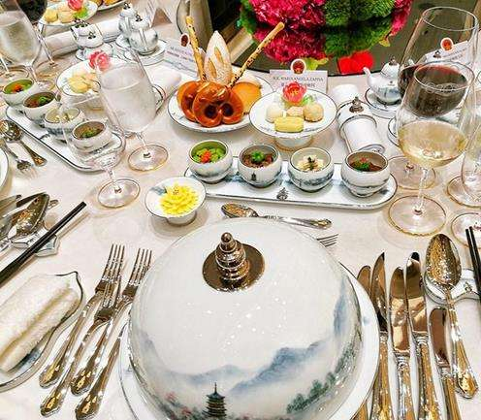
western dishes mainly include knife, fork, bowl, plate, plate, etc.
西餐的餐具主要有刀子、叉子、碗、盘子、碟子等。

Slide 6
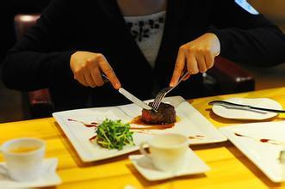
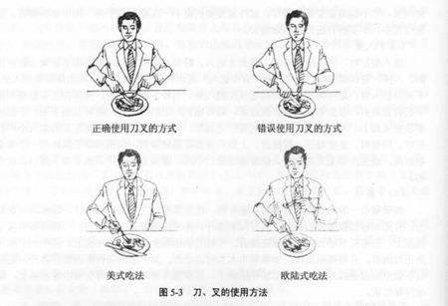
when eating with a knife and fork, take the knife and fork from the outside to the inside. hold the fork with your left hand and knife with your right hand. while cutting, hold the fork in your left hand while holding the food down. with the knife in your right hand, cut it into small pieces and place the fork in your mouth. when using a knife, the blade must not be turned outward.
使用刀叉进餐时，从外侧往内侧取用刀叉，要左手持叉，右手持刀；切东西时左手拿叉按住食物，右手执刀将其切成小块，用叉子送入口中。使用刀时，刀刃不可向外。

Slide 7
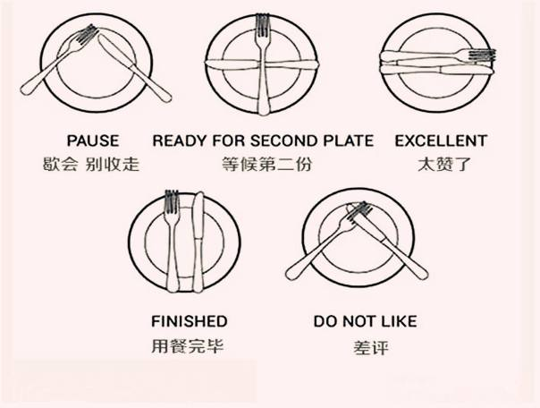
进餐中放下刀叉时应摆成“八”字型，分别放在餐盘边上。刀刃朝向自身，表示还要继续吃。每吃完一道菜，将刀叉并拢放在盘中。

Slide 8
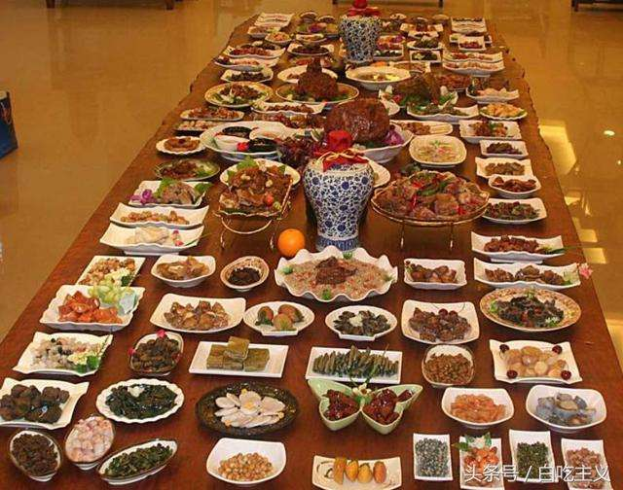
chinese food is usually served in the order of cold dishes, drinks or wine, hot dishes, staple food and soup, and finally fruit and dessert.
sequence of service上菜顺序
中餐的上菜顺序一般是先上凉菜、饮料或酒，然后是热菜、主食和汤，最后是水果和甜点

Slide 9
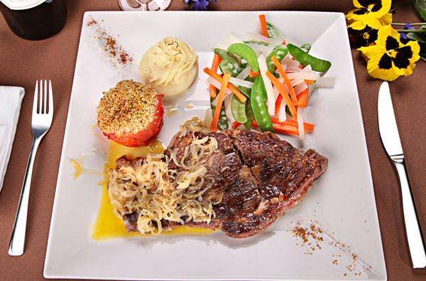
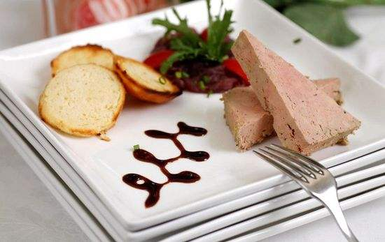
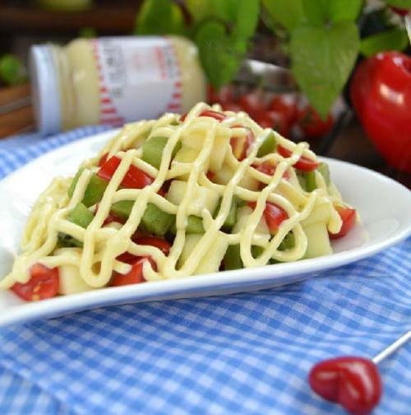
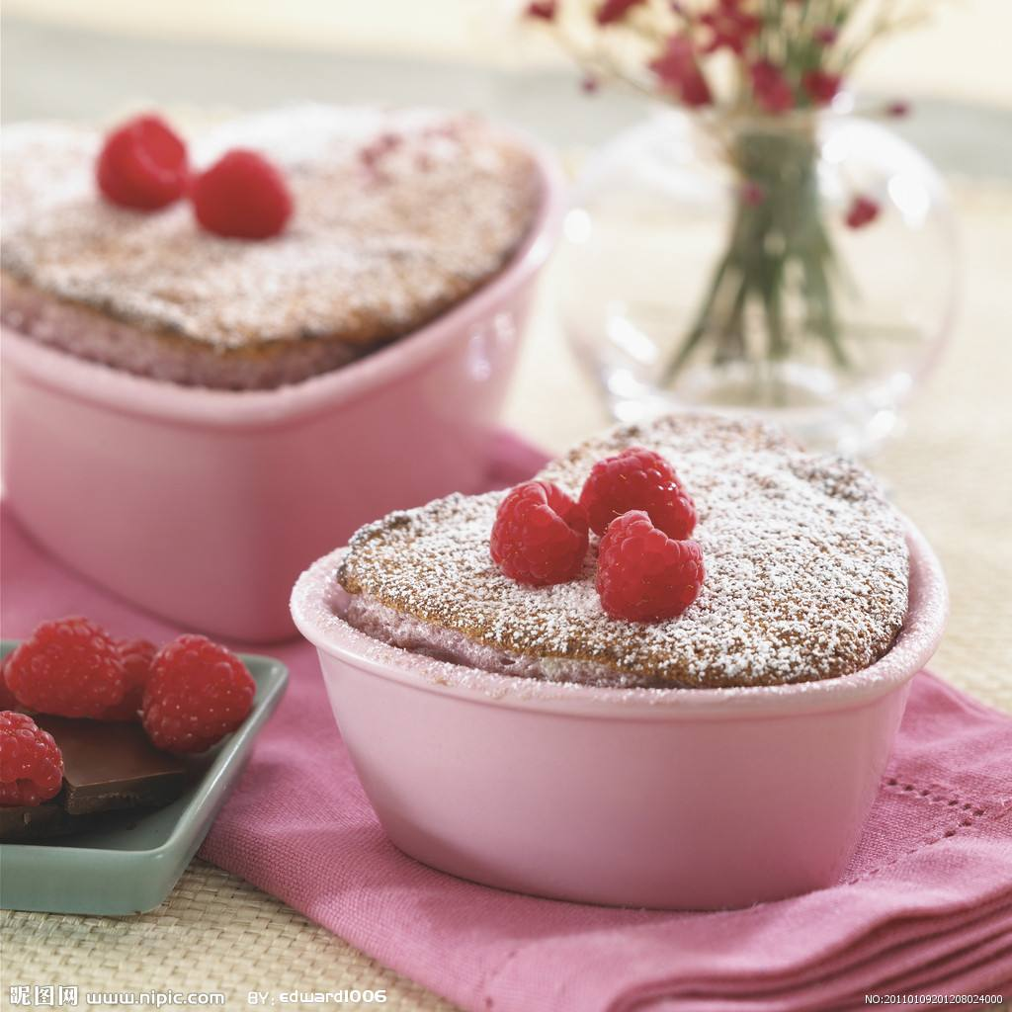
In the west, the serving process is usually: bread and butter, cold food, seafood, main course, dessert, coffee and fruit.
而西方的上菜程序通常是：黄油面包、冷菜、海鲜、主菜、甜点、咖啡和水果。

Slide 10
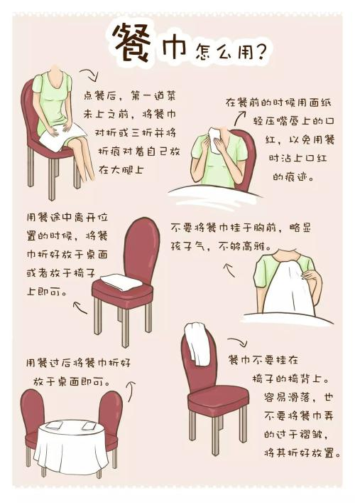
1. The towel can only be used to clean hands, after rub hands, should be returned to the original plate, by the service member to take away, before the end of the party, will be on a piece of wet towel to wipe your mouth, don't be used to wipe the sweat or face.
napkin餐巾
2.in western food, the napkin is placed on the plate or beside it.
1.毛巾只能用来擦手，擦完手之后，应放回原来的盘子里，由服务员拿走，在宴会结束前，会再上一块湿毛巾用来擦嘴，千万不能用来擦汗、抹脸。
2.西餐中，餐巾放在盘子里，要么放在盘子的旁边。

Slide 11
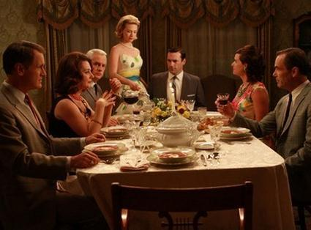
1.soon as a westerner sits down at the dinner table, he or she begins to taste the food on his or her plate intently.
2.talk to the right or left guests at dinner, but don't just talk to a few acquaintances. try not to interrupt or cut in while others are talking.
1西方人一坐到餐桌上便专心致志地开始品尝自己盘中的食物，喝汤时不能发出响声，吃东西要闭嘴咀嚼。
2.进餐时可以与左右客人交谈，但不要只同几个熟人交谈，别人说话时不能打断插话尽量，一辆尽量保持在对方可以听见的程度解决食物不要说话，即使有人同你讲话，也要等咽下食物以后再回答。

Slide 12
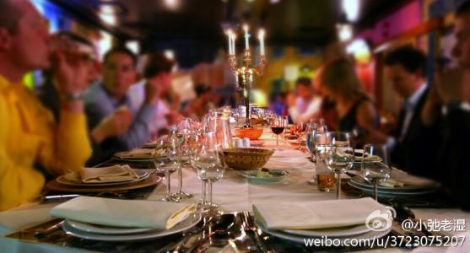
western feasts typically consist of only four or five dishes, preferably just over or over. if after all of the world's best food in the home, the hostess will be very happy, think such things everyone likes his dishes, a kind of recognition for her cooking skills. in the face of a big dinner, the host will say that he has given all he has to offer
西方盛宴一般只有四到五个菜，以恰好吃完，或者稍有剩余为最佳。如果在家里最好吃完所有的菜，这样女主人会很高兴，认为这样事大家喜欢他的菜，对她烹饪手艺的一种认可。面对丰盛的宴席，主人会说已经倾其所有来招待大家。

Slide 13
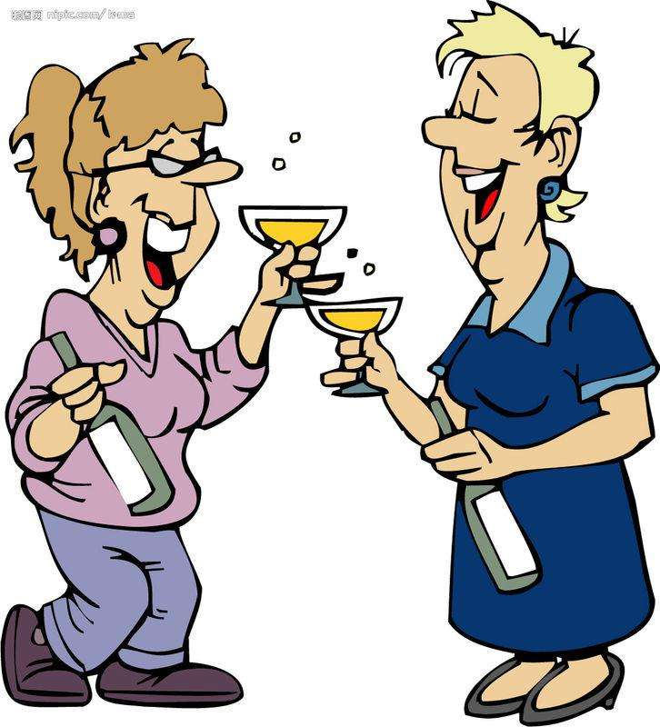
Leaving the way离席方式
after the western food banquet, napkin picked up the first lap, and then placed in the left side of the table rose up and leave, leave, should help the elderly or insulation, pull the seat ms farewell, to thank master should be. when you're more discreet, you can also thank you by phone
西餐的宴会结束后，首先将腿上的餐巾拿起，然后放在餐桌的左侧起身离席，离席时，应帮助隔座长者或女士拉动座椅，告别时，应向主人致谢。更为慎重时，还可以以电话的方式致谢。

Slide 14
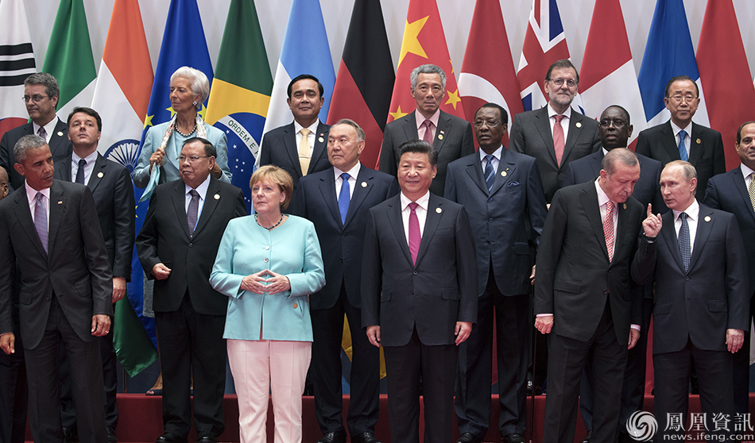
epilogue结语
1.a section of personal table manners will directly affect the atmosphere of dining. having a decent table manners is a reflection of respect and politeness for others.
2.understanding and mastering the differences in table manners in chinese and western cultures is of great significance for the intercultural communication in china.
1.个人的餐桌礼仪的一段会直接影响进餐的氛围，拥有一种得体的餐桌礼仪，是对他人尊重和礼貌的体现.
2.了解并掌握中西方文化中餐桌礼仪的差距对于我国跨文化交流有极其重要的意义。

