Slide 1
中华传统美德
诚信（Honesty）

Slide 2
HONESTY
one
two
three
four
HO
NE
ST
Y

Slide 3
Why “Honesty” is such a lonely word,
为什么“诚信”如此孤单
people can’t be honest
人们从不诚实
because they used to be dishonest?
因为他们的过去是有污点吗？
Or because protecting someone you love
或者，为保护所爱
so you can’t be honest,
人们就大可不必诚实
or because you have difficulties
亦或有很多的麻烦
so you can’t be honest. ）
所以人们略掉诚实

Slide 4
When I'm deep inside of me
当我过度沉迷
Don't be too concerned
请不要太过担心
I won't ask for nothin' while I'm gone
我会一无所求地离去
But when I want sincerity
但当我需要忠诚时
Tell me where else can I turn
告诉我该如何走下去
'Cause you're the one that I depend upon
只因你是我唯一肯信赖的人
Honesty is such a lonely word
诚实，这个孤独的字眼
Everyone is so untrue
每个人都辜负着它
Honesty is hardly ever heard
诚实，很少被提及的字眼
And mostly what I need from you
我希望从你那里体会

Slide 5
But I don't want some pretty face
但我不想要一些美丽的面孔
To tell me pretty lies
告诉我美丽的谎言
All I want is someone to believe
我需要全心全意地相信某人
Honesty is such a lonely word
诚实，这个孤独的字眼
Everyone is so untrue
每个人都辜负着它
Honesty is hardly ever heard
诚实，很少被提及的字眼
And mostly what I need from you
我希望从你那里体会

Slide 6
If you search for tenderness
如果你探求人们最柔软的一面
It isn't hard to find
你不难发现
You can have the love you need to live
你会拥有在这世上生活所需要的足够的爱
But if you look for truthfulness
但如果你要寻找真相
You might just as well be blind
你可能会变得盲目
It always seems to be so hard to give
这东西好像很难给出
Honesty is such a lonely word
诚实，这个孤独的字眼
Everyone is so untrue
每个人都辜负着它
Honesty is hardly ever heard
诚实，很少被提及的字眼
And mostly what I need from you
我希望从你那里体会

Slide 7
什么是诚信
通俗的讲：
A popular talk
诚就是实事求是，不扩大，不缩小。
Honesty means seeking truth from facts,no expansion and reduction.
信就是有信用讲信誉，不弄虚不作假。
It is credit[ˈkredit]， credibility and no fraud.

Slide 8
诚信的名言警句
Honesty is the foundation of human nature.
If you want others to be honest, you must first trust yourself.
Honesty is the best quality[ˈkwɔliti] of life.
Sincerity[sɪnˈserɪti:] is a kind of open mind.
No legacy[ˈleɡəsi] can be as rich as honesty.
诚信为人之本。——鲁迅
如果要别人诚信，首先要自己诚信。——莎士比亚
诚实是人生永远最美好的品格。——高尔基
真诚是一种心灵的开放。——拉罗什富科
没有一种遗产能象诚实那样丰富的了。——莎士比亚

Slide 9
看几张图片
下面请大家

Slide 10
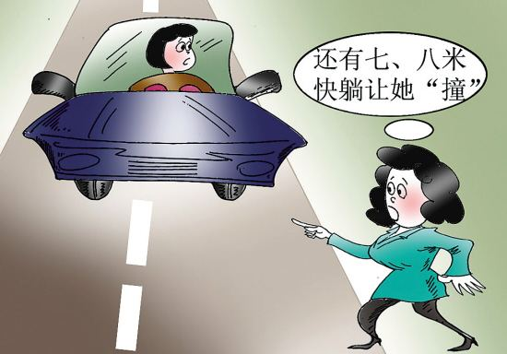
碰瓷行为
请在此输入您的文本。请在此输入您的文本。请在此输入您的文本。请在此输入您的文本。请在此输入您的文本。请在此输入您的文本。请在此输入您的文本。请在此输入您的文本。

Slide 11
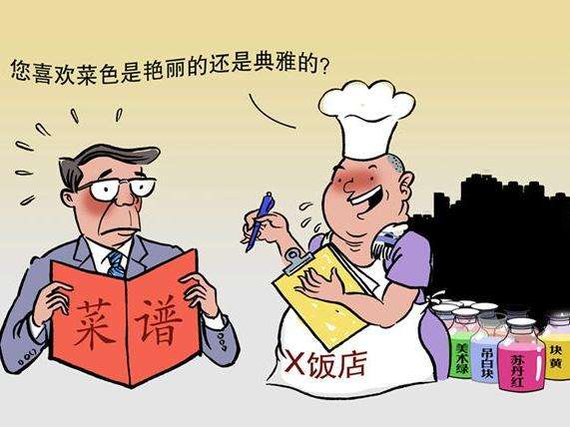
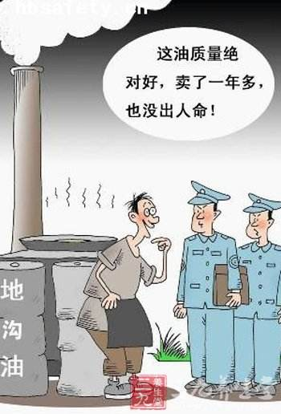
假冒伪劣食品
这样是食物你们敢吃吗？

Slide 12
诚
诚信是中华民族的传统美德
Honesty is the traditional virtue[ˈvə:tju:] of the Chinese nation.
是中国传统伦理文化的重要范畴
It is an important category[ˈkætiɡəri] of Chinese traditional ethics culture.
信

Slide 13
倡议
诚信，从小事做起！
Honesty starts from trivial matters！
诚信，从我做起！
Honesty starts with me！

Slide 14
谢谢欣赏

