Slide 1
中西餐桌礼仪
Chinese and Western Table Manners

Slide 2
现在社会礼仪无处不在，除了在日常生活中的职场、商务礼仪之外，大部分人经常会忽略餐桌礼仪。其实用餐不单是满足基本生理需要——也是头等重要的社交经验。餐桌礼仪对你我都非常重要，它在中国人的生活秩序中占有一个非常重要的地位。而中西餐在礼仪方面的要求也有许多差别。
Nowadays, social etiquette is everywhere. In addition to the workplace and business etiquette in daily life, most people often ignore table etiquette. In fact, dining is not only to meet basic physiological needs -- but also the most important social experience. Table manners are very important to you and me. It has a very important position in the Chinese life order. There are also many differences in the etiquette requirements of Chinese and Western foods.

Slide 3
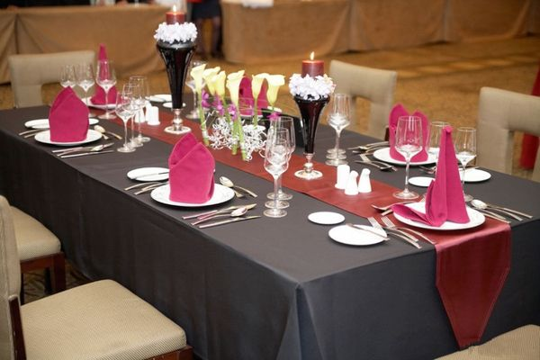
从餐具使用上看中西文化差异
在中国餐具较简单一般只有杯子、盘子、碗、碟子、筷子、匙羹等几种，而西方分有刀叉匙杯盘等，刀又分为食用刀、鱼刀、肉刀、奶油刀、水果刀，叉又分为食用叉、鱼叉、龙虾叉。茶杯，咖啡杯为瓷器并配有小碟，水杯、酒杯多为玻璃制品。
In China, there are only cups, plates, bowls, dishes, chopsticks, spoons and so on. In the west, there are knives, forks, spoons, cups and dishes. Knives are divided into food knives, fish knives, meat knives, butter knives, fruit knives. Forks are also divided into forks, harpoons, lobster forks. Cups, coffee cups are porcelain and are equipped with small dishes, cups and glasses are mostly glass products.

Slide 4
从停餐方式上看中西文化差异
中方筮席中暂时停餐可以把筷子直搁在磲子或者调资上。如果将筷子横搁在磲子上那是表示酒醉饭饱不再进膳了。在西方略事休息时,刀叉的摆法不同意思不同,刀叉以八字形状摆在盘子中央意味着要略作休息;若刀叉突出到盘子外面,不安全也不好看,边说话边挥舞刀叉是失礼举动。用餐后,将刀叉摆成四点钟方向即可。
In the Chinese side, the chopsticks are temporarily suspended, and the chopsticks can be placed directly on the bar or on the capital. If the chopsticks are placed on the top of the stick, it means that they are not drunk enough to eat. The knife and fork are placed in the middle of the plate in a figure of eight, which means a slight rest. If the knife and fork stick out of the plate, it is unsafe and unsightly. It is impolite to wave the knife and fork while talking. After meals, set the knives and forks in a four o'clock direction.

Slide 5
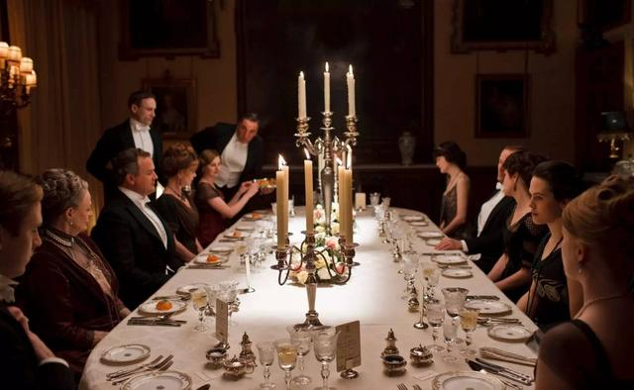
从服装上看中西文化差异
在中国,人们在餐馆用餐的李着可以便一些,即使是T恤、牛仔裤都可以有在重要的宴会上方穿得隆重但在西方去高档的餐厅,男士要穿着整洁的上衣和皮鞋女士要套装和有跟的鞋子。如果指定穿正式服装的话,男士必须打领带。不可穿休闲服到餐馆里用餐
In China, people can dress more conveniently at restaurants, even T-shirts and jeans can be worn grandly at important banquets, but in the West to high-end restaurants, men should wear a clean coat and leather shoes, women should wear suits and heeled shoes. If a formal dress is specified, a man must wear a tie. Don't wear casual clothes to eat in restaurants.

Slide 6
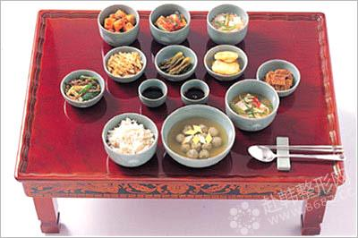
从上餐顺序上看中西文化差异
在中国，第一道菜是汤，紧接着是主食比如干饭,再则是餐酒最后一道菜是水果用来促化在西方国家里上菜顺序一般是菜和汤、水果,餐酒，主食，最后是甜点和咖啡
In China, the first dish is soup, followed by staple foods such as dry rice, and the last dish is wine. Fruits are used to promote the order of serving in Western countries: dishes and soup, fruit, wine, staple food, dessert and coffee.

Slide 7
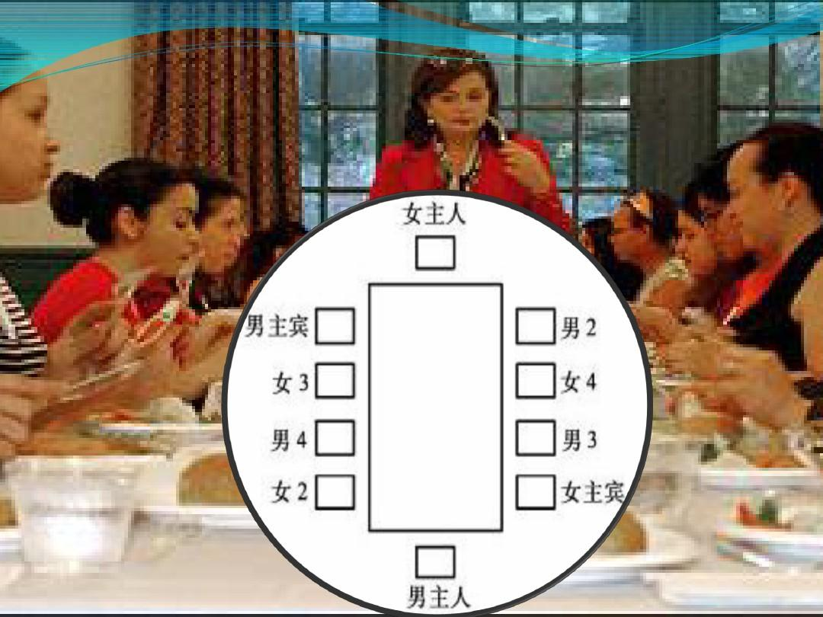
从入座次序上看中西文化差异
中国一般是客齐后导客入席，以左为上,视为首席,相对首座为二座,首座之下有三座,二座之下为四座。
In general, China is a guest guide after the Qi Dynasty, with the left as the top, as the chief, relative to the first seat for two, under the first seat for three, two for four.

Slide 8
从入座次序上看中西文化差异
在西方,一般说来,面对门的离门最远的那个座位是女主人的,与之相对的是主人的座位。女主人右手边的座位是第一主宾席，一般是位先生,男主人右边是第二主宾席,一般是主宾的夫人。女主人左边是第三主宾席，男主人左边是第四主宾席。
In the West, generally speaking, the seat farthest from the door facing the door is the hostess's seat, which is opposite to the hostess's seat. The seat on the right hand side of the hostess is the first guest seat, usually a gentleman, and the second guest seat on the right side of the male host, usually the wife of the guest of honor. The hostess has third main seats on the left and the fourth main table on the left.

Slide 9
That's all
Thank you!
汽修1组： 温光伟 陶荣宇 张浪 陈忠宇 宋晓侠

