Slide 1
英语
汽修2 组（225）
2018年
11月7号
毛文晨总策划

Slide 2
2组成员
于和翌
毛文晨
李壮
刘帅
陆思佳
毛文晨总策划

Slide 3
youth
青 · 春

Slide 4
We were born and raised In an age like this.
我们出生成长
在这样的一个年代

Slide 5
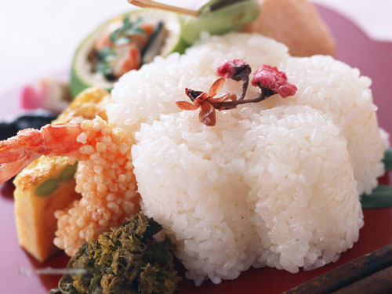
Economic take-off
经济腾飞
Network developed
衣食无忧

Slide 6
But we 've been looking for The sky that belongs to us.
但我们一直寻找着
那片属于我们的天空

Slide 7
struggle
用行动去
奋斗
A person's pursuit of higher goals, his talents on the development of faster, more useful to society.
The waves after a grounding, pebble becomes more beautiful and smooth.
一个人追求的目标越高，他的才力就发展得越快，对社会就越有益。
经过海浪的一番磨砺，卵石才变得更加美丽光滑。

Slide 8
love
去诠释
爱情
I know someone in the world is waiting for me, although I've no idea of who he is But I feel happy every day for this.
I don't know what to say…I was just thinking of her a lot at that moment.
我不知道该说什么，我只是突然在那一刻很想念她。
我知道这世上有人在等我，但我不知道我在等谁，为了 这个，我每天都非常快乐。

Slide 9
To the youth
致青春
Youth is not a time of life; it is a state of mind.
青春不是一段年华，而是一种心境。

Slide 10
谢谢老师和同学们

