Slide 1
Chinese and western table manners
Signs before eating
吃饭前的征兆

Slide 2
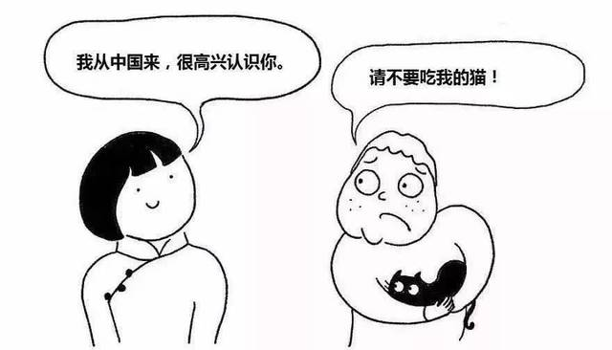
Invite guests 邀请客人 Invitation
Chinese and Western Tableware Use
中方与西方的餐具使用Tableware use
A
B
Where to sit at dinner吃饭时坐的位置order of seats
C

Slide 3
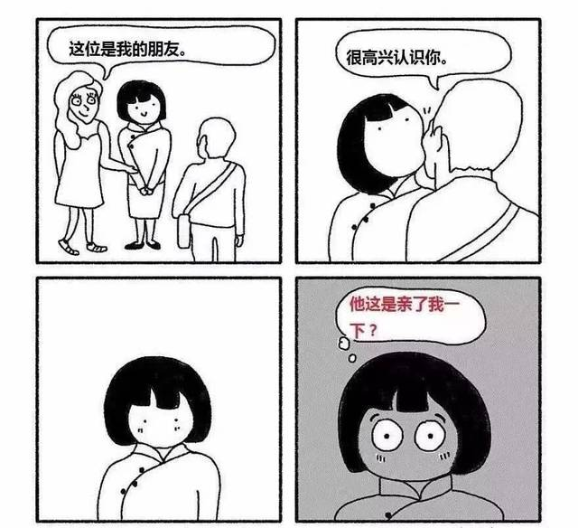
Invitation
China
1.Hey, brother, when you're free, you didn't go to me to sit down
喂，兄弟有空没去我那里坐坐呗
2.Long time no see, go and have a drink
好久不见，走喝点去

Slide 4
Western countries
1.Westerners like AA system
西方人喜欢AA制
2.There is no loud speaker in the restaurant
餐厅不见大声喧哗者
3.Don't overeat
不暴饮暴食 幻灯片 2

Slide 5
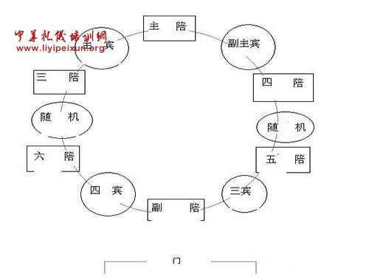
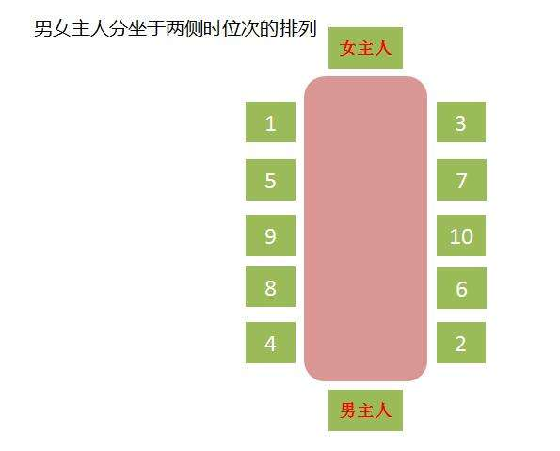
order of seats
China
1.由主人来安排座位
The host will arrange the seats
2.通常是以右为上Usually right - up
3.离门最远的、面对着门的位置是上座，离门最近的、背对着门的位置是下座，The position farthest from the door and facing the door is the upper seat, and the position closest to the door
and facing away from the door is the lower seat
4.上座的右边是第二号位，左边是第三号位，依次类推The right side of the seat is number two, the left side is number three, and so on
5.圆桌Round table

Slide 7
Western countries
1.长桌Long table
2.每个人入座或离座，均应从座椅的左侧进出Everyone should enter or leave the seat from the left side of the seat
3.男女交叉安排Cross arrangement between men and women
幻灯片 2

Slide 8
Tableware use
Chinese people
1.Can't put chopsticks in the rice不能把筷子插在饭里
2.Do not knock on the bowl with chopsticks不可以拿筷子敲碗

Slide 9
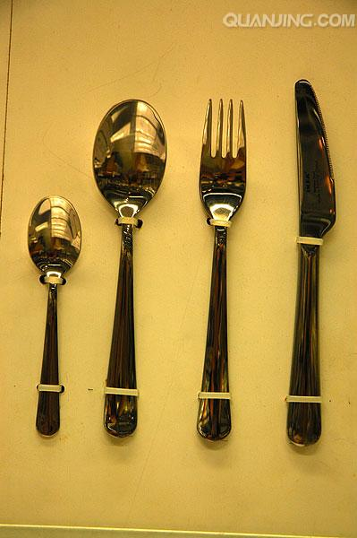
Americans
knife and fork 刀叉
Butter knife: right in front of the left hand黄油餐刀：左手正前方
Dessert knife and fork: put the plate right in front of the table甜品刀叉：横放餐盘正前

Slide 10
tablespoon餐匙
汤匙：餐盘右侧最外端 tbsp: outermost end on right side of dinner plate
甜品匙：甜品刀叉正上方dessert spoon: dessert knife and fork directly above
然而西方也存在差异，例如：However, there are also differences in the West, such as:

Slide 11
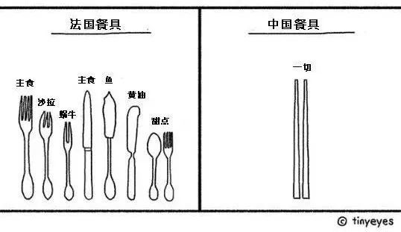
British style: 英国式
American style:美国式
right knife and left fork, cutting while eating
右刀左叉，一边切割，一边叉而食之
Right knife left fork, all cut, then put the knife diagonally in front of the plate, change the fork in the left hand to the right hand, and eat again. It's easier.
美国式：右刀左叉，全部切割好，然后把餐刀斜放在餐盘前方，将左手中的餐叉换到右手，再来食用。比较省事。

Slide 12
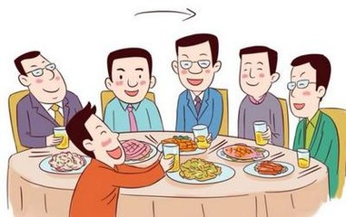
So what are the similarities between Chinese and western dining tables 那么中西方餐桌有什么相同点吗

Slide 13
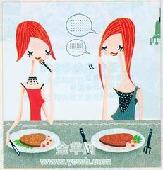
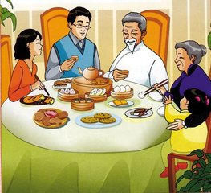
那么中西方餐桌有什么相同点吗
中国人喝汤不能发出声音西方人亦然
Chinese can't make a sound when they drink soup, so can westerners
进餐的速度，宜与男女主人同步，不宜太快，亦不宜太慢。
The speed of eating should be synchronized with that of male and female hosts, not too fast or too slow.

Slide 14
Thank you for watching.
汽配一班7组：苏德伟、宋健宁、类鸿运、洪家乐、王俊军

